Slide 1
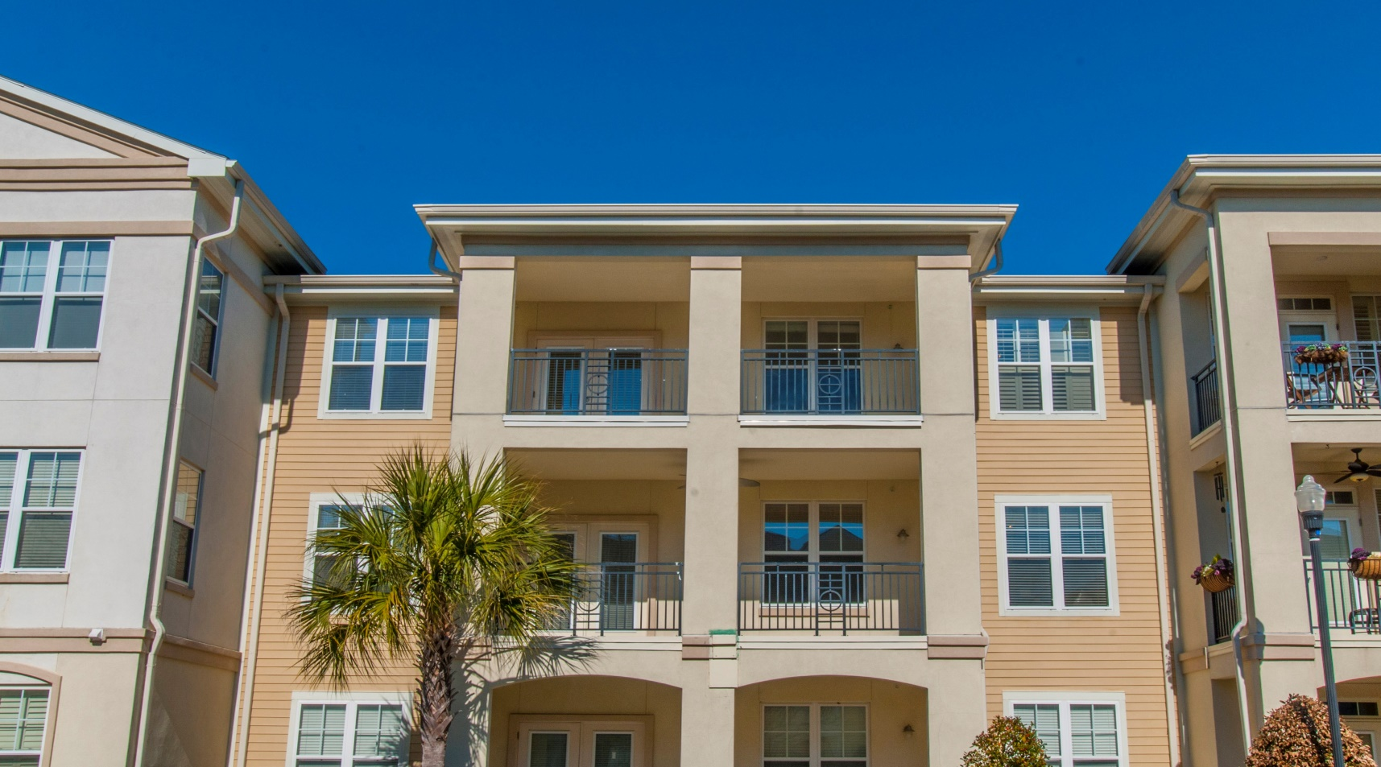
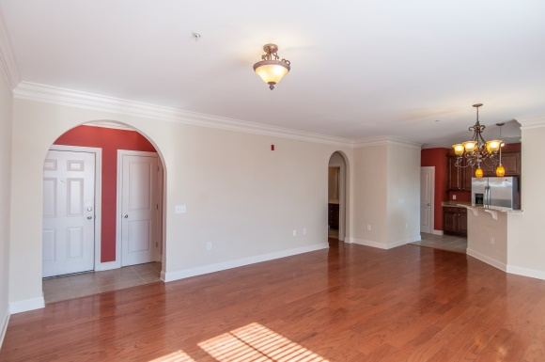
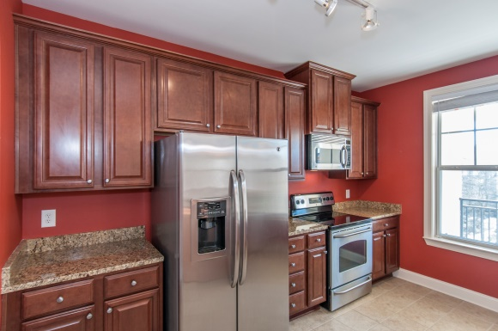
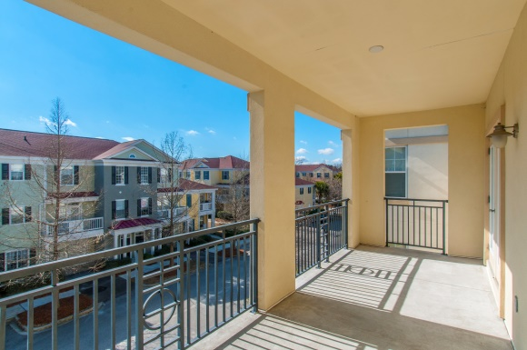

1900 Belle Isle Ave #304
One Belle Hall :: Mount Pleasant :: MLS# 14031781 :: $228,000
Opportunity for CASH Investor Clients!
Just Reduced!
For your CASH Investor Clients Est. Rental Income $1350 per month The perfect purchase for the long term investor Beautiful Condo Move-in-Ready Great location, walking distance to shopping, dining, and grocery store | FEATURES: 2 Spacious Bedrooms & 2 Full Baths Granite Countertops Stainless steel appliances Hardwood Floors Open Floor Plan Extra large Balcony for relaxing or entertaining Washer and Dryer Included
Wendy Arnsdorff
843-364-8619 - M
843-284-1800 – O
wendy.arnsdorff@carolinaone.com
www.wendyarnsdorff.com
Carolina One Real Estate
Mt. Pleasant North Office 2713 N Highway 17
Mt. Pleasant, SC 29466

