Slide 1
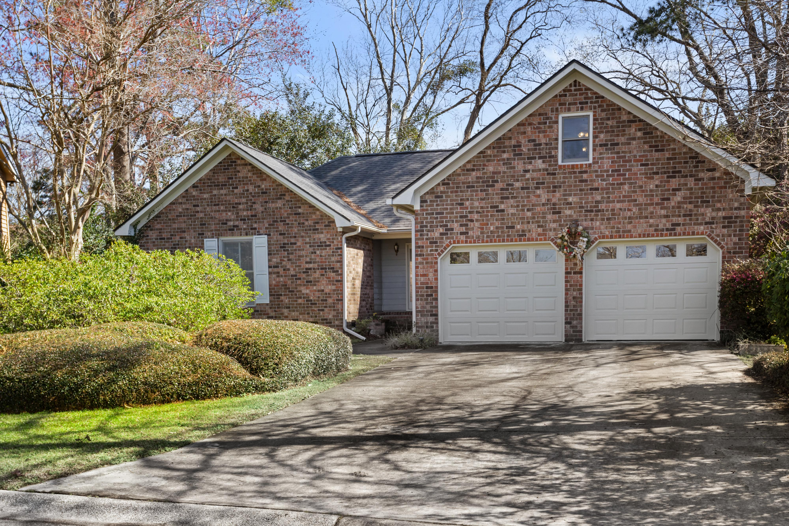
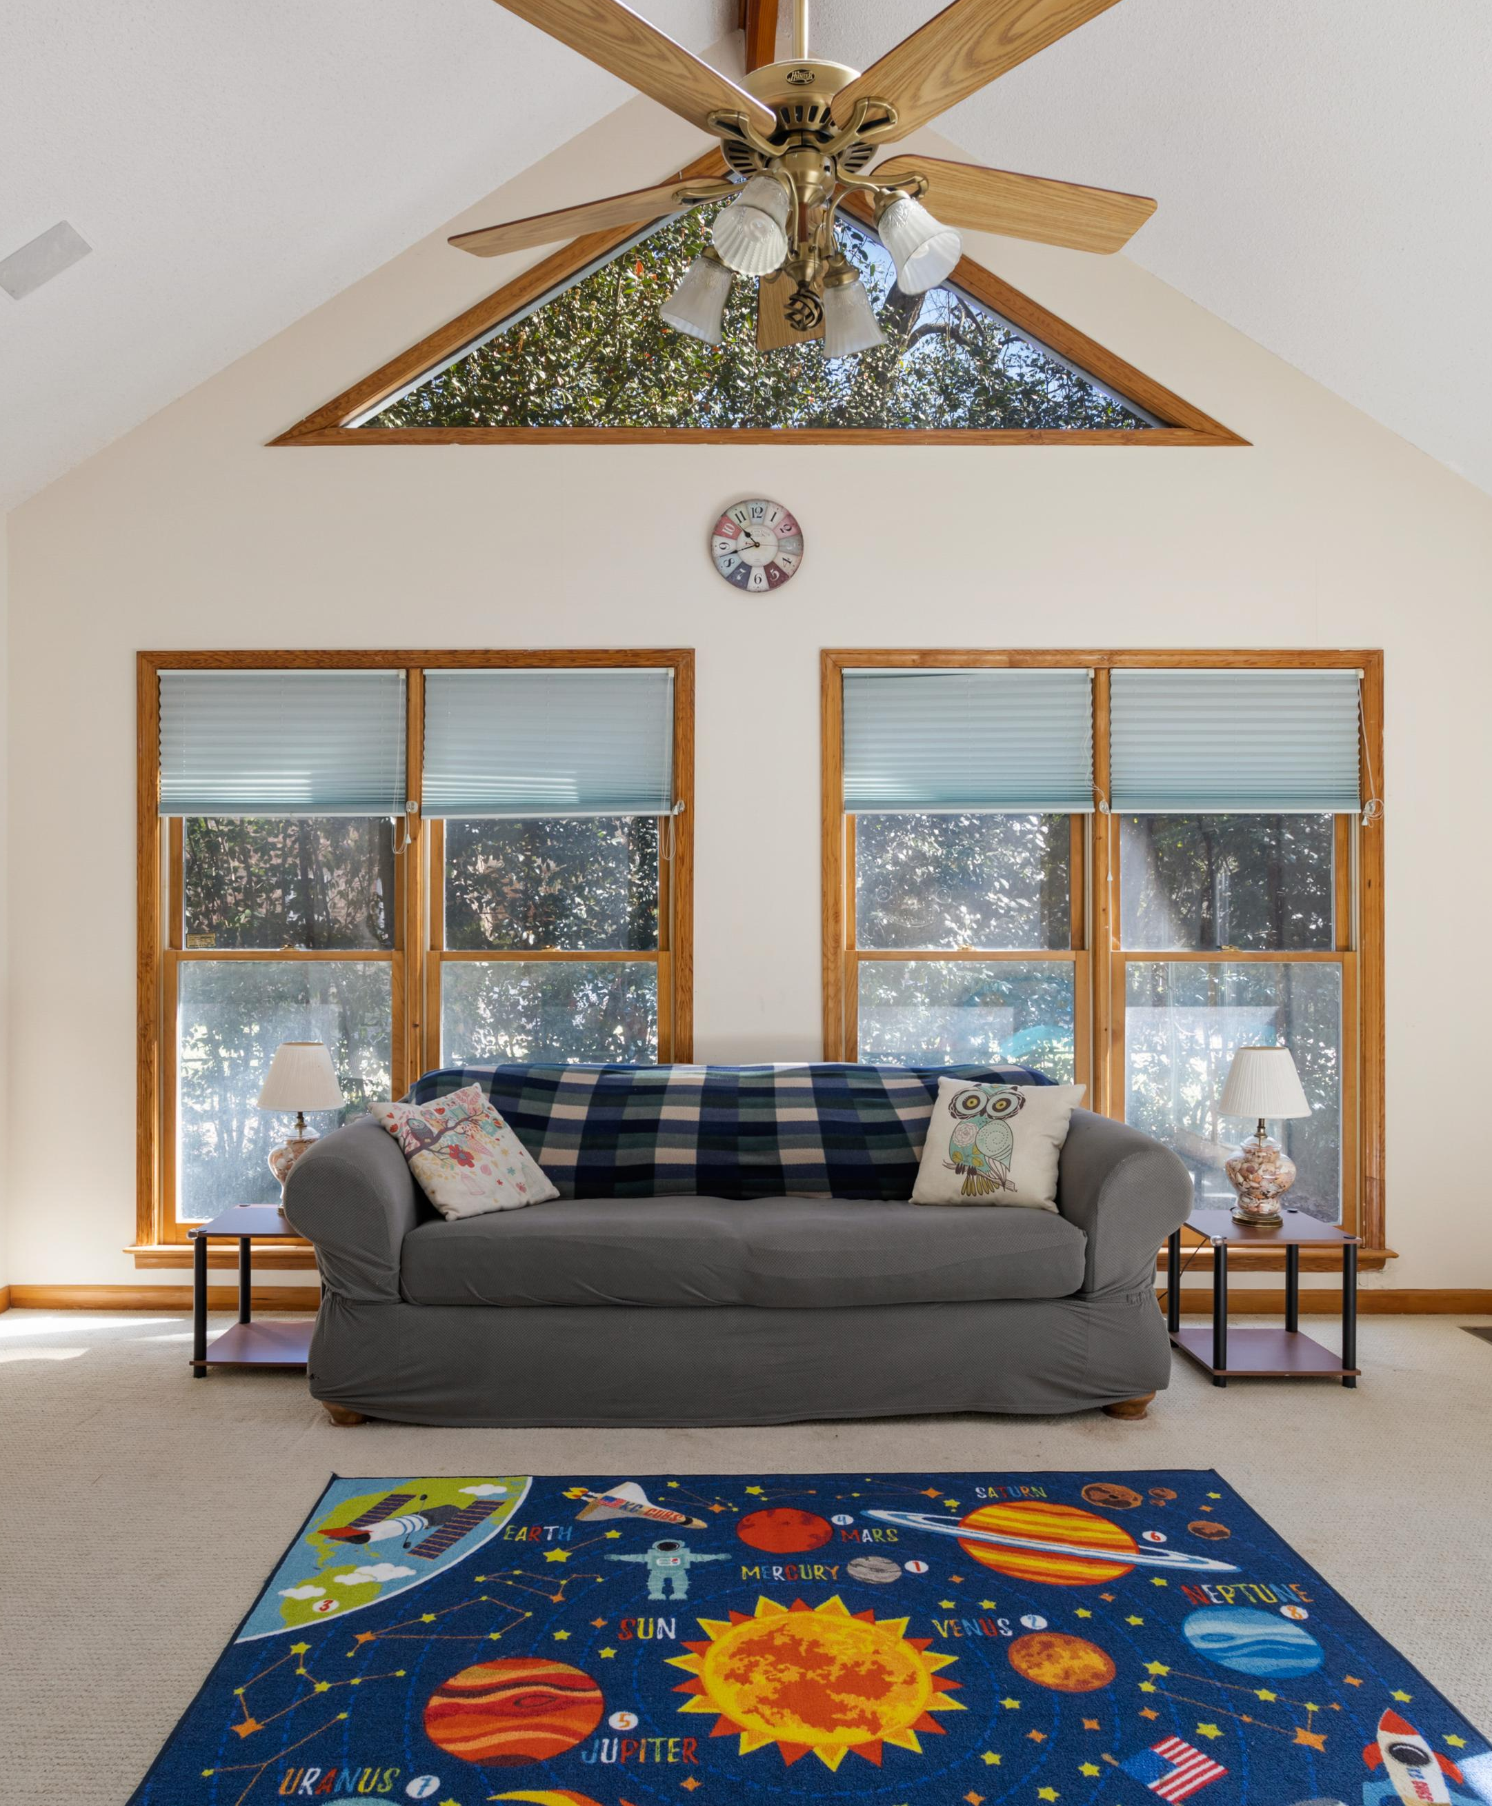
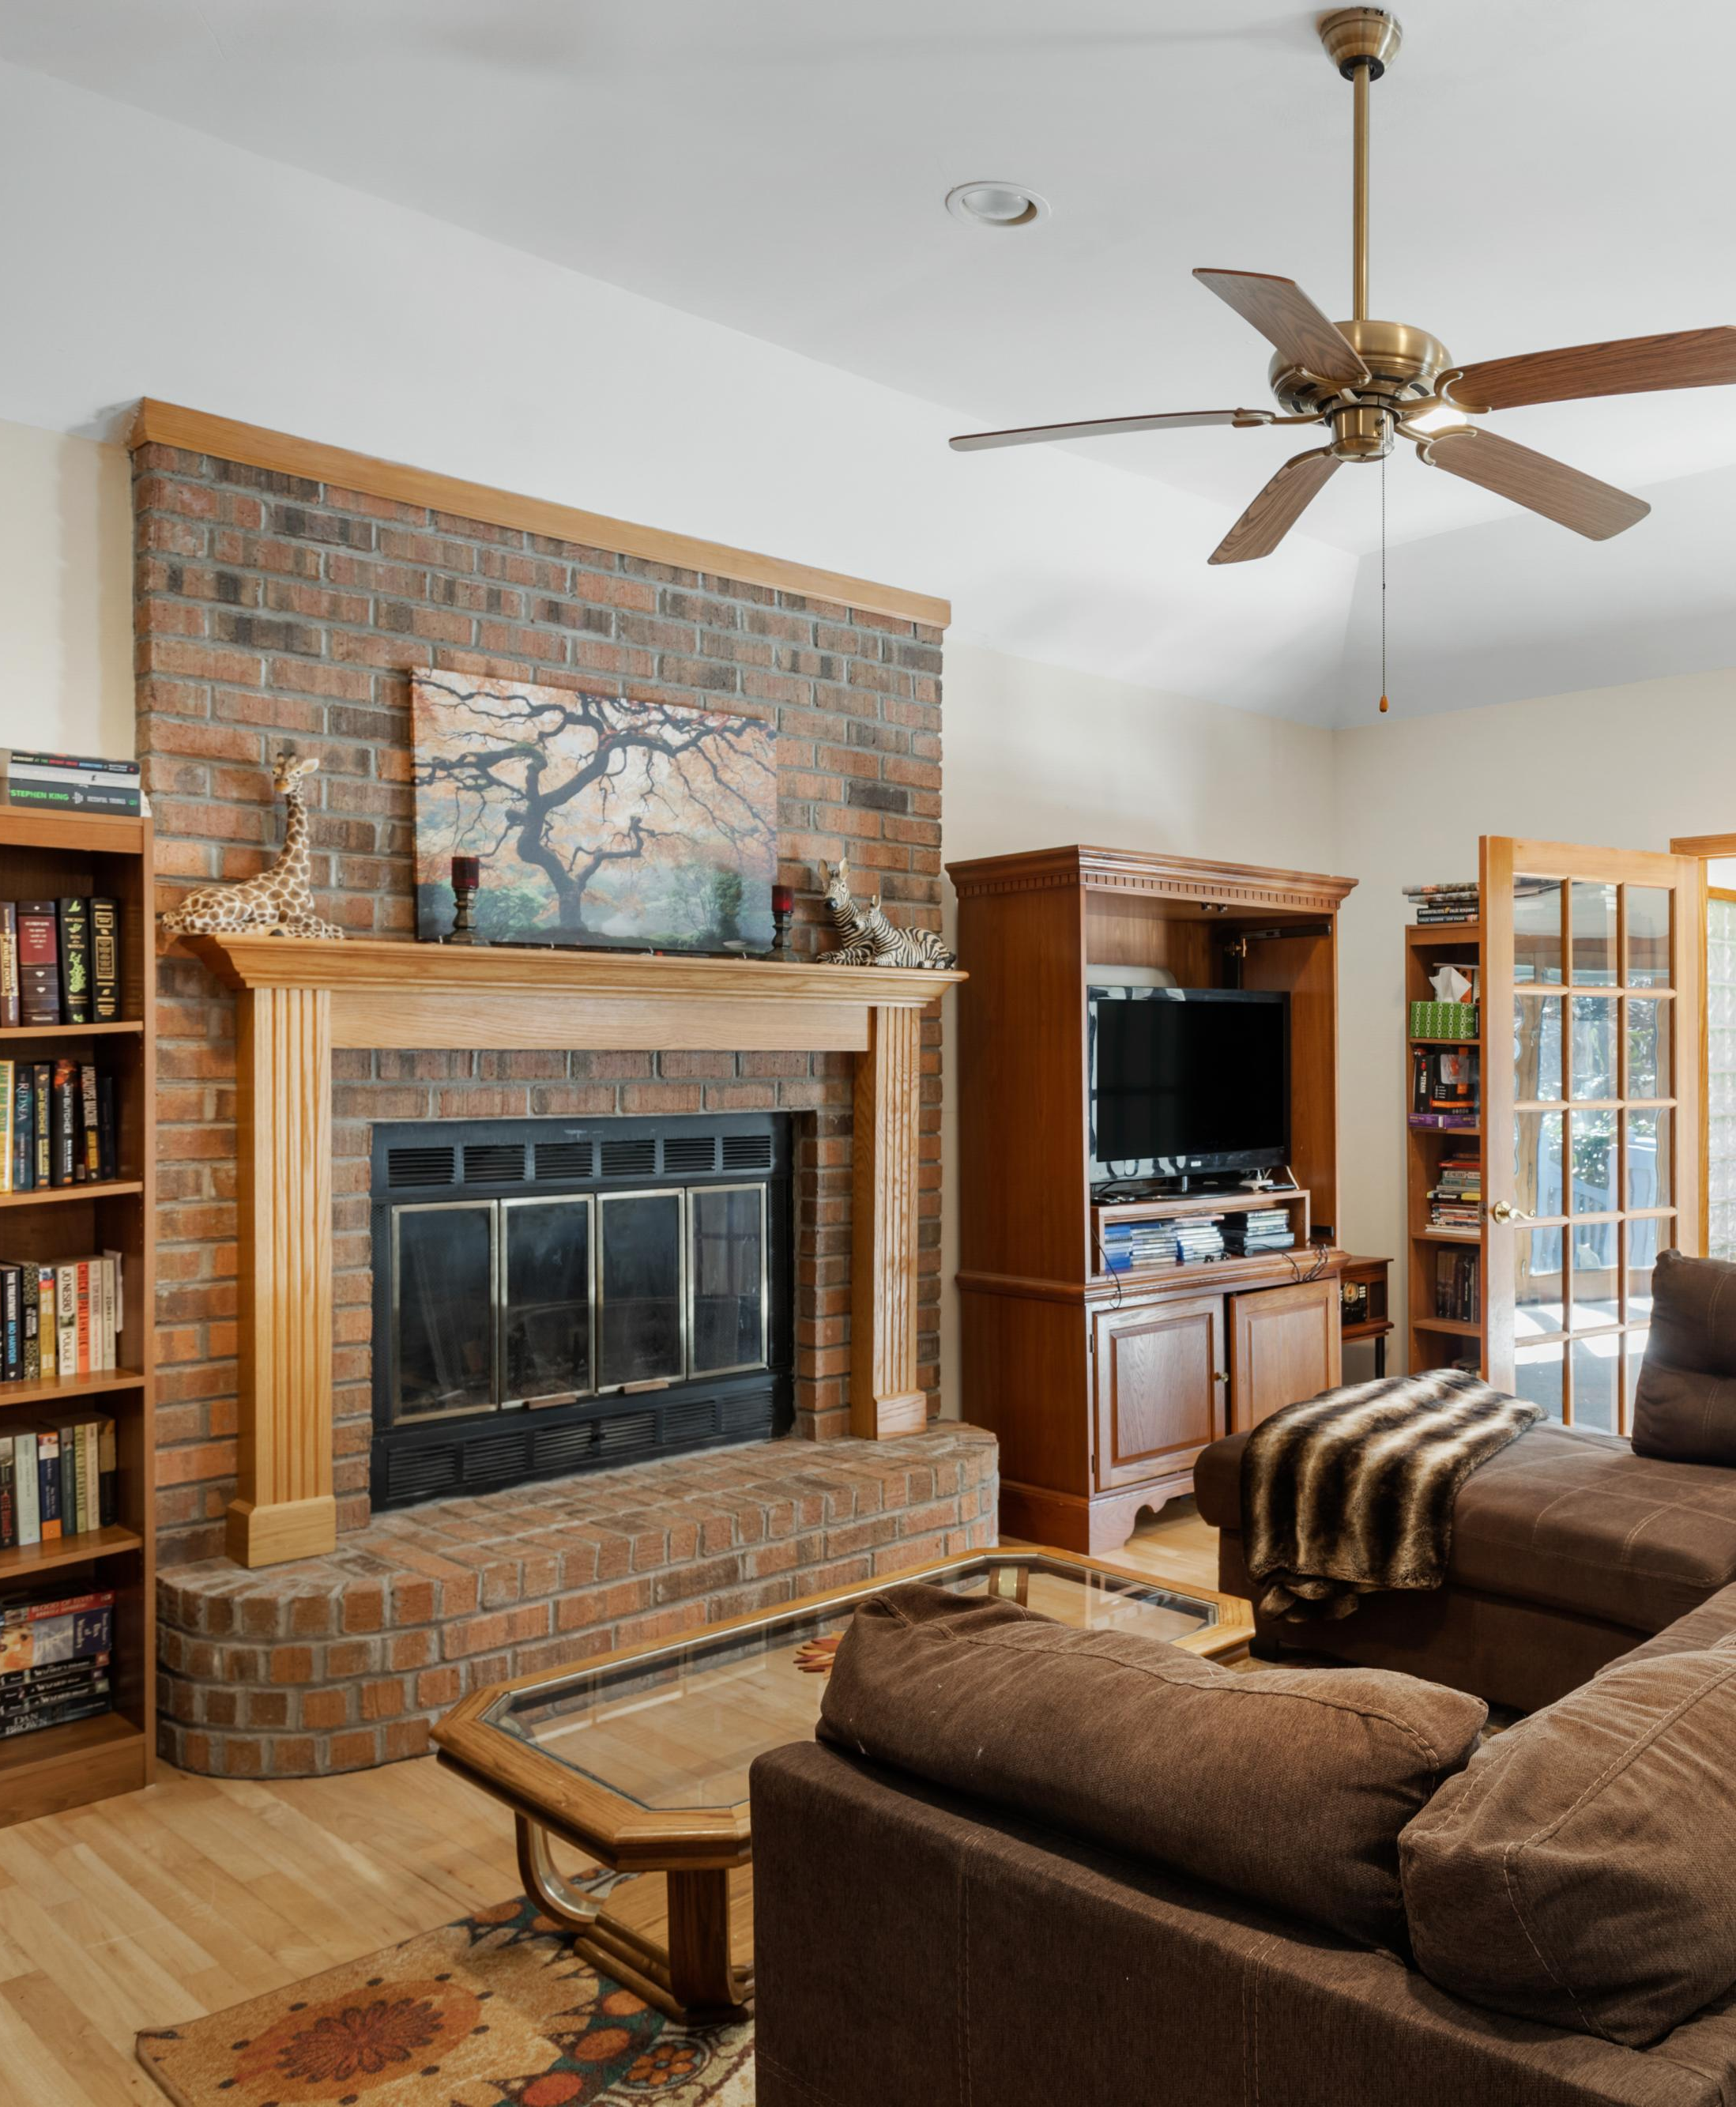

1901 Sandcroft Drive
OPEN HOUSE SAT & SUN MARCH 6-7 FROM 11-3
Rice Hollow
Charleston, SC 29407
$389,000
MLS# 21005842
3 Beds
2 Baths
1,989 SqFt
Location! Location! Location! Brick house! Valuable 1 story house! Hardwoods! Split bedroom plan! Such a livable floor plan with a surprise: the relaxing Sunroom with vaulted ceiling, French doors and multiple windows which allows for abundant natural light to flow into the spacious Family Room which has a real wood burning fireplace and a high ceiling. Another surprise is the large Bonus Room for a quiet home office, exercise room, playroom, media and game room or an all-in-one room! The mature landscaping wraps the house and back yard offering privacy for the deck and play area. With this location, I-26 & I-526 as well as Hwy 61 & Hwy 17 are literally within 5 to 10 minutes of the house making virtually every corner in Charleston/North Charleston within reach in 20-30 minutes. 15 minutes to Downtown, 30 minutes to beaches. Come enjoy this walkable neighborhood within the award-winning school District of Orange Grove Elementary School. Living here is changing your home-life to living on Easy Street!
SEND YOUR CIENTS AND COME BY
TO SEE THIS LOVELY HOME!
Kay Kennerty
REALTORⓇ
843-345-5011
Kay@AgentOwned.com
AgentOwned.com
Notes:
DO NOT ALTER LAYOUT. YOUR FILE WILL BE RETURNED OR EDITED IF IT IS RECEIVED ALTERED.

