Slide 1
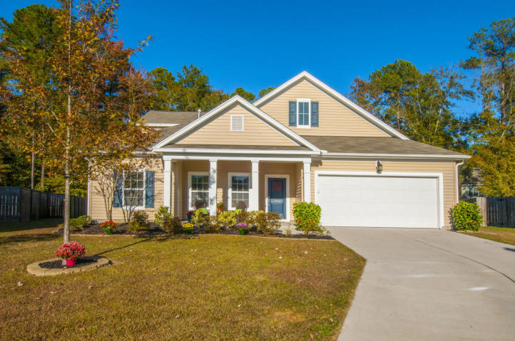
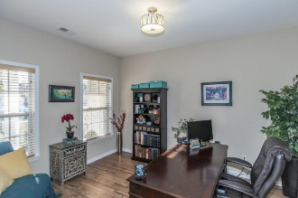
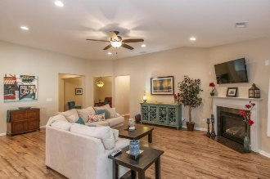
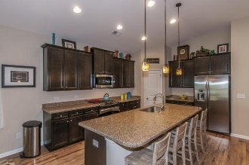
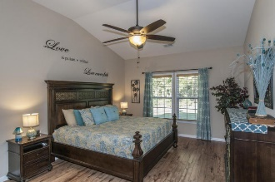
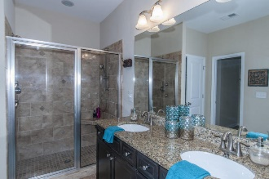
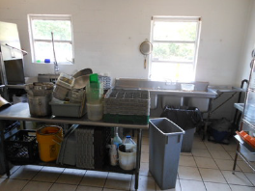
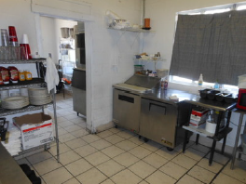
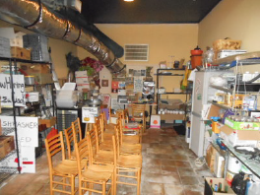
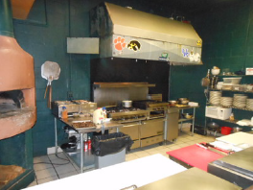
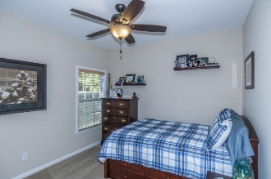
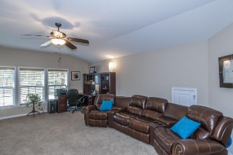
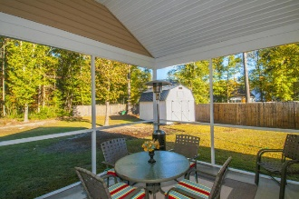
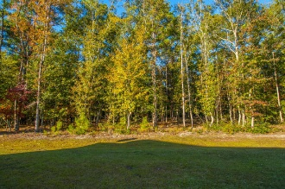
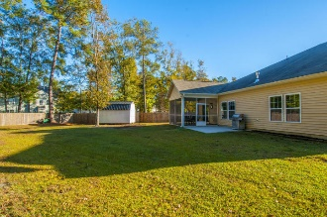
Stunning Home for Sale in Tanner Plantation
1902 Wild Indigo Way
Hanahan, SC 29410 ~ MLS# 17000884 ~ $373,200
$40,000
Price Reduction!
First class all the way!!!
Truly a 10 on a 10 point scale
Stunning one story home loaded with all the bells and whistles. Situated in a cul-de-sac, and backs up to a wooded area. This home boasts 4 full bedrooms, 4 full baths plus a bonus room and an office. Be prepared to fall in love when you walk in the door. Laminate Wood floors in the living area's, custom lighting through out and a seamless floor plan that is made for effortless entertaining. The vaulted ceilings and corner fireplace are just 2 more of the many unique features. Owners suite featuring a deluxe bathroom with a walk in shower and a large closet. The large bonus room features a full bath & walk in closet which could serve as a 5th bedroom. You will love the gourmet kitchen and this one does not disappoint. Big center island w/ a huge sink + natural gas range, lots of cabinet & counter space. Hanahan is known for their school system. Senior center and more. Owner is willing to sell most of the furniture. Washer/Dryer and Fridge are negotiable.
You better hurry…this home may very well have multiple offers
the first weekend it's offered for sale.
Rick Willis
843-327-3017 · Rick@RickWillis.com · The Group, LLC

