Slide 1
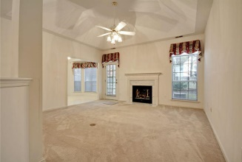
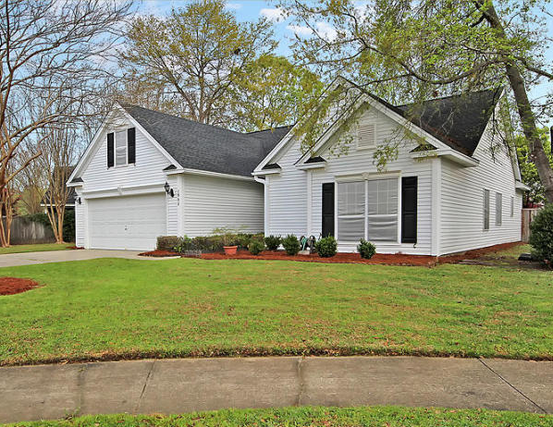
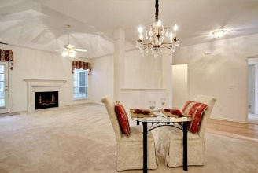
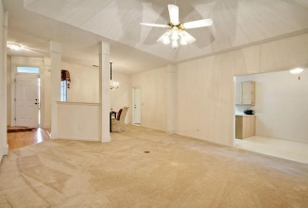
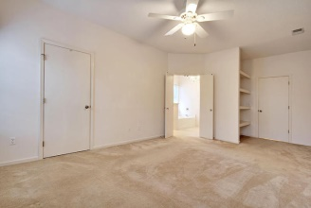
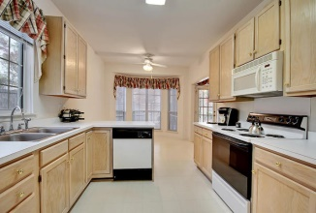
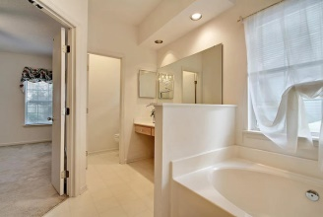
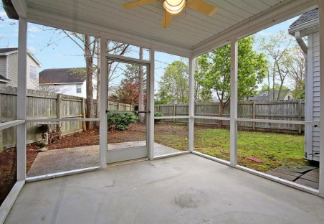
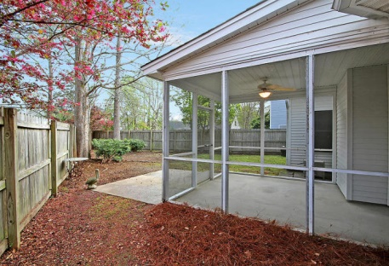
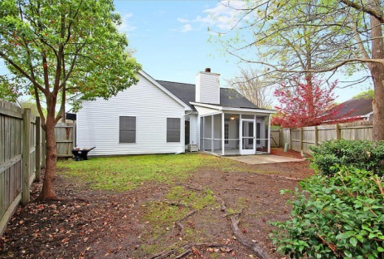

1903 Treebark Drive
Westborough | Charleston, SC 29414
MLS# 15008242 | $221,900
Immaculate home close to everything!
Only one meticulous owner and No smokers or pets have ever been in this house. Originally built as a “Good Sense Home” and has New Architectural Shingle Roof and HVAC system 2011. Care-free living - No Flood Insurance Required! One-story-living with a Spacious Open Concept Living & Dining. Enjoy Vaulted Ceilings and your Marble Gas Fireplace flanked by large windows. Take in Charleston’s beautiful weather on your Screened-in Porch. The manageable, fenced backyard makes maintenance easy! The Master Suite boasts an amazing amount of space and a huge Walk-in Closet. The large master bathroom has both a separate soaking tub and massive walk-in shower. Beautiful Custom Curtains convey with property. You have an Extra Large 2 Car Garage with Opener. Extremely low HOA Fees of $138 per year with the Option to join the Forrest Lakes Pool & Tennis Club. 2 Minutes to Great Shopping & some of Charleston's best Medical Facilities, 5 Minutes to West Ashley Park, 7 Min to I-526, 13 Minutes to Boeing, 13 Minutes to the Airport, 20 Minutes to Downtown Charleston, & 27 Minutes to the Beach! Fantastic Neighborhood with lots going on: Halloween Parade, Neighborhood cookouts and more!
Call or email for details: (843) 214-8451 or Robin@ThePhillipsRealtyGroup.com

