Slide 1
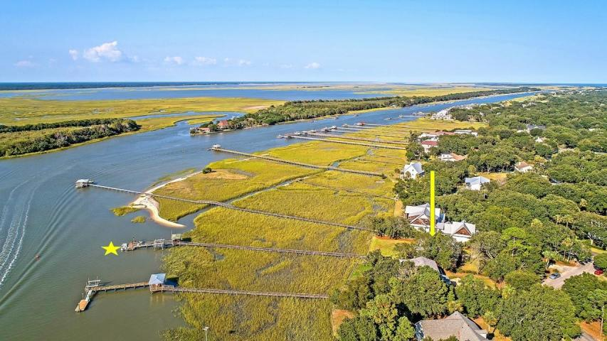
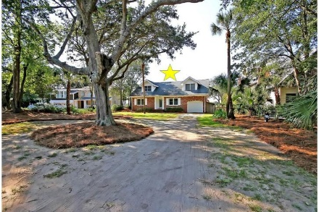
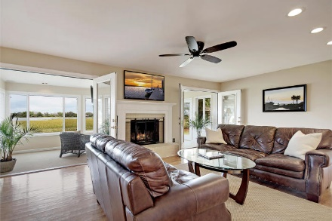
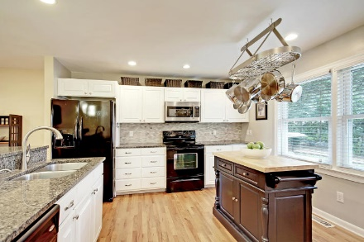
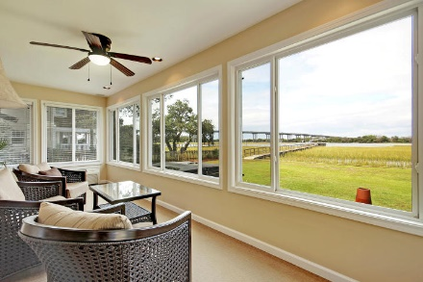
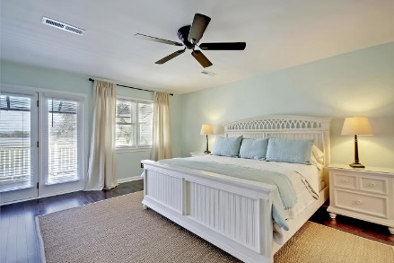
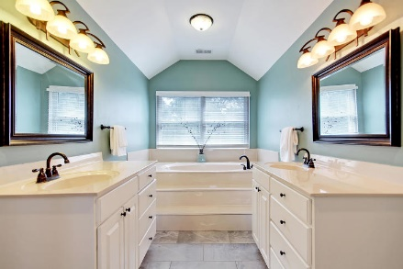
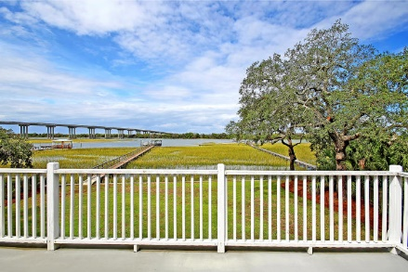
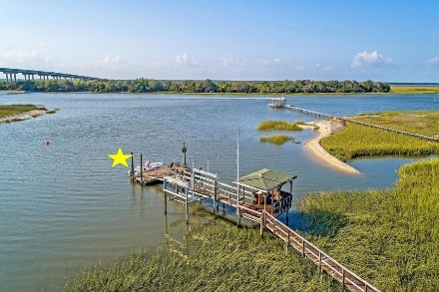
Updated Intracoastal Home
Price Reduced!
1903 Waterway Boulevard Isle of Palms, SC 29451 ~ MLS# 19001064 ~ $1,999,999
Location is tricky because you're always looking for privacy but yet its still nice to be close to everything. That perfect combination is exactly what you get with this rare half acre, waterfront home on the Isle of Palms. With a dock, boat and gazebo right on the water, you get to enjoy breathtaking sunsets every night and have direct boat access to the water right from your backyard. Cars are nice, but here all you need is your golf cart to go two blocks to the beach and an even shorter distance to Harris Teeter, shopping and dining. A Florida room with a balcony on top really allow you to take full advantage of the home's million dollar view. Major renovations throughout make this a comfortable place to begin your island lifestyle living!
Book your showing today!
Additional features include:
Separate mudroom access
Large lot with beautiful oaks in the front yard and a waterfront retainer
Great neighborhood off the main roadways so very little through traffic
Private neighborhood boat launch
Tyler Hawkins tyler@mattoneillteam.com (843) 908-2734

