Slide 1
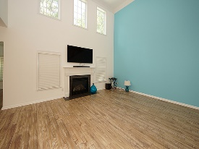
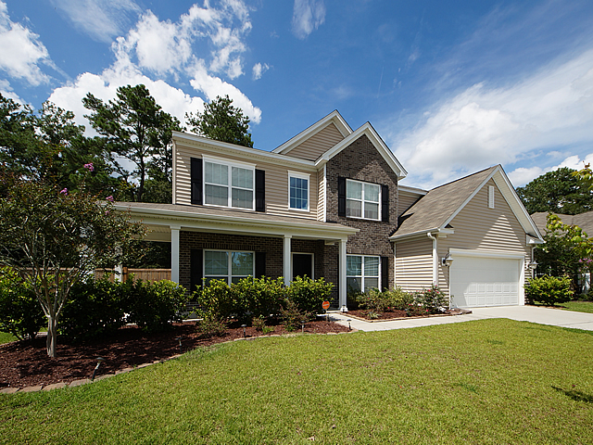
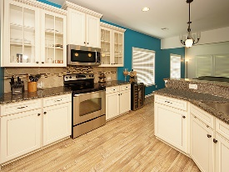
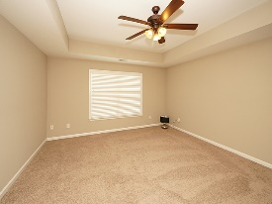
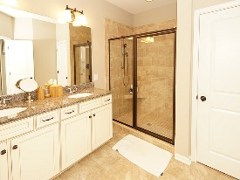
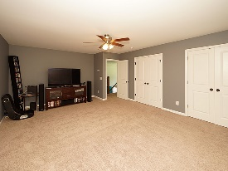
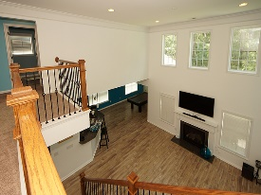
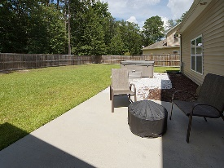


Open House Sunday Starting at 10am!! Impressive home loaded with upgrades!
1904 Wild Indigo Way
Tanner Plantation
Hanahan, SC 29410
Open House Canceled!
Under Contract In 3 Days!
MLS# 17019857 | $368,500
5 Bed / 2½ Bath
Two story foyer has grand formal dining room with trey ceiling and an office with glass french doors. The kitchen is a chefs delight with stainless steel appliances and beautiful upgraded cabinets & granite counter tops w/under mount sink & deluxe faucet. It is open to the two story, bright and sunny family room. Wrought iron railings up the staircase add elegance and a custom look. First floor master bedroom with the luxury bathroom package to include his/her sinks and a luxurious shower. Professional paint, upgraded flooring & lighting, chic design and a Jacuzzi hot tub make this an exceptional home!
Connie White, Broker
C: 843-532-3356
conniesyouragent@gmail.com
Charleston Homes
597 Old Mt. Holly Road
Suite 301
Goose Creek, SC 29445

