Slide 1
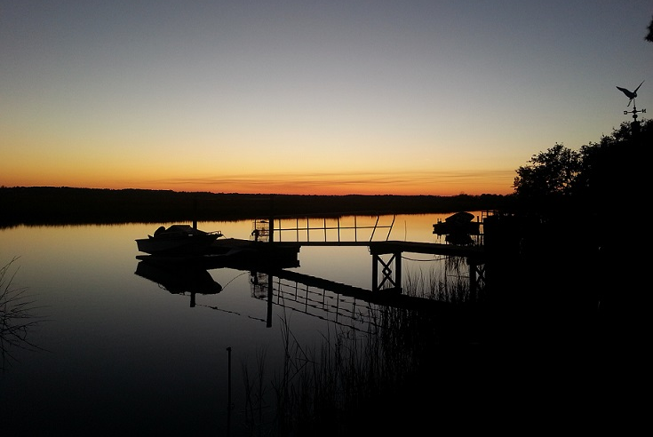
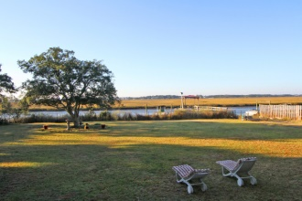
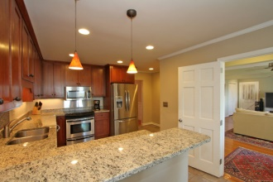
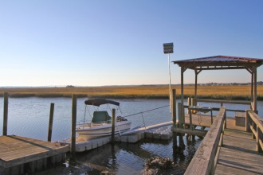
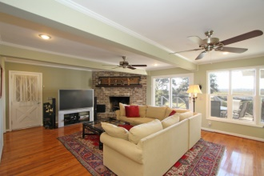
1905 Capri Dr - Capri Isle - Charleston - MLS# 14030034 - $730,000
Incredible Sunset views of the Stono River
Dock with private boat ramp
4 Bedrooms/3½ Baths
Separate apartment or In-law suite
3-car garage
Newly renovated
Luxury Lowcountry Living!
For more details, please contact
Kimberly S. Ritter, ABR, CRS
843.693.8802 | kritter@carolinaone.com
Carolina One Real Estate | 628 Long Point Rd | Mt Pleasant, SC 29464-3032

