Slide 1

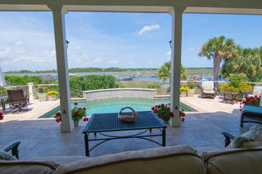
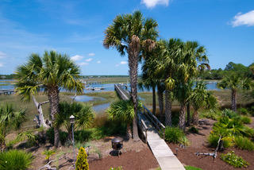
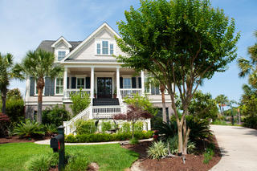
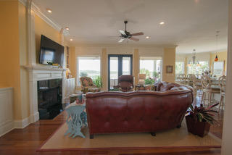
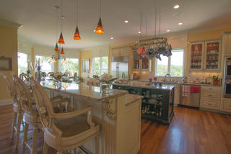
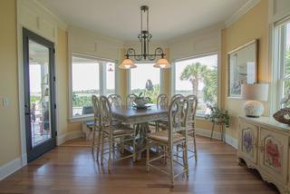
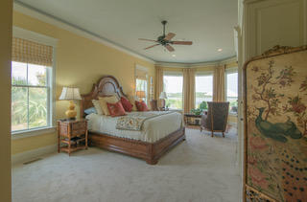
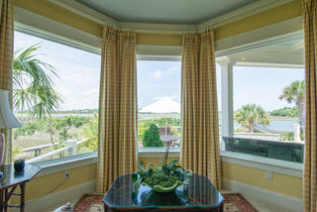
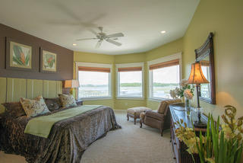
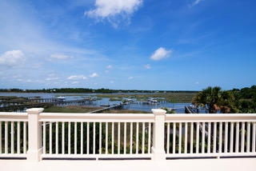
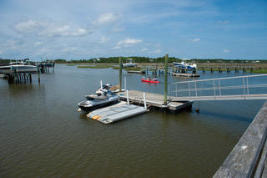
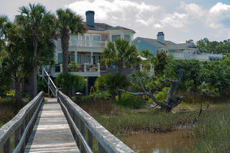
Panoramic Views Of The Wando River!
If You're Looking For Luxury, Privacy And Comfort… This Home Has It All!
Leah Biller
(843) 224-9294
leah.biller@exprealty.com
www. exprealty.com
1905 E Canning Dr | Park West | Mt Pleasant | MLS# 19015433 | $1,575,000
This beautiful custom built home in Masonborough (Park West) is located on a cul-de-sac with a private dock on Darrell Creek and quick access to the Wando River. This house offers the ultimate in luxury living! Expansive outdoor living space offers a large veranda overlooking the raised gunite pool built into the back deck. The kitchen, family room and eating area are all open and the perfect layout for entertaining. Viking Range, Sub Zero Fridge, and ,Wolf double ovens, and an ice maker. The kitchen has massive walk-in pantry with secondary refrigerator. Mudroom off the garage. The cooktop has been converted from gas to electric, but can easily be converted back to gas if preferred. Gleaming hardwood floors extend throughout the first floor. With five spacious bedrooms, this home offers plenty of space for large families. The yard is meticulously manicured with blooming flowers around every corner. No expense was spared in creating this private oasis!
EXP Realty LLC · 110 Traders Cross · Ste 212 · Bluffton, SC 29909

