Slide 1
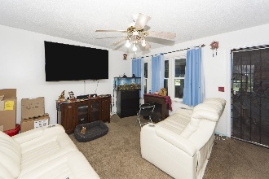
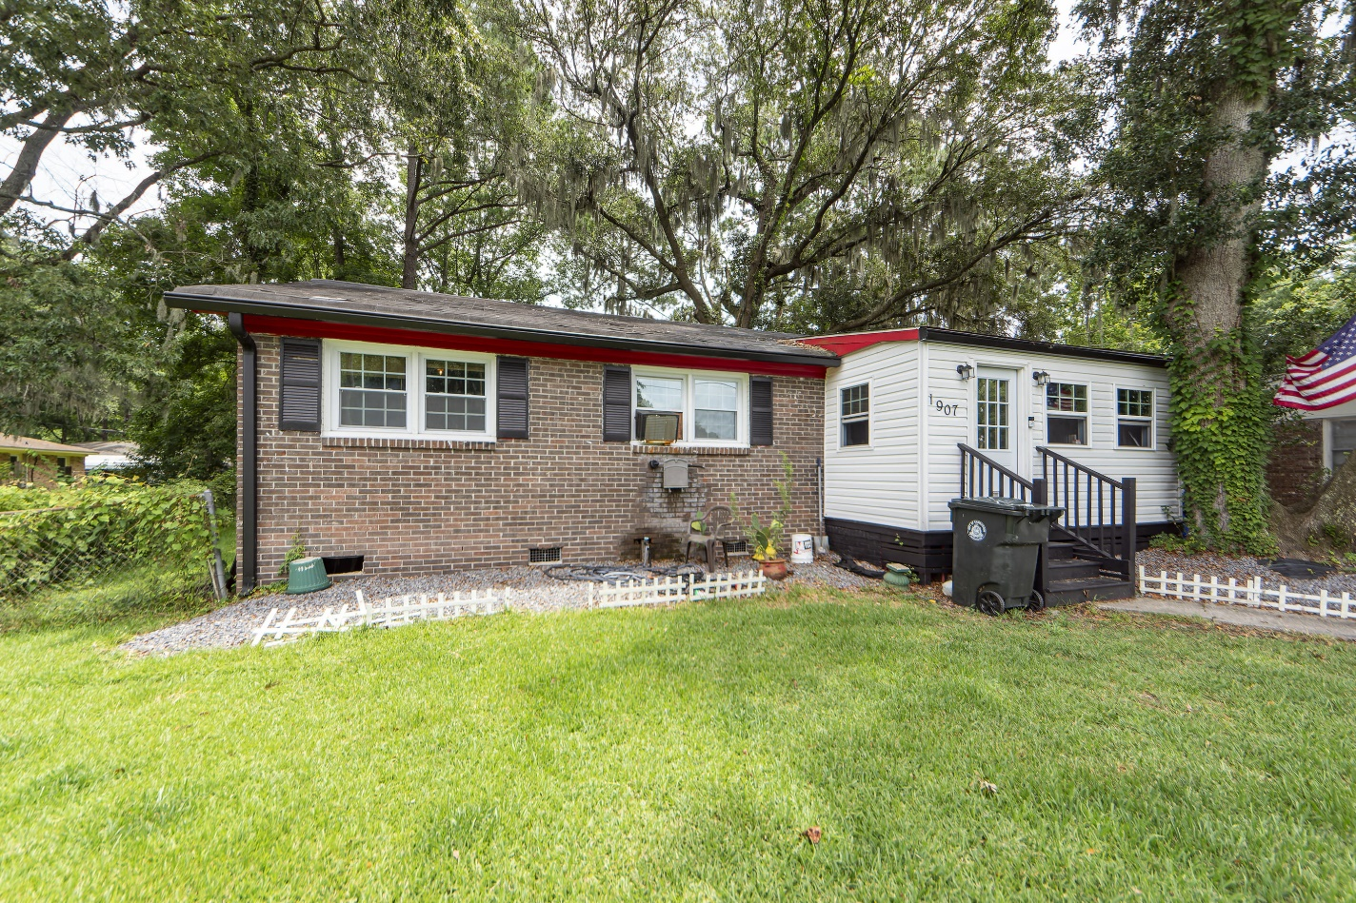
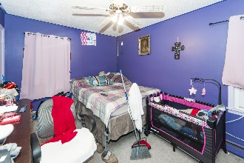
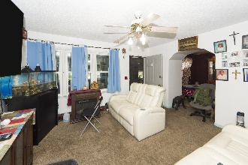
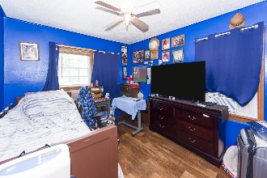
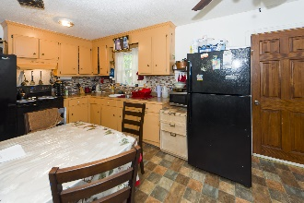
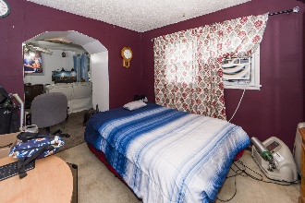
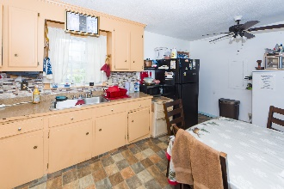
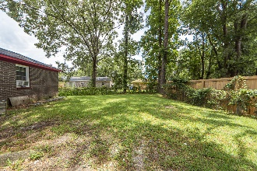
3% Commission And $3000 Bonus
1907 Hazelwood Drive
Orleans Woods | Charleston, SC 29407 | MLS# 24019428 | $315,000
2 BEDS, 1.5 BATHS ∙ 1100 SQ. FT
3% COMMISSION AND $3000 BONUS IF RATIFIED BY THE END OF AUGUST!
Well maintained home at an exceptional value!! NO HOA, NO HOA FEES! Park your boat, work trailer, camper...etc at your own home. Spacious house with easy 3rd room conversion to add value!! Amazing private yard with grand Oak trees and plenty of shade. Walk to Citadel Mall, the movies, sporting goods stores, and tons of restaurants! MUSC West Ashley location just a short walk away. Close to downtown Charleston as well. Large open kitchen perfect for those who love to cook. This opportunity won't stick around long at this price point.
Take a virtual tour!
Johnny Crosby
843-270-9407
jcrosby@charlestonhomeproviders.com
Brand Name Real Estate | 4 Carriage Lane, Suite 106 | Charleston, SC 29407

