Slide 1
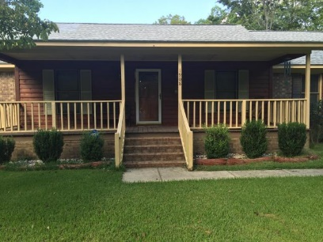
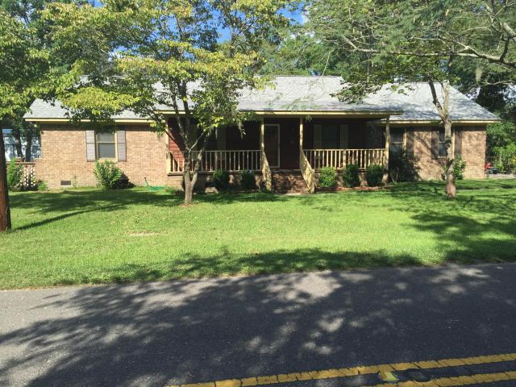
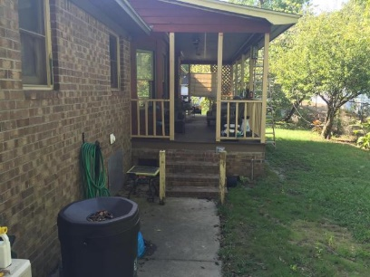
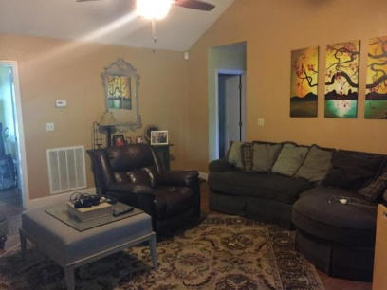
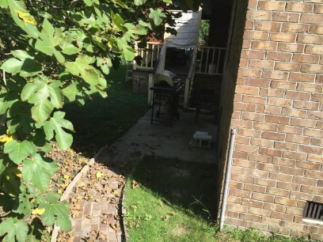
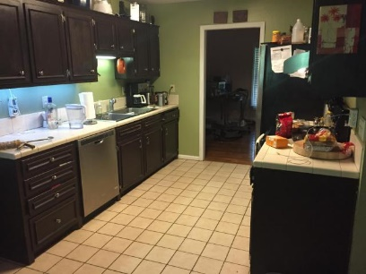
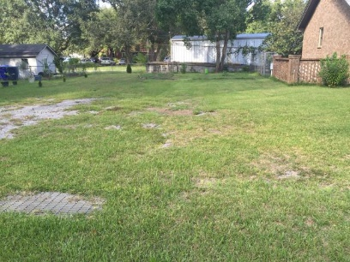
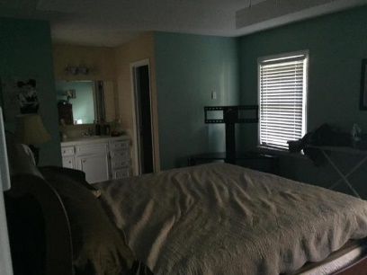
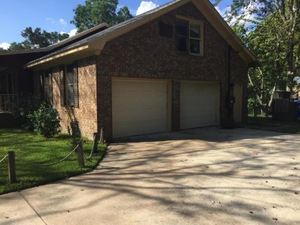
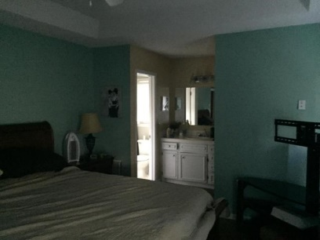
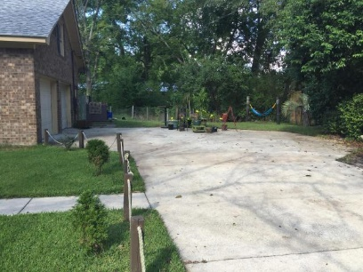


1908 Dulsey Road Tiger Swamp ~ Charleston MLS# 16025471 ~ $279,000
Reduction in Price
Great home in very desired neighborhood, close to everything. Right next door to Stono Elementary School, kids walk to school. Home has been updated and repaired a lot since purchase. There is still work in progress being done. Hardwood floors throughout and a new roof just installed. New front porch deck boards have been added. Great private back yard with screened porch. More info to follow. Home is being SOLD AS Is…Motivated Seller. You have to look at this Home its a real deal, close to I526, downtown Charleston, a lot of homes in this area are being renovated. ANY REASONABLE OFF WILL BE CONSIDERED.
John H. Beckroge
ABR, EPRO, REALTOR
jbeckroge@gmail.com
O - (843) 884-7300 | M - (843) 367-3196
The Boulevard Company, LLC | 35 Broad Street | Charleston, SC 29401

