Slide 1
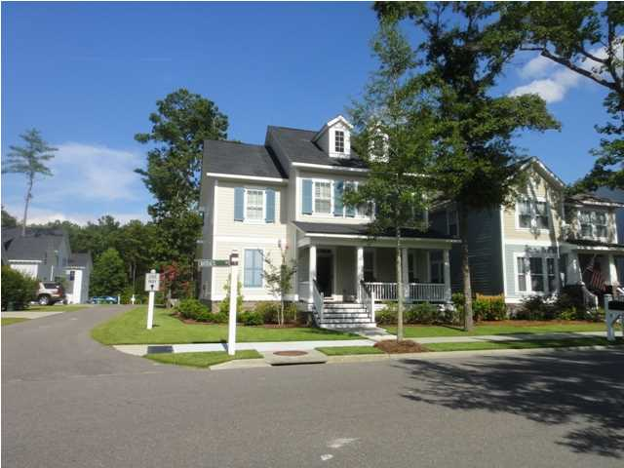
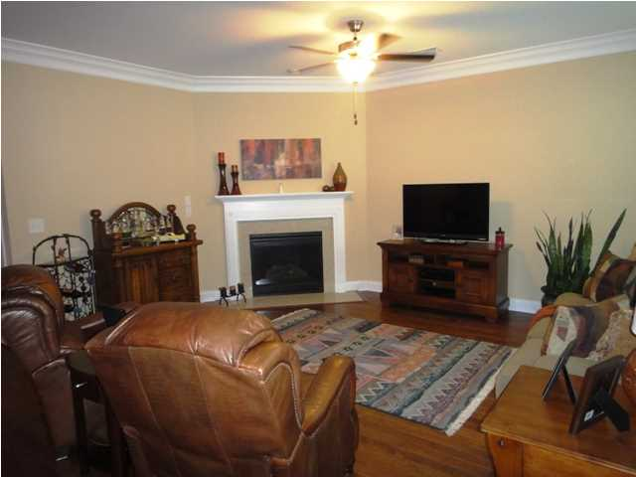
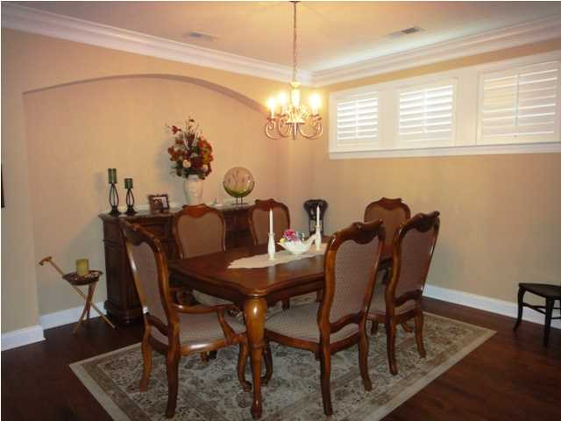
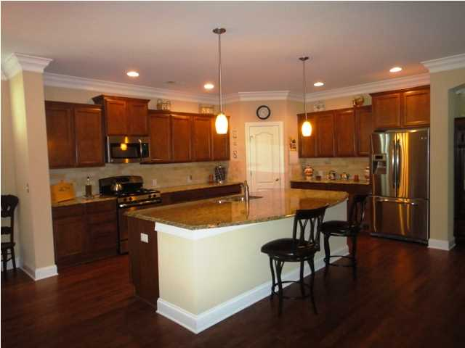
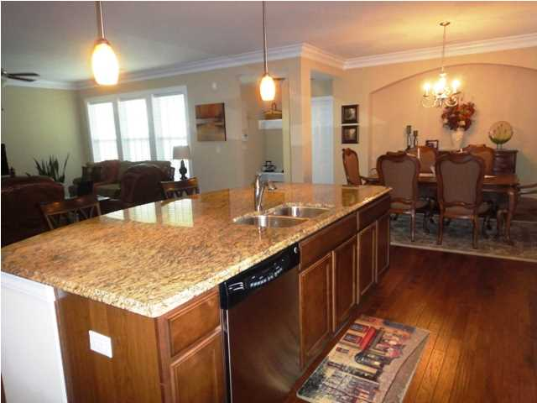
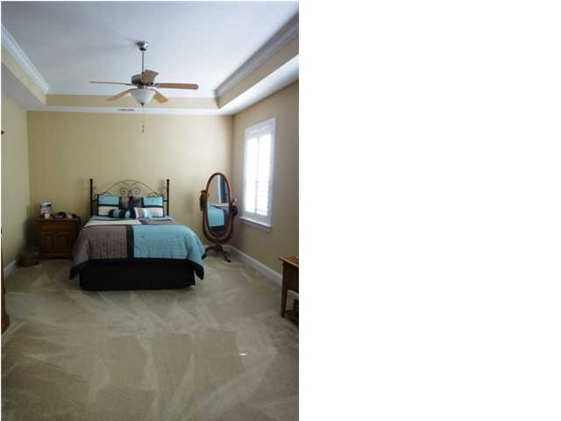
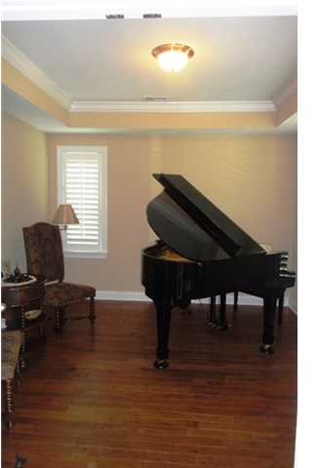
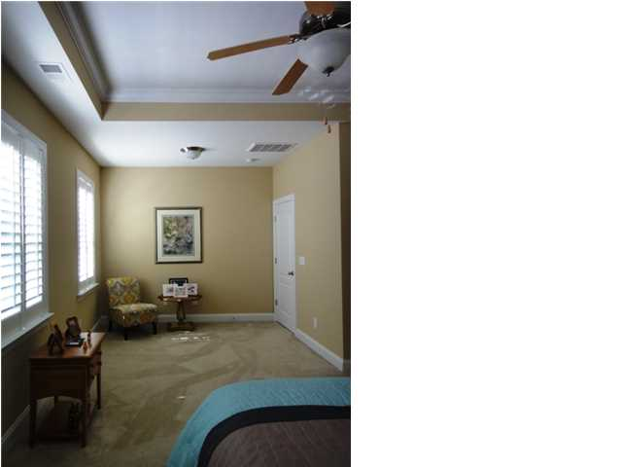
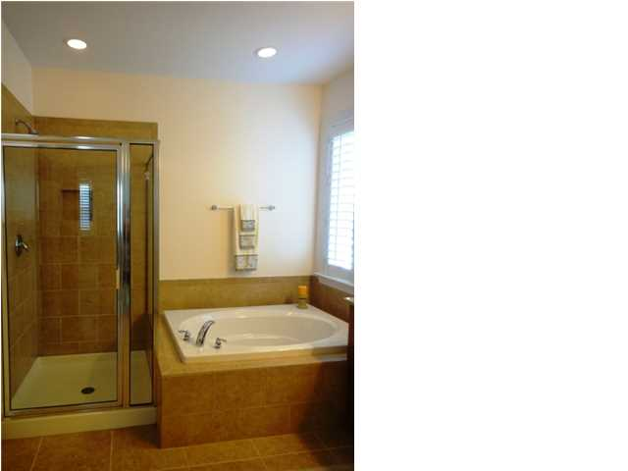
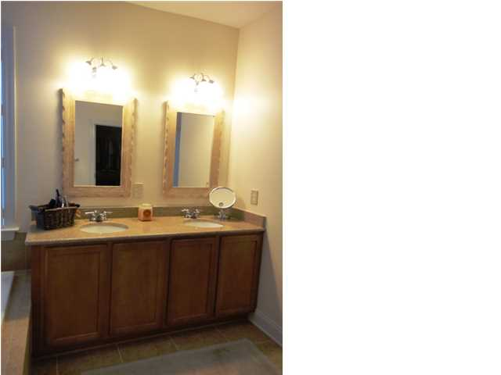
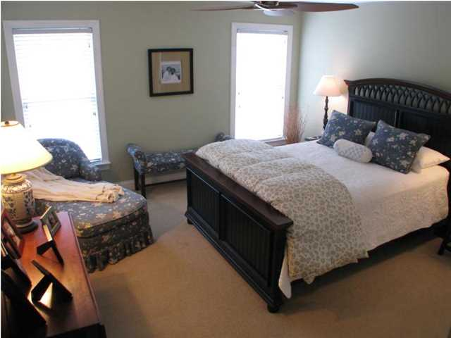
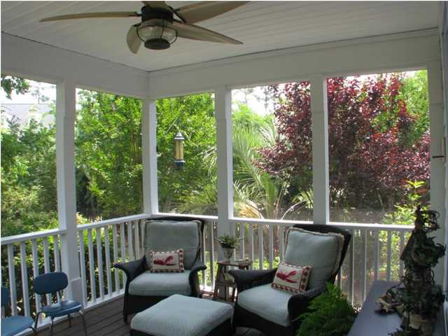
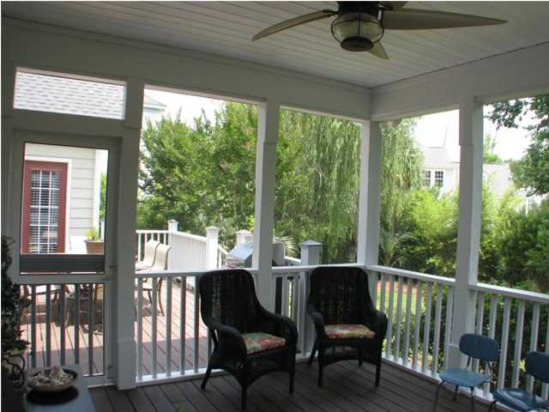
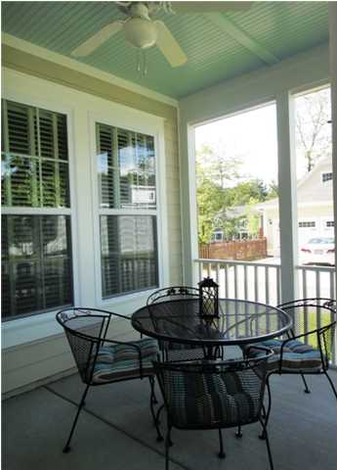
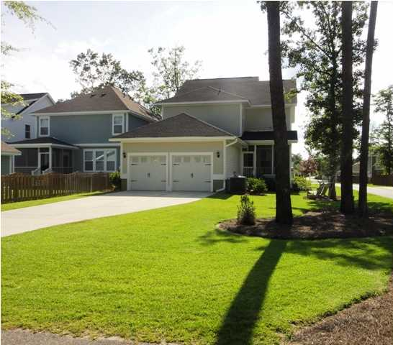
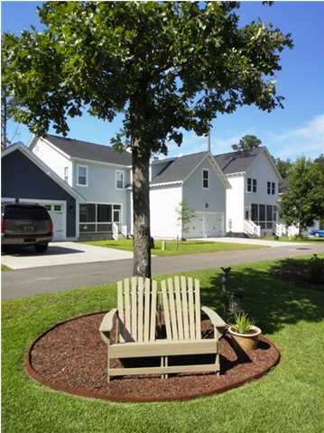


190 Bateaux Dr The Ponds Summerville MLS# 1417378 $323,999 3 Bedrooms | 2½ Baths
PRICE REDUCED and MOVE IN READY!!! Welcome to The Ponds. A Beautiful Master Planned Community sitting on a 1,100 acre preserve. This lovely David Weekly home is the Gunderson plan featuring an Open Floor plan, Amazing kitchen with abundant cabinet space, large granite island, upgraded tile back splash in the kitchen, Stainless Steel appliances, wood floors throughout the main level, study /office, family room with a fireplace, Plantation Shutters and Crown Molding. Upstairs you will find a great loft area, space for movies, kids and entertainment. You will also find your owners retreat with a sitting area. The Master Bath has an oversized closet, separate tub and shower and dual sinks. This home also features 2 additional bedrooms and an oversized laundry room. You will enjoy your Summer evenings relaxing in your screen porch. This property also has an in-ground sprinkler system. Corner lot and room for the kids to play in the back yard. Right around the corner is the farmhouse amenity center with the pool, picnic pavilion, amphitheater, open lots for the kids and dogs to play and miles and miles of walking trails through the LIVE OAKS. This development also hosts the YMCA. There is something for everyone.
No need to wait on new construction, this home is READY and WAITING ON YOU to come home.
$1,000 Agent Summer Bonus
Becky Eakle
ABR, CPDE, LMC, MRP, SFR (843) 475-4149 M
becky.eakle@cbunited.com

