Slide 1
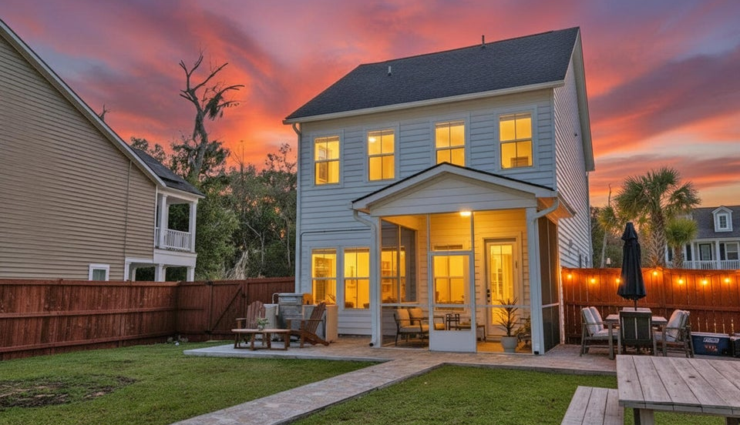

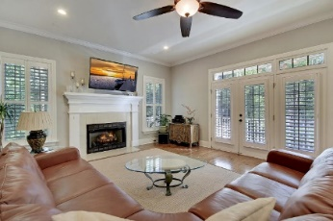
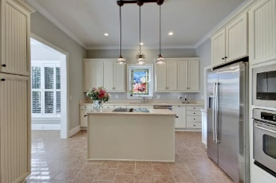
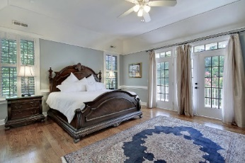
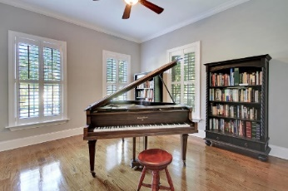
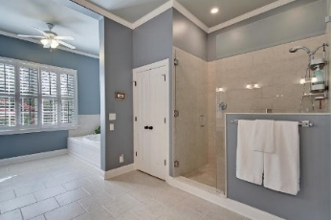
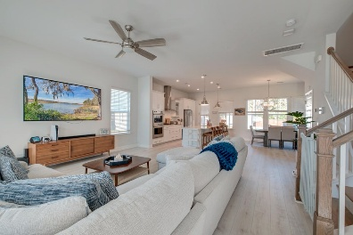
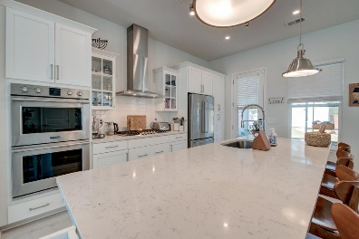
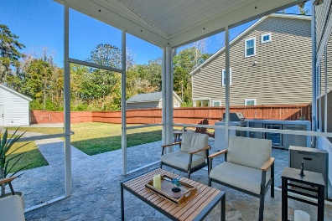
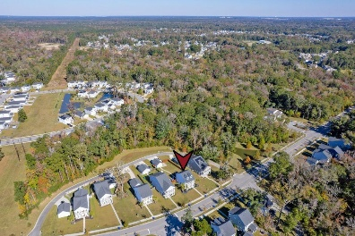
Price Reduced!
Have You Seen This One?
Happy Hour Broker Open House Friday, Nov 22 from 3-5
$100 Gift Card Giveaway
190 Barons Drive
Grand Bees | Charleston, SC 29414 | MLS# 25030469 | $519,000
Beautiful Charleston single style home on a spacious lot with double front porches and the groomed, landscaped yard. This move-in ready home is a must-see!
Ground Floor
Bright, open floor plan enhanced by luxury vinyl plank flooring, tall ceilings, and abundant natural light.
Well-appointed kitchen with white shaker cabinetry, stainless steel appliances including a double oven and gas cooktop with range hood, gleaming countertops, a large island with seating, and a pantry with wooden shelving, opens to the dining area with views of the fenced backyard beyond
Screened porch offers a peaceful place to enjoy the outdoors
Newly poured concrete pad perfect for grilling and entertaining
Detached garage, which features insulated walls, an epoxy-coated floor, and additional storage
Upstairs
Lovely primary bedroom offers private access to the second-floor porch, a custom walk-in closet, and a luxurious ensuite bath with dual vanities, a freestanding tub, and a frameless step-in shower.
Two additional bedrooms + full bathroom
Extensive custom organization and storage throughout
Grand Bees
Community offers a swimming pool & less than one mile from bees landing recreation center
1.4 miles from the shopping and dining options at West Ashley Circle
4.3 miles from bon secours St. Francis hospital and I-526
10 miles from downtown Charleston
10.5 miles from Charleston International Airport.
Listing agent is owner
*Ask about the possibility of receiving reduction in interest rate and free refi.*
Shira Zano shira@mattoneillteam.com 843-402-8826

