Slide 1
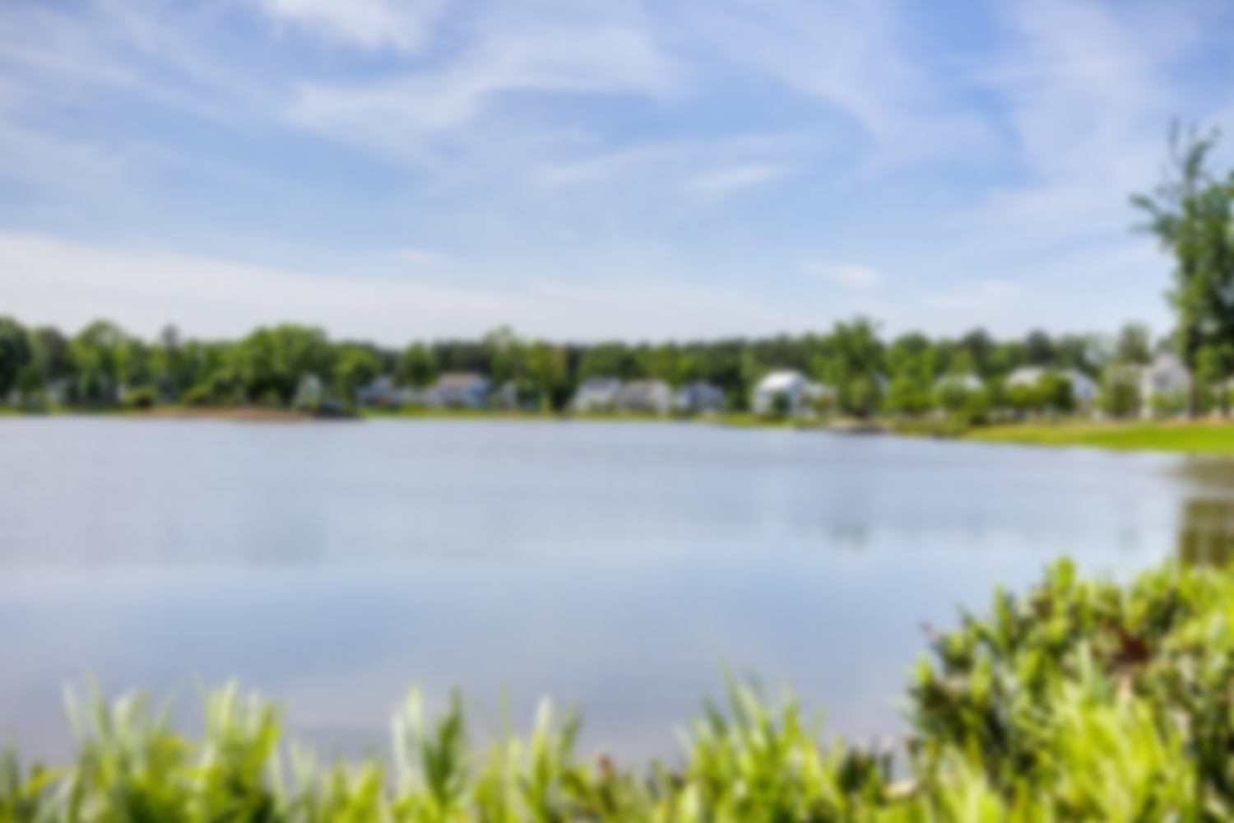
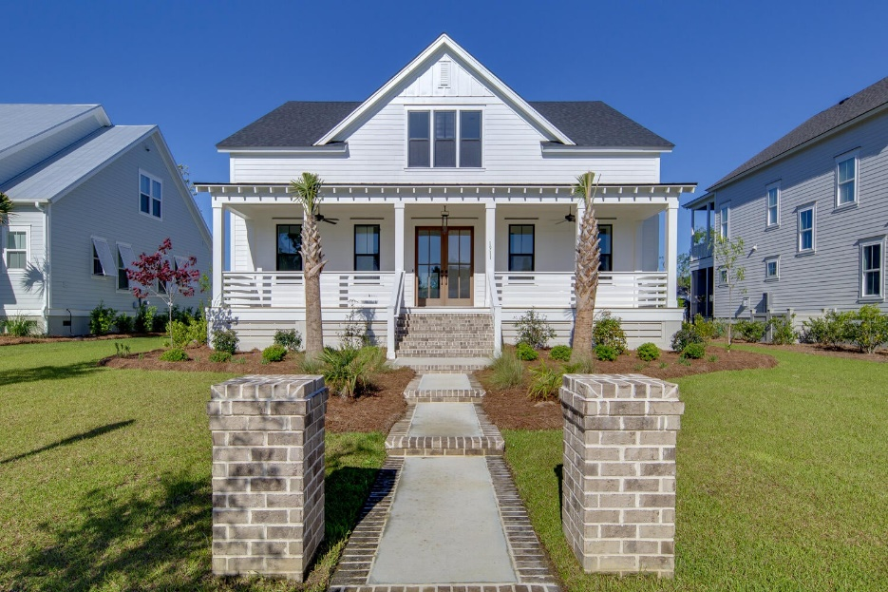
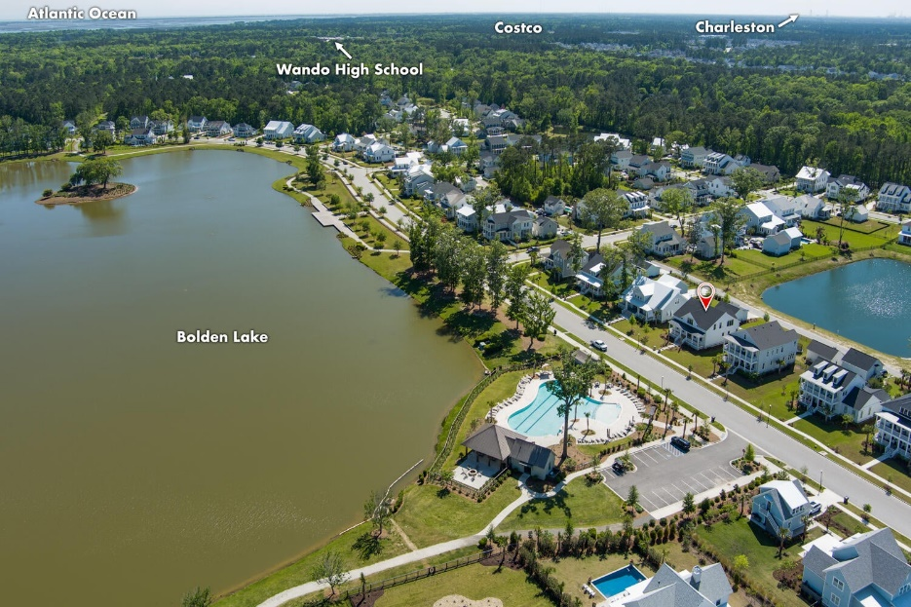
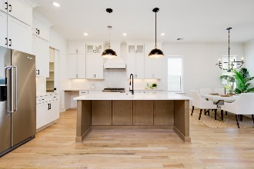
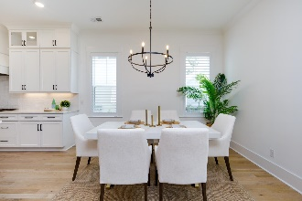
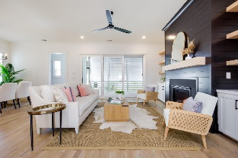
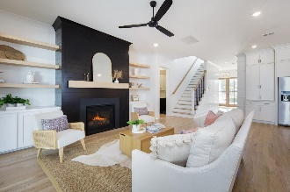
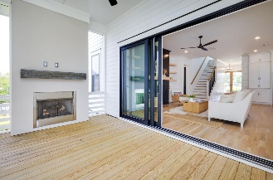
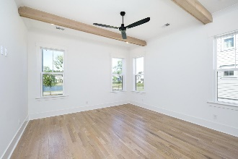
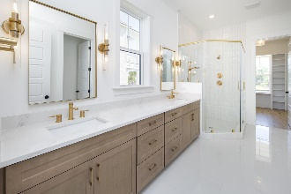
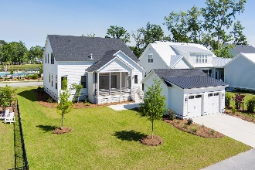
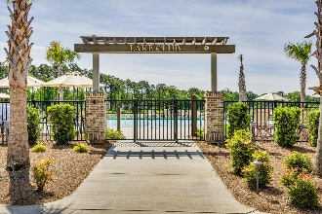
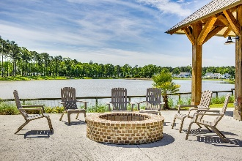


CUSTOM HOME IN RIVERSIDE AT CAROLINA PARK
1911 Bolden Drive
Mount Pleasant, SC 29466 | MLS# 23009194 | $1,540,000
Welcome to 1911 Bolden Drive! This unique offering provides a rare chance to enjoy a LAKE FRONT, CUSTOM home. This picturesque Lowcountry home is located in the exclusive Riverside enclave in Carolina Park, steps away from the most significant amenity - Bolden Park. The neighborhood's center piece, majestic Bolden Lake, fronts this home which faces east and boasts daily sunrise views. In the rear of the home, there is also a large pond feature offering sunset views.
The highlights of this 5 BDRM, 4.5BA, 3464 SF home include a thoughtfully designed open floor plan with timeless signature and custom interior trim details. The main living space offers a great area for entertaining, is generously sized, abundant with natural light from all of the windows, and provides direct access to the rear screened in porch which features an elegant gas fireplace and tri-fold sliding door to enjoy a nice Charleston breeze. In the kitchen, high impact stainless steel appliances all surround a beautiful custom-built center island. Thermador Professional series 36-inch range and dishwasher, beautiful 'to-the-ceiling' cabinetry with glass highlights, uniquely crafted tile back splash, stunning high-end lighting, walk-in pantry, and on-trend fixtures round out the gourmet kitchen appointments. The family room boasts a cozy gas fireplace flanked by custom cabinetry and floating shelves. The private owner's suite is located on the main level with a feature rich master bath including double sinks, a walk-in tiled shower with frameless glass shower door, a cavernous walk-in closet, and a custom-built linen closet. Also conveniently located on the first floor is a mudroom with custom fitted built-ins, a generous laundry room replete with countertop, sink and cabinetry, and a secondary bedroom en-suite for guests, easily doubling as a first-floor office. There are three additional bedrooms on the second floor each with private full bath access and a very functional flex/media/playroom with built-in shelving and storage. Plantation shutters, Bermuda shutters for rear porch and master bath, all appliances convey.
With its convenient Mt. Pleasant address, abundant natural beauty, and endless array of amenities, including the new Lake Club featuring a resort-style pool, wood framed picnic pavilion, and fire pit overlooking scenic Bolden Lake, you will not run out of things to do! Residents also have access to an outdoor kitchen, a second swimming pool located in the Village and available to join, playground, tennis courts, pickleball courts, an open-air pavilion, dog park, the Great Lawn, miles of walking trails and future Riverside crabbing dock. The Bend shopping development includes restaurants, coffee shop, wine bar, yoga, hair and nail salon, golf cart shop and other local businesses and is just a golf cart ride away. The regional library, top area schools, hospital, fire station, Sweetgrass pharmacy and Costco are also a short bike ride or golf cart distance away. This home is also only 15 minutes to the Isle of Palms and Sullivans Island, 25 minutes to Downtown Charleston and the Charleston International Airport.
Virginia Landon
803-493-9202
virginialandon@kw.com
Keller Williams Realty | 496 Bramson Ct Ste 200 | Mt. Pleasant, SC 29464

