Slide 1
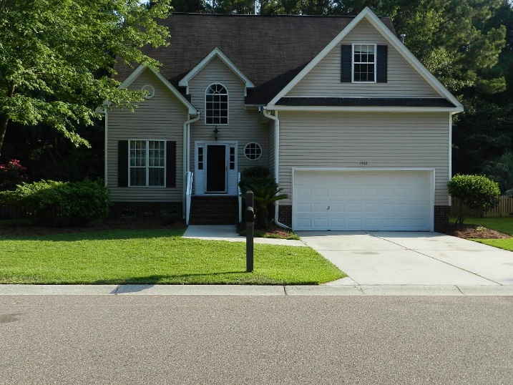
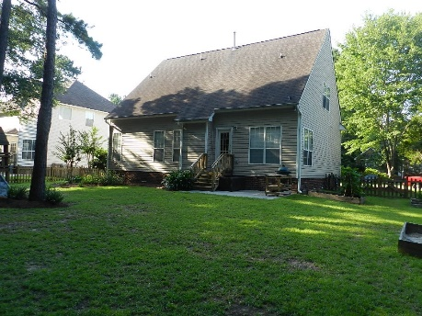
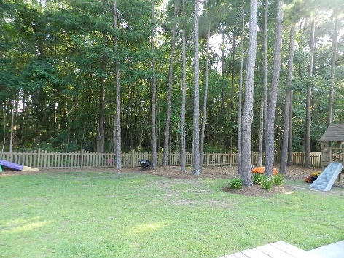


Do You Recognize A Good Deal When You See One?
1912 Smokerise Way Planters Pointe ~ Mt Pleasant, SC 29466
AN INCREDIBLE OPPORTUNITY IS AVAILABLE FOR A SHORT TIME. THIS AWESOME HOME CAN BE PUCHASED IN ITS CURRENT "AS IS" CONDITION FOR $341,500.00. THE PRICE WILL INCREASE TO $367,000.00 WHEN RENOVATIONS COMMENCE.
An Amazing fully detached 2 story home that is situated on a quiet tree-lined street and surrounded by a large private fenced yard. Upon completion of renovations:
This Remarkable freshly painted home with new wall to wall carpet offers a Dramatic entry foyer with 18+ ft. ceilings, 3 large bedrooms upstairs including the FROG. There are several large rooms with selected wood flooring on the main floor including the spacious master bedroom suite that offers high vaulted ceilings, a huge walk-in closet and a private master bathroom with a relaxing soaking tub and a separate walk-in shower. The exciting, freshly painted Great Room offers quality wood flooring, vaulted ceilings, a classic fireplace and large windows that provides remarkable views of the fenced back yard and wooded area. The Distinctive Formal Dining room with vaulted ceilings and priceless wood flooring is perfectly positioned adjacent to the Stylish Kitchen that is appointed with new granite counter tops, stainless appliances and wood flooring. The Valuable breakfast room is appointed with selected wood flooring, a vaulted ceiling and large windows that fills the room with natural light. There is a French door walkout to the patio and large private back yard that is perfect for outside entertaining and cook-outs...
Bill Everett, Jr
Broker
843-693-8539
Bill@TheEverettGroup.net
RE/MAX Pro Realty, 9209 University Blvd, Charleston, SC 29406

