Slide 1
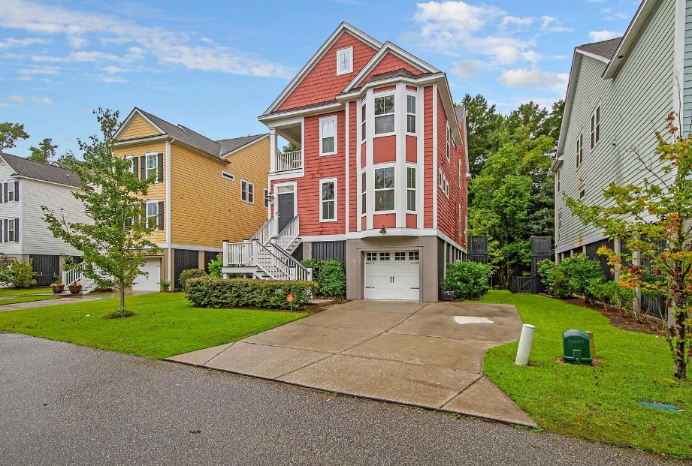
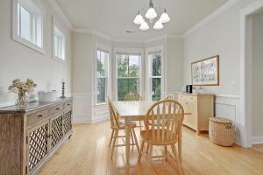
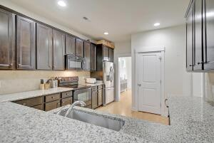
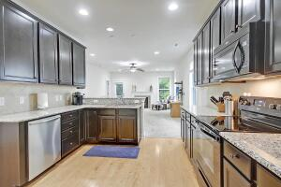
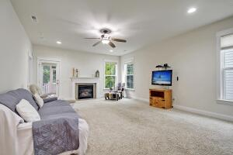
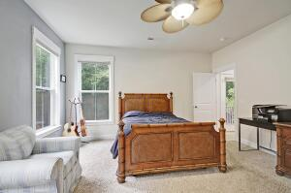
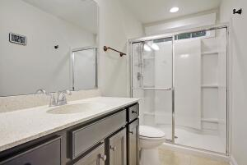
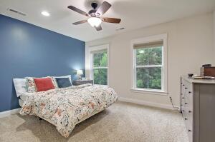
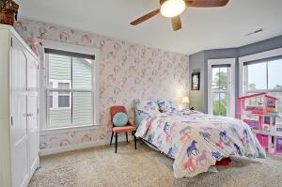
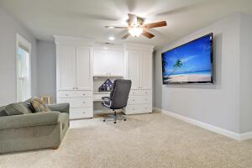
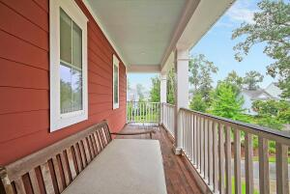
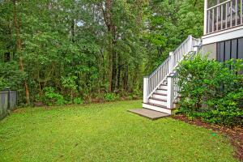
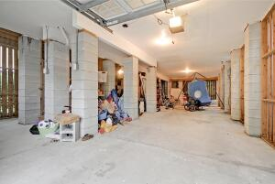


Carolina Bay ~ 5 BR ~ 3.5 BA!!
1913 Clay Lane
Carolina Bay
Charleston, SC 29414
MLS# 21025925
$549,900
5 Bedrooms | 3½ Baths | 2,652 sf
Welcome to 1913 Clay Lane! This home is centrally located in the lovely neighborhood of Carolina Bay. Close to it all! This Charleston single style home is ready for you to move right in. Upon arriving, you'll notice the double side porches on the left side of the home. Perfect for relaxing and having a glass of sweet tea. Once entering, you'll immediately notice an abundance of natural light. Straight ahead is the dining room which leads into the kitchen. The kitchen offers ample cabinetry, a pantry and breakfast bar. The kitchen overlooks the family room to create a nice open floorplan. The master bedroom is also located on the main floor. The master bath has a separate shower and tub, walk in closet and double sink vanity. The main floor also gives you access to the back screened in porch which overlooks a wooded paradise. Head back inside and upstairs and you'll first enter the loft area which has a huge built in shelf, bookcase and desk area, access to the upstairs porch and the laundry room. Off the loft are two large bedrooms and a full bathroom. Also upstairs are two more bedrooms with a jack and jill bathroom. Great closet space and also pull down attic upstairs gives you plenty of storage. Storage is really never an issue because the elevated floor plan gives you a huge garage area. You can store your kayaks and canoes here as well as park two cars! This home has it all and the location is amazing! You are close to the 526 interstate, tons of shopping, restaurants and not a far drive from the beach. Walk through the neighborhood walking trails with marsh views or head to the community pool! You'll feel like you're always on vacation living here!
Larry & Kathy Mazalatis
Larry Cell 843-693-0529
Kathy Cell 843-693-0159
Office 843-871-9133
AGENTOWNED PREMIERE GROUP | 1800 TROLLEY RD | SUMMERVILLE, SC 29485

