Slide 1
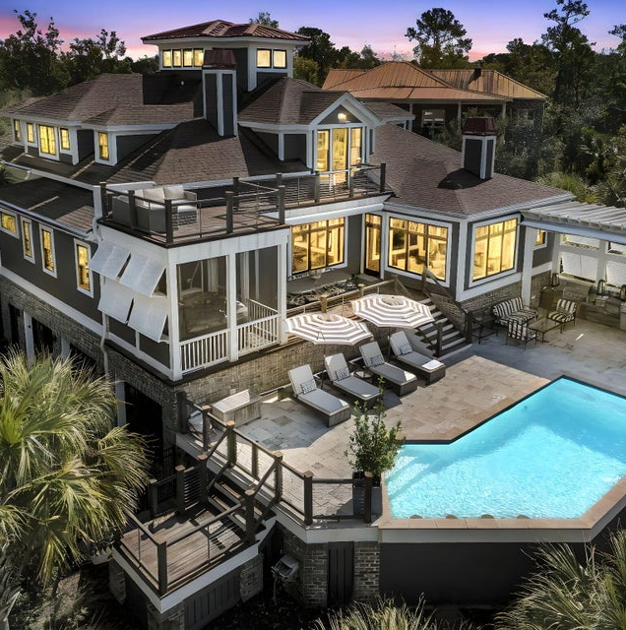
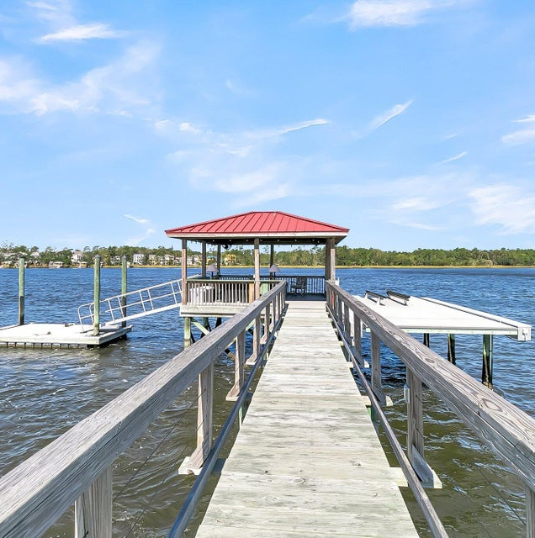

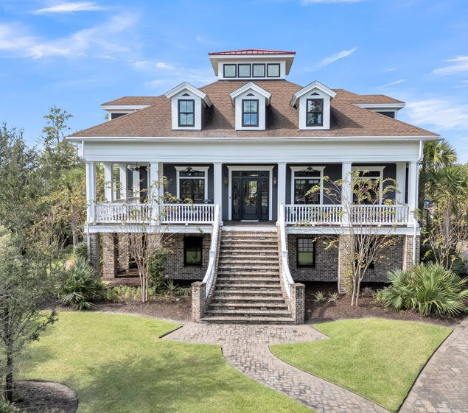
LISTED AT $4,944,000
Deep Water
Boaters Dream
Summer Oasis
®
PROPERTY FEATURES
listed exclusively by:
CHRISSY STRICKLAND
843-906-5553
chrissychsrealtor@gmail.com https://residerealestatellc.com/
4 Bedrooms
5.5 Bathrooms
5500 Sq ft
Deep Water Cul-de-sac Lot
New Interior/Ext. Paint
10,0001b boat lift
Full Home Generator
1.55 Acres
Heated Pool
Insurable Ground Floor level

