Slide 1
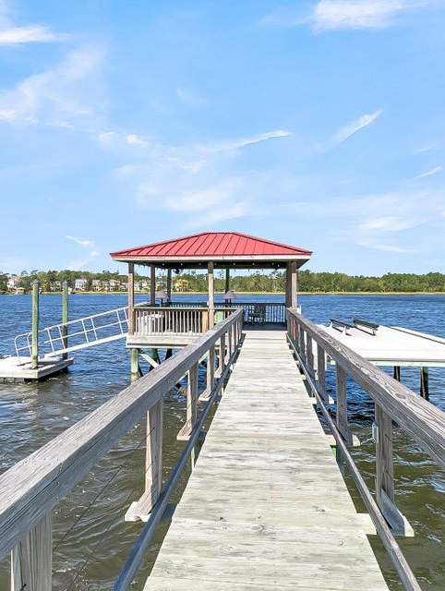
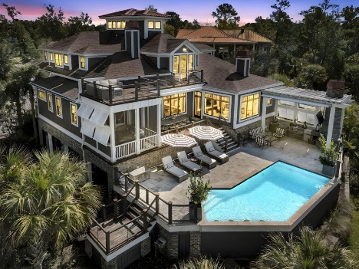
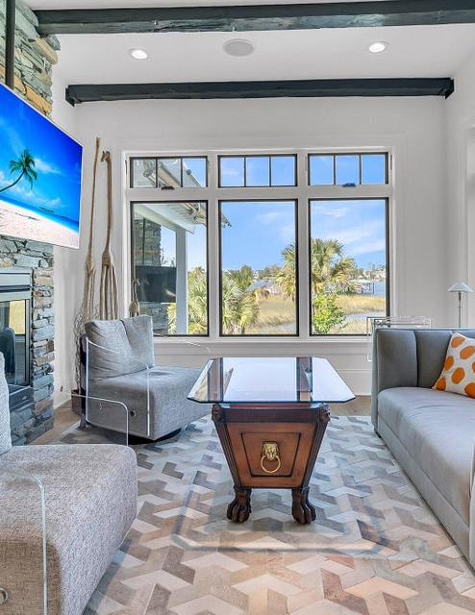
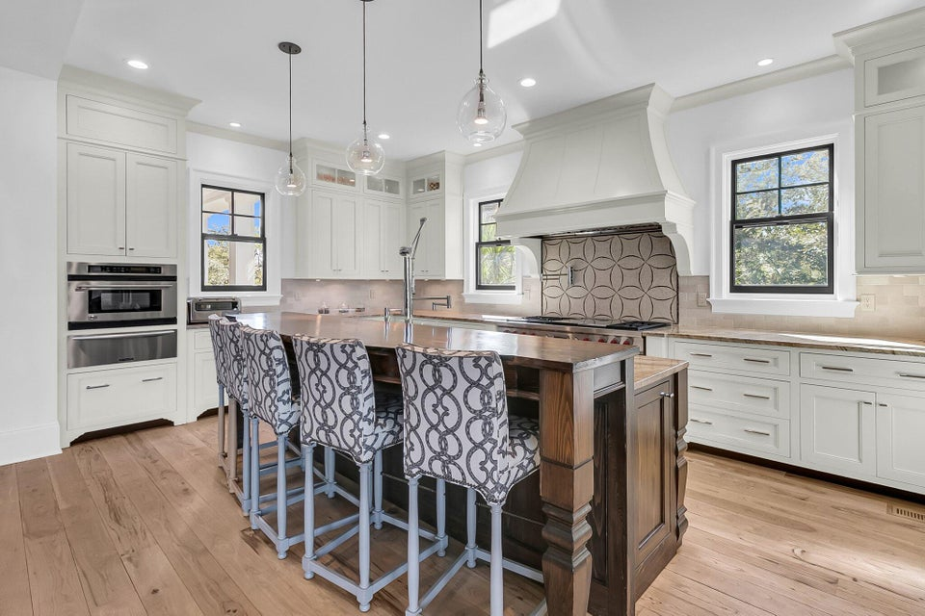
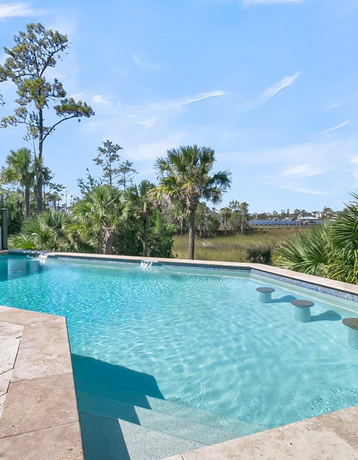
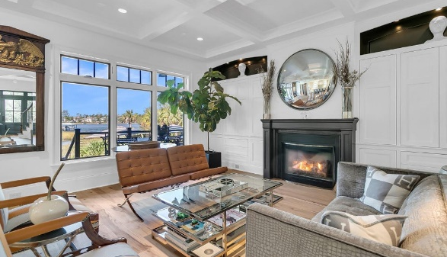


Deepwater
Lowcountry Estate
To A Showing At This Deepwater Estate!
1913 Mooring Line Way
Dunes West | Mount Pleasant, SC 29466
MLS# 24026820 | $4,944,000
Chrissy Strickland
843-906-5553
chrissychsrealtor@gmail.com
Visit My Website
1913 Mooring Line Drive is more than just a home.... It is a lifestyle! Experience the best in Low-Country living with this one-of-a-kind gem. A breathtaking custom-built estate offers the perfect blend of modern elegance and waterfront living. Situated on a 1.55 acre lot, it offers the epitome of living on the Wando River, including breathtaking views and stunning sunsets. The true deep-water covered dock is complete with: WIFI access, custom lighting, a 10,000 lb boat lift and large floater. Upon entering the home, you are welcomed with panoramic views of the scenic Wando River, hickory floors throughout and large windows that allow natural light to flood the space. A full-size elevator accesses all floors of the home. Step outside to experience the elevated outdoor oasis, complete with a stunning rectangular saltwater heated pool, travertine tile throughout, a fully equipped built-in outdoor kitchen with cooktop, and gas grill. Additional improvements include: a full home gas powered generator, a completely fenced yard, two retractable poolside awnings for added shade, and a mosquito spraying abatement system. A charming short walkway leads right out to the dock. We invite you to see this beautiful property for yourself!
Virtual Tour | Video Tour
EXP Realty LLC
170 Meeting Street Ste 304
Charleston, SC 29401

