Slide 1
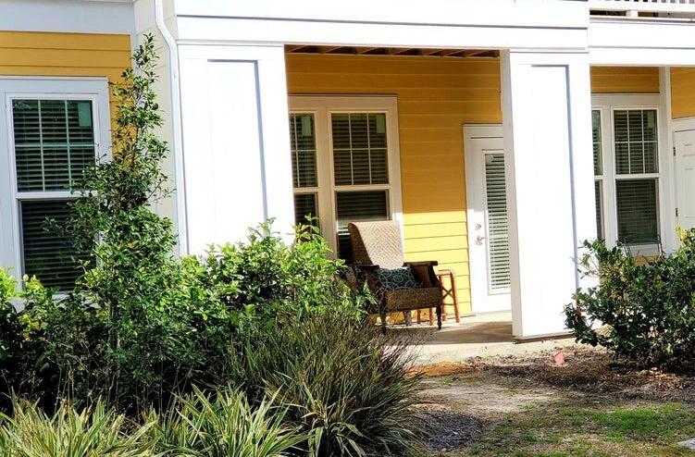
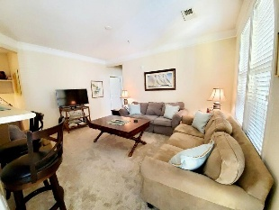
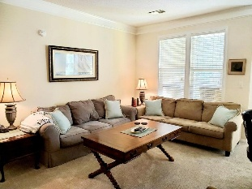
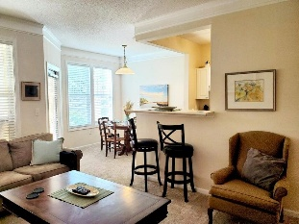
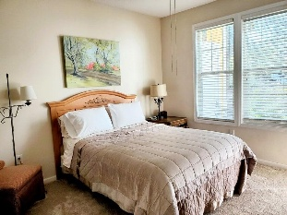
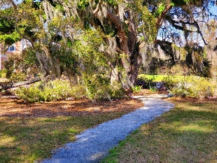

1914 Chatelain Way Mount Pleasant, SC 29464 | MLS# 25029300 | $329,000
Just Listed in Southampton Pointe
A rare find! Ground floor (no stairs) condo in a secure gated community in Area 42, close to beaches, downtown Charleston, and I-526. There is a foyer area with an office nook, open kitchen, breakfast bar, dining area, and open living room. The bedroom has an exceptionally large walk-in closet with shelving. Full bathroom has ceramic tile flooring and shower. There is a laundry room with a washer and dryer. The appliances have been recently replaced and the carpet is new as of October, 2025. Spacious covered front porch or patio area with a storage closet. The community amenities offer walking trails with beautiful landscaping, a pool, club house, workout facility, dog park, and car wash area. Boat storage may be available on a first come, first serve basis. Transfer fee may apply.
Matt Galvin
843-245-6913
matt.galvin@agentownedrealty.com
mattgalvin.agentowned.com
AgentOwned Realty Co. Preferred Group, Inc.
824 Johnnie Dodds Blvd
Mt Pleasant, SC 29464

