Slide 1
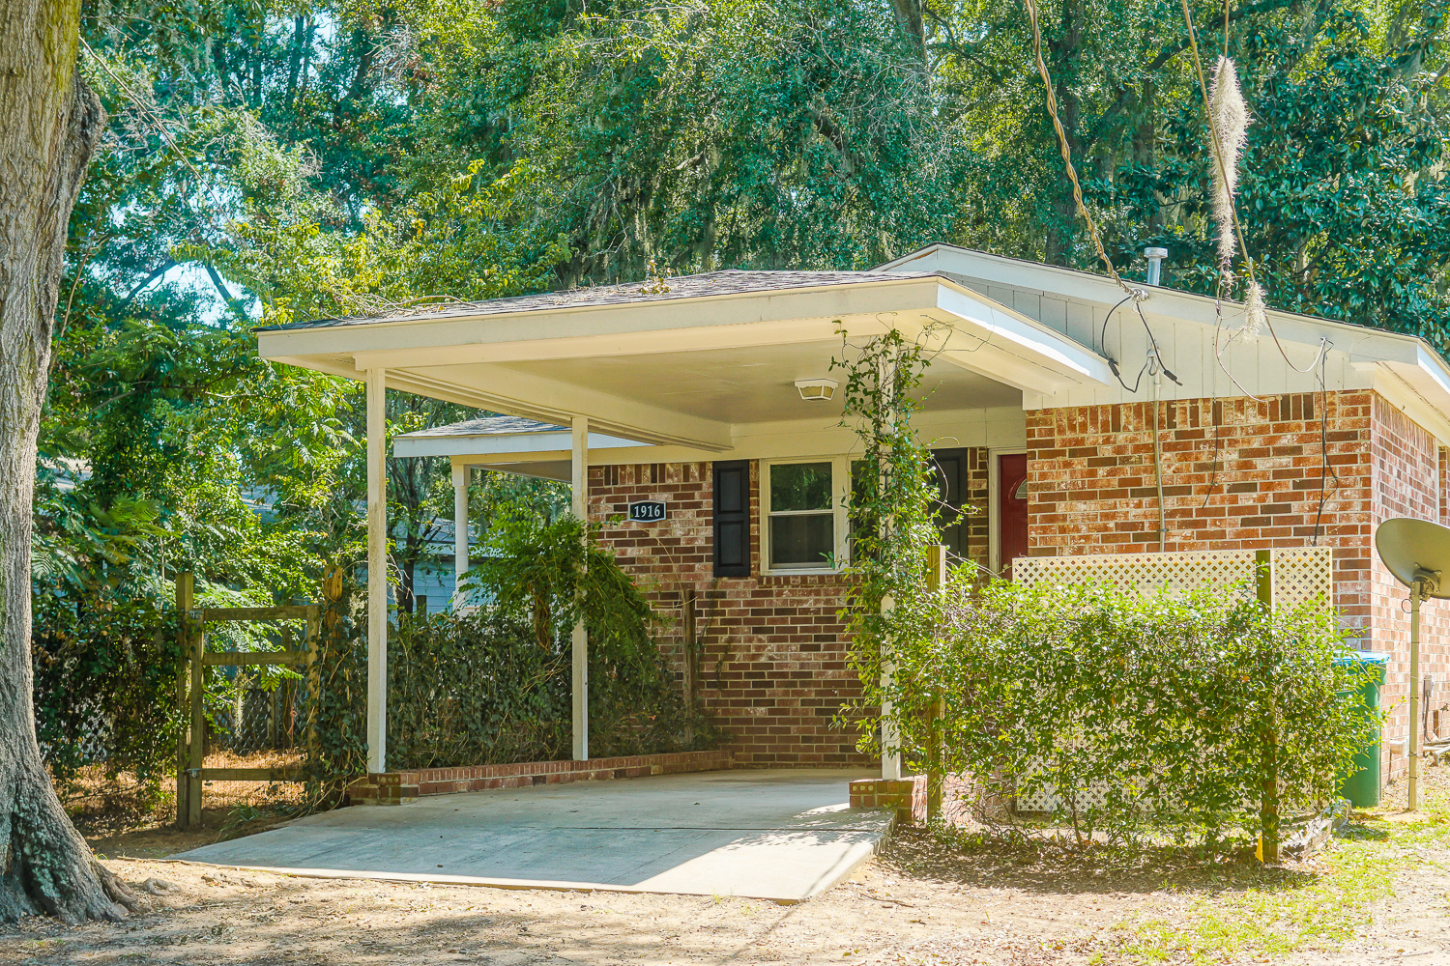
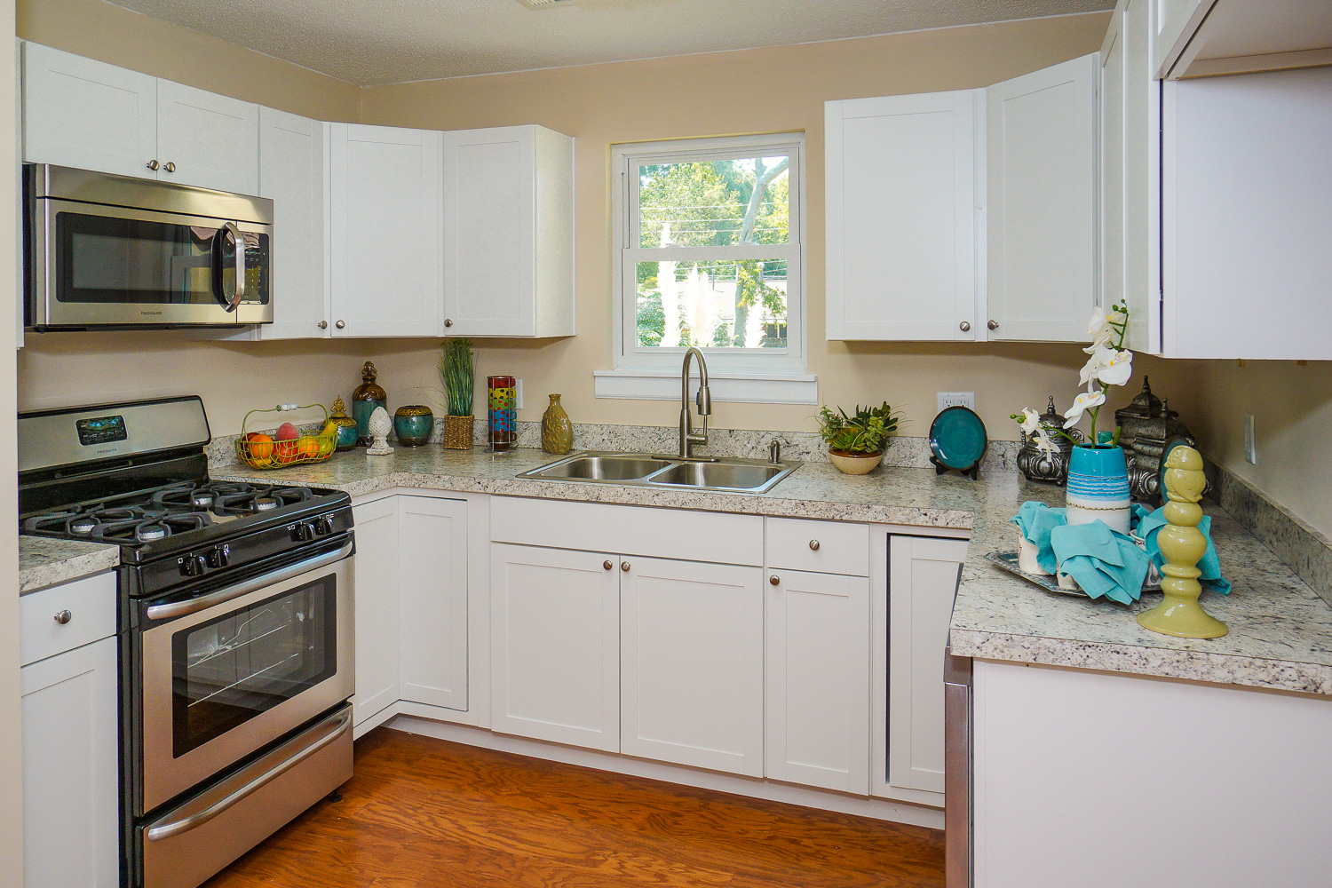
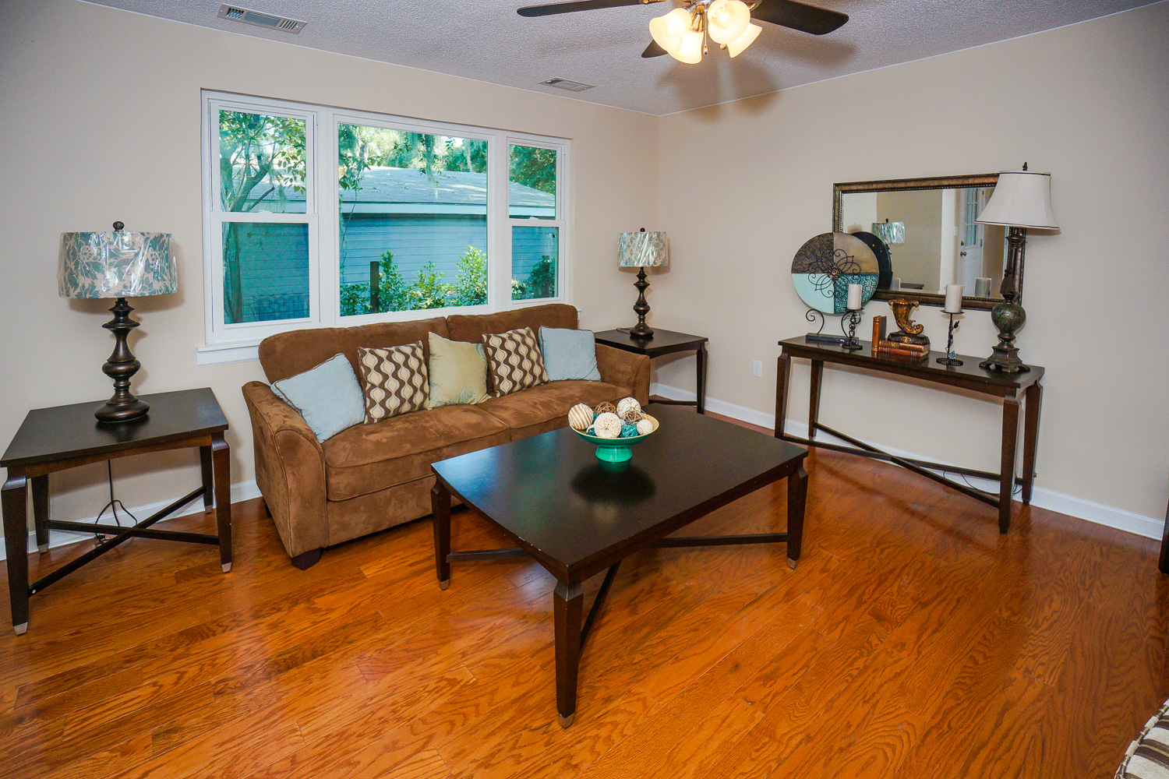
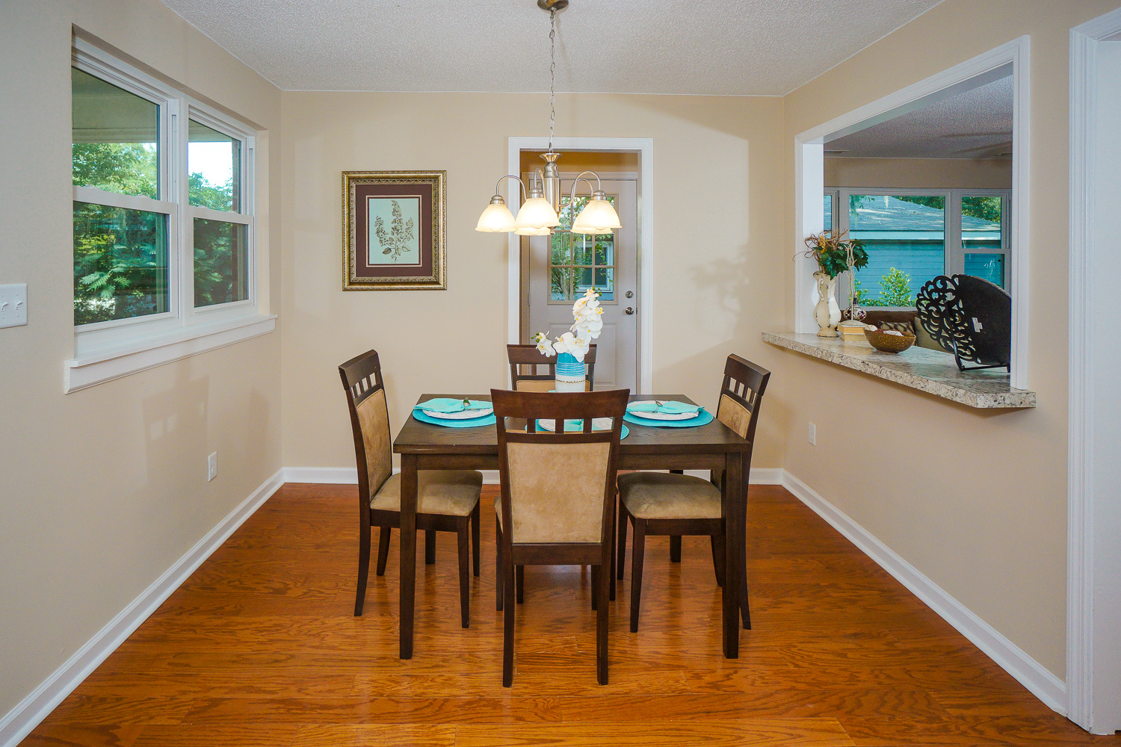
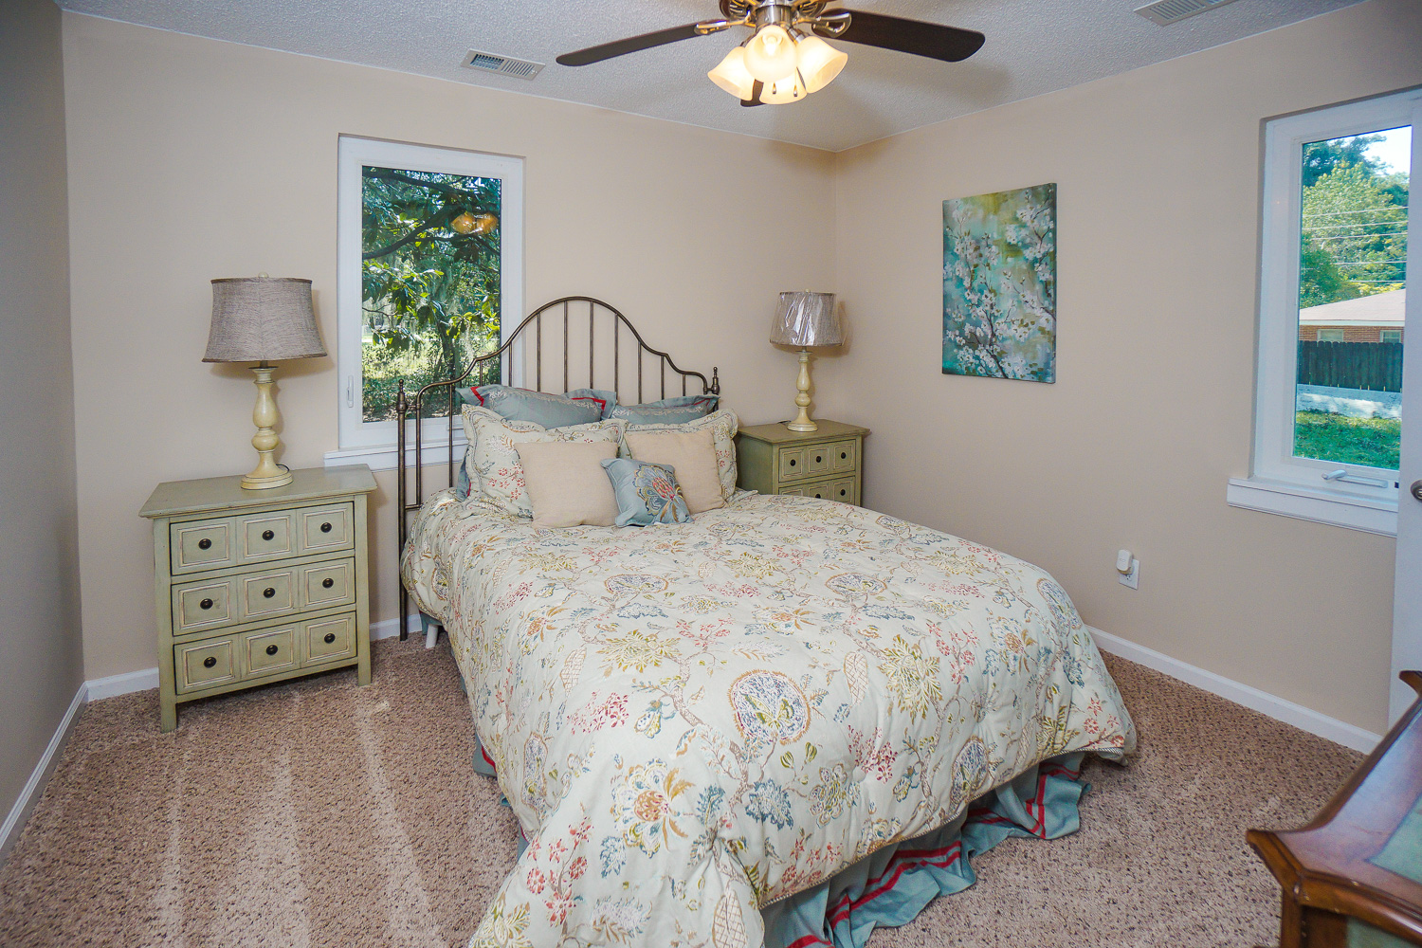
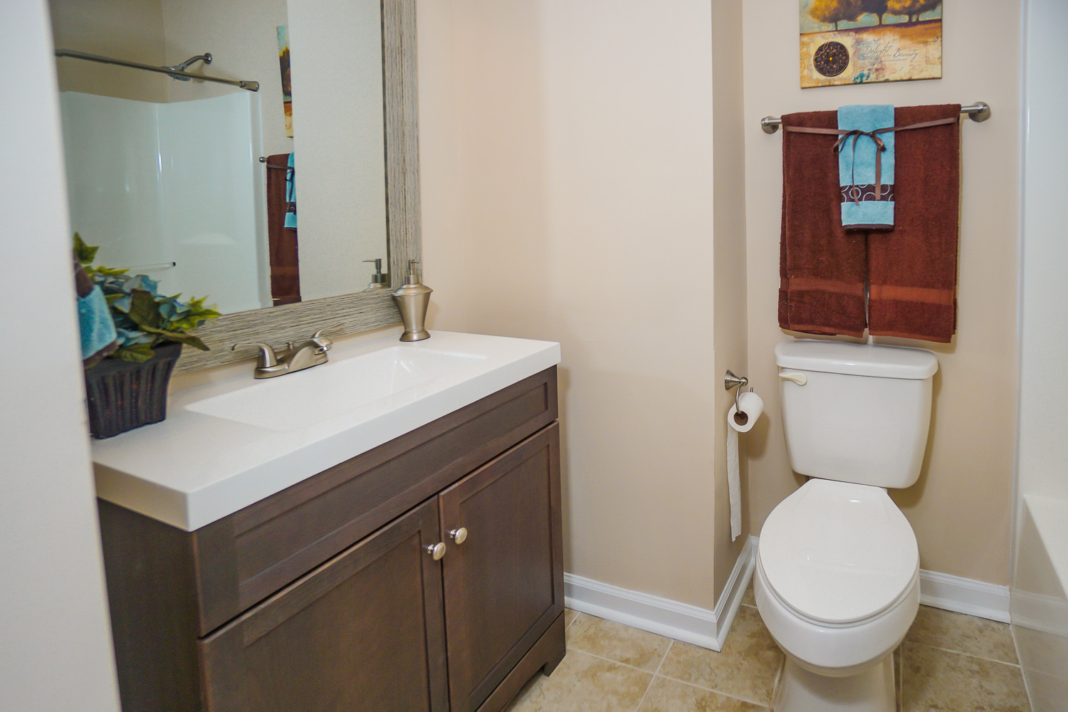
1916 Baggett St ~ Beaufort
$150,000
Wow! Beautifully-Renovated 3BR/ 1.5BA/ All-Brick Home on a fenced lot in Downtown Beaufort! Walking distance to the NEW Starbucks & Town Center! NEW HVAC (interior & exterior units), NEW Premium Architectural Roof, Insulated Windows, Newer Water Heater, NEW Doors! The home’s entire interior (Walls, Ceilings, Trim & Doors) has just been professionally painted! NEW premium wood flooring, NEW frieze carpeting/pad & NEW premium tile! The kitchen has just been renovated with NEW countertops, NEW white modern cabinets, NEW premium sink/faucet & NEW premium stainless steel appliances! NEW vanity/ top, NEW commode & NEW brushed nickel fixtures in both bathrooms! Enjoy the shade of the huge live oak trees, outdoor patio & fenced yard! Hard to beat this price right in downtown Beaufort!
Bedrooms:
Bathrooms:
Sq Ft:
Fence:
Lot Size:
3
1.5
1073
YES
0.17 Acres
Year Built:
New Roof:
New Central Air:
New Heat:
Type of Floors:
1978
2016
2016
2016
Wood, Ceramic Tile, Carpet
Greg Cook
Anchor One Realty, LLC
843-343-3030
gcook@AnchorPropertiesofSC.com

