Slide 1
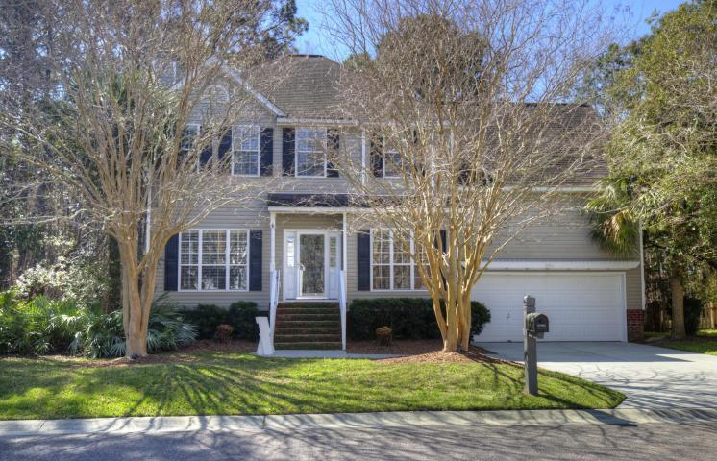
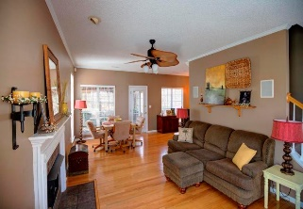
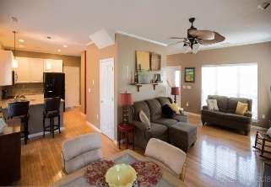
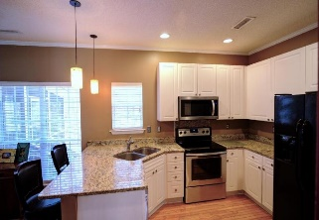
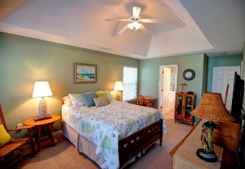
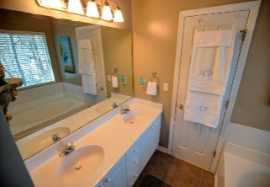
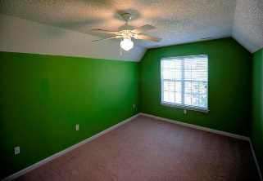
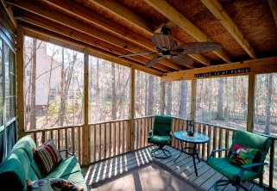
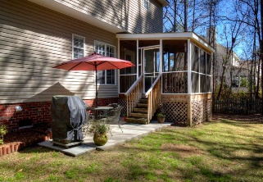
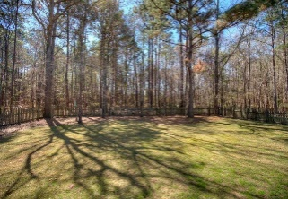
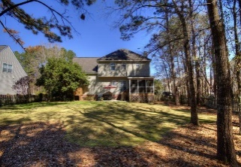

1916 N Smokerise Way
Mount Pleasant, SC 29466 ~ MLS# 18006421 ~ $369,000
Just Listed in Planters Pointe
$369k in Planters Pointe
11 Sq Ft Shy Of 1,800 Square Feet!
Do Not Miss This Home On Your MLS Searches!
Looking for a home in Mt Pleasant with a large backyard? Look no further! The first floor has hardwood floors throughout. The large family room features a gas log fireplace, built in surround sound speakers, and access to a nice screened porch overlooking the large, fenced in backyard. The kitchen features white cabinets, granite counter tops and all kitchen appliances are included. Separate dining room along with half bath are also located downstairs. Upstairs you will find a spacious master bedroom with tray ceiling and attached master bathroom. The master bathroom contains a double vanity, garden tub and separate shower. You will also find 3 more bedrooms upstairs as well as a full bathroom. The FROG was converted to be a large guest room, but could be a fantastic game or play room!
Scott Fulton
(843) 324-8845 O | (843) 324-8445 M
scott.fulton@agentownedrealty.com
AgentOwned Preferred Group | 824 Johnnie Dodds Blvd | Mt Pleasant, SC 29464

