Slide 1

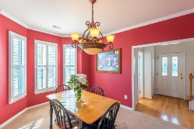
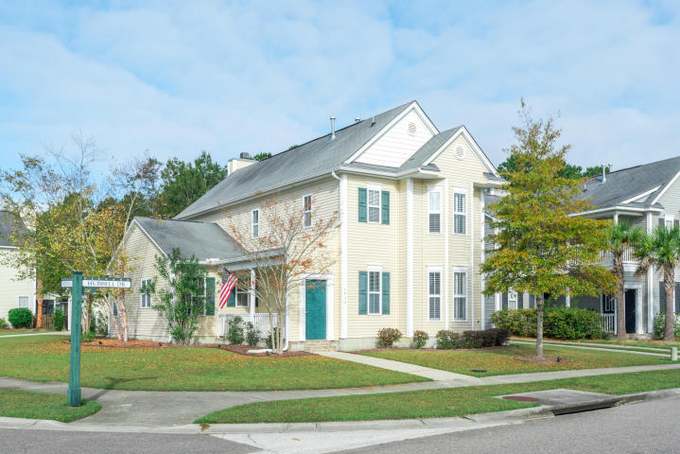
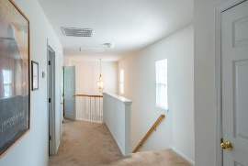
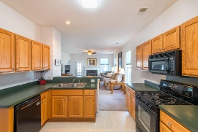
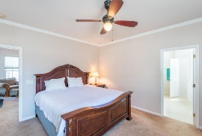
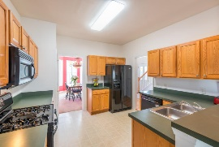
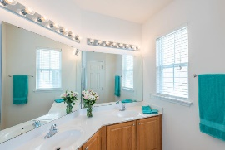
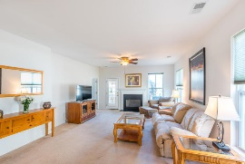
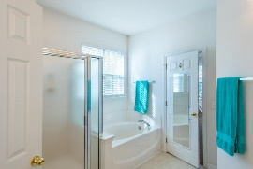
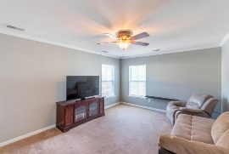
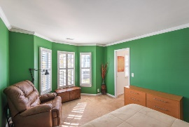
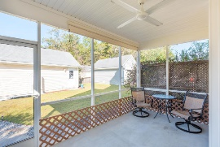
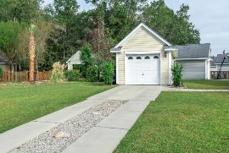
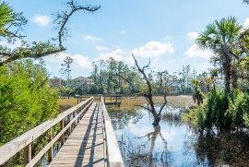
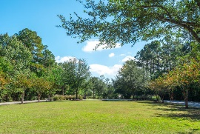

A Must See In Park West At A Great Price!
1917 Hubbell Drive
Mount Pleasant, SC 29466 ~ MLS# 17030115 ~ $379,900
Charming 4br/2.5ba Charleston single sits on large corner lot in the desirable Village at Park West. Open floor plan with a spacious family room featuring wall to wall carpet, ceiling fan, gas fireplace, and access to screened in porch. Master bedroom is located on 1st floor with large walk-in closet, double bowl vanity, garden tub and separate shower. Upstairs you will find 3 spacious bedrooms and one full bath with plenty of space. Park West offers wonderful amenities including tennis courts, outdoor pools, crabbing dock, dog park, and fitness trails. This wonderful neighborhood offers so much and is a short drive to the beach and downtown Charleston.
Andrew Tackitt
(843) 437-8726
andrew@radekopf.com
1205 Two Island Court, Suite 201
Mount Pleasant, SC 29466
Phone: (843) 579.2217
Fax: (843) 971-0281
Erin Quinn Hanhauser
(843) 743-8204
erin@radekopf.com

