Slide 1
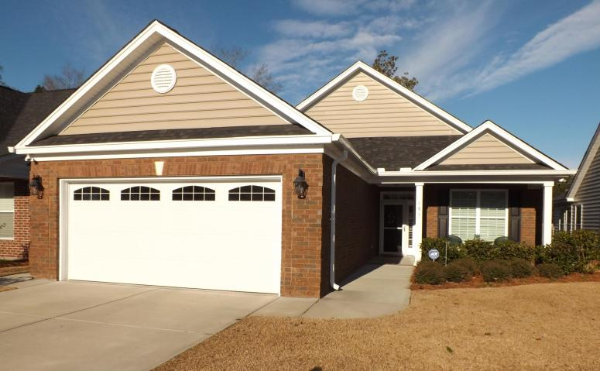
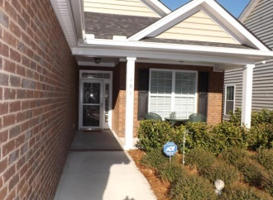
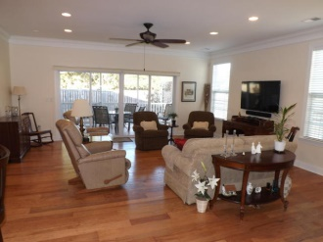
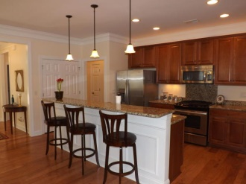
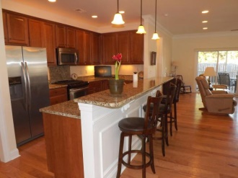
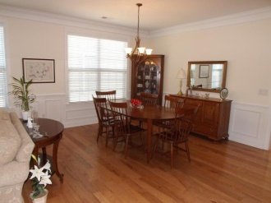
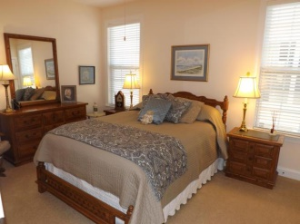
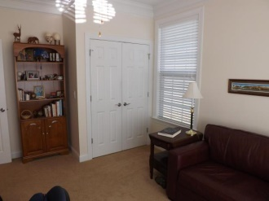
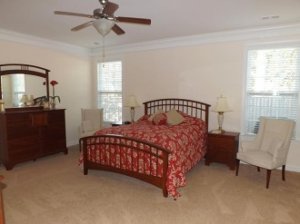
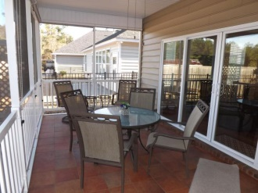
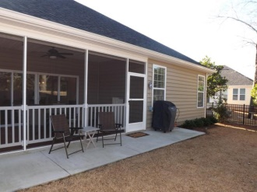

191 Angora Way Pines at Gahagan :: Summerville :: MLS# 15002841 :: $281,900
55 and Better!
Just Reduced!
No need to go through the hassle of building -- ​and the window treatments (2'' wood blinds) are already in place! Enjoy this 1 story, almost new, move-in ready, gorgeous home in 55+ ''lock and leave'' gated community with easy access to shopping, medical care and I-26. This house was meticulously planned with thousands of dollars spent in modifications and upgrades ​too numerous to list ​ (list provided in documents in MLS). Open floor plan, large rooms, light and inviting. 9' smooth ceilings, crown molding, granite counter tops, 42'' cabinets. Master bath has 2 raised vanities, cultured marble shower with glass doors and enclosed water closet. Large master bedroom has terrific walk in closet with extra shelving. Enjoy meals and relaxing on the screened porch (with private fenced back yard). Community has beautiful clubhouse with exercise room and pool. Monthly HOA fee includes mowing and edging so you can enjoy all that's offered in Summerville and nearby Charleston. Has ADT security/fire system.
Foster Smith
(843) 974-6029 - O
(843) 202-8762 – F
fsmith@carolinaone.com www.homesofsummerville.com
Carolina One Real Estate
Summerville Office
900 N Main St.
Summerville, SC 29483

