Slide 1
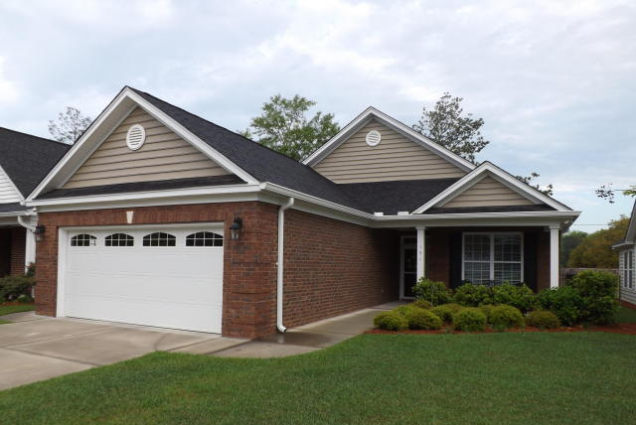
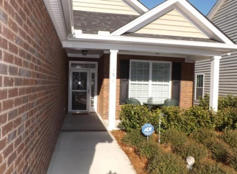
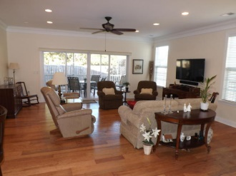
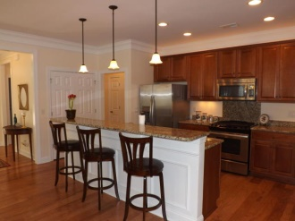
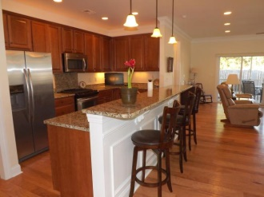
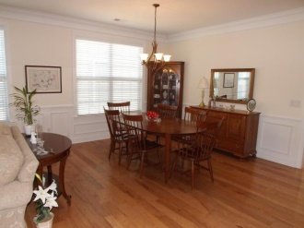
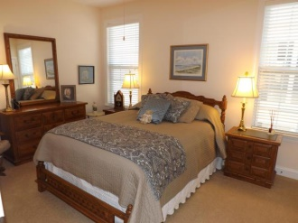
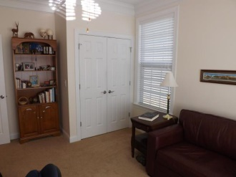
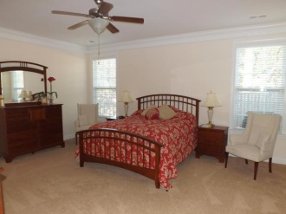
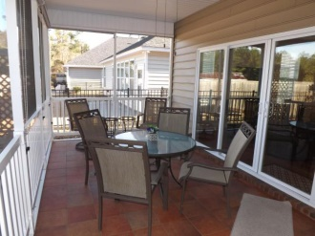
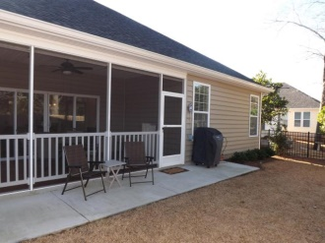

191 Angora Way
Pines at Gahagan :: Summerville :: MLS# 15002841 :: $275,000
55 and Better!
Just Reduced!
Enjoy easy living in this ​''​55 and better​''​ gated lock and leave community. No need to go through the stress of building -- and the window treatments (2'' wood blinds) are already in place! Small community of approximately 105 homes has beautiful clubhouse with exercise room, pool and activities. Easy access to shopping, medical care and I-26. This nearly new, 1 story move-in ready home was meticulously planned with ​over $40,000​ spent above builder's list price, including construction modifications and upgrades. [See upgrade list in documents in MLS]. Open floor plan, large rooms, light and inviting. 9' smooth ceilings, crown molding, granite counter tops, 42'' cabinets. Master bath has 2 ​separate ​raised vanities, cultured marble. Large master bedroom has terrific walk in closet with extra shelving. Enjoy meals and relaxing on large screened porch with custom ceramic tile floor & private quiet fenced back yard. Security/fire system. Monthly HOA fee includes mowing and edging so you can enjoy all that's offered in Summerville and nearby Charleston. Beautiful home -- a must see!!
Total square feet: 2780 | Heated/AC square feet: 1855
Foster Smith
(843) 974-6029 - O
(843) 202-8762 – F
fsmith@carolinaone.com
www.homesofsummerville.com
Carolina One Real Estate
Summerville Office
900 N Main St.
Summerville, SC 29483

