Slide 1
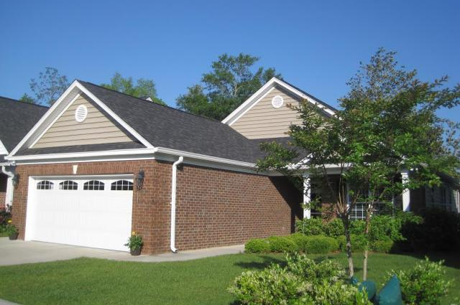
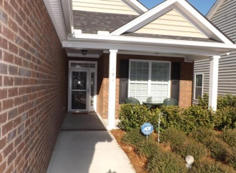
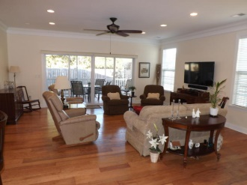
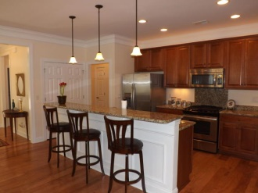
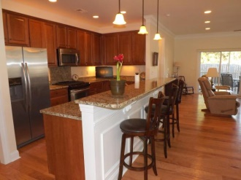
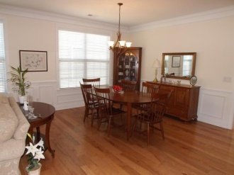
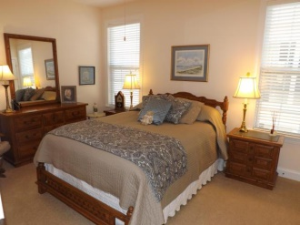
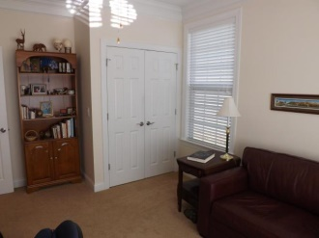
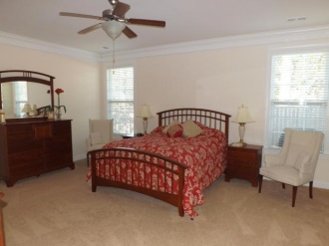
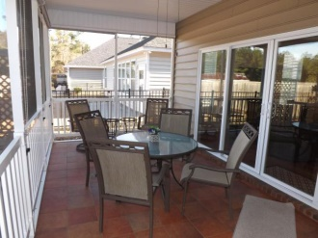
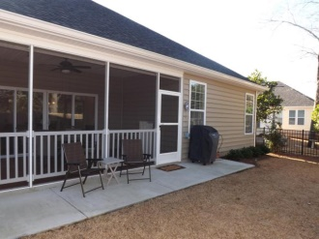

191 Angora Way Pines at Gahagan :: Summerville :: MLS# 15002841 :: $275,000
55 and Better!
Well Worth
a Look!
Take a look at this ​ fantastic home before you buy in any 55+ community! Only 2 years old, this 1 story home is move-in ready and was meticulously planned [with $30K+ in modifications, upgrades, and many wonderful features ​ -- upgrade list in MLS documents] and has been meticulously maintained. ​ Pines at Gahagan is a gated ''lock and leave'' community conveniently located close to shopping, medical facilities, I-26 and just a short walk to historic downtown Summerville. Small community of approx. 105 homes has beautiful clubhouse with exercise room, library, pool and activities.​ Open floor plan, large rooms, light and inviting. 9' ceilings, crown molding, wainscoting, granite counter tops, 42'' cabinets. Master bath has 2 separate raised vanities, cultured marble shower. Large master bedroom has terrific walk-in closet with extra shelving. Lots of storage. 2 car garage is oversized. Enjoy meals and relaxing on wonderful screened porch with custom porcelain tile floor and Coolaroo shades; private, quiet fenced backyard. Security/fire system. Irrigation system. Monthly HOA fees include yard maintenance so you can enjoy all that's offered in Summerville and nearby Charleston. BEAUTIFUL HOME and GREAT VALUE -- it's well worth a look!!
Total square feet: 2780 | Heated/AC square feet: 1855
Foster Smith
(843) 974-6029 - O
(843) 202-8762 – F
fsmith@carolinaone.com www.homesofsummerville.com
Carolina One Real Estate
Summerville Office
900 N Main St.
Summerville, SC 29483

