Slide 1
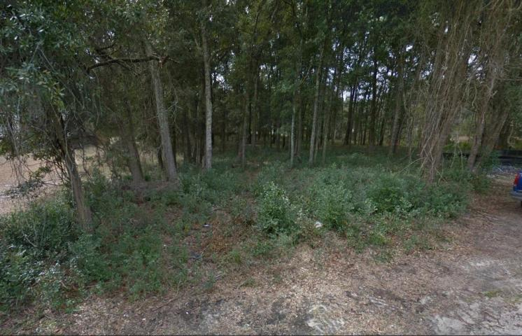
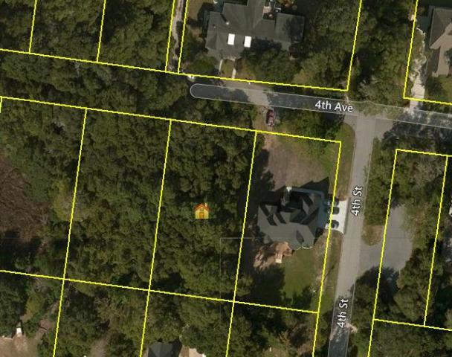
Almost a half acre near Ravenel Bridge and Waterfront Park.
191 4th Avenue
Scanlonville ~ Mount Pleasant, SC 29464
MLS# 17016063 ~ $345,000
Visualize your dream home on an almost half acre lot near the foot of the Ravenel bridge surrounded by beautiful trees, neighbors with new custom homes, and a crab dock on your street. This one of a kind lot is located at the entrance to the new Remley's Park Subdivision along the new extension to 4th Avenue. Although located at the entrance to Remley's Park, this lot is not legally part of the development and does not have to pay in to the HOA and is not subject to the restrictions of the HOA. Lot is located in an AE Flood Zone. Owner has Plat of property with tree survey, copy of FEMA Letter of Map Revision and geotechnical report. Public Water and Sewer available to site. Property owner is a SC licensed Real Estate Agent.
Thomas Hartnett, Jr
Hartnett Realty Co., Inc.
1156 Bowman Road, Suite 200, Mt. Pleasant, SC 29464
tom@hartnettrealty.com
(843) 723-7222 Office | (843) 270-2915 Mobile

