Slide 1
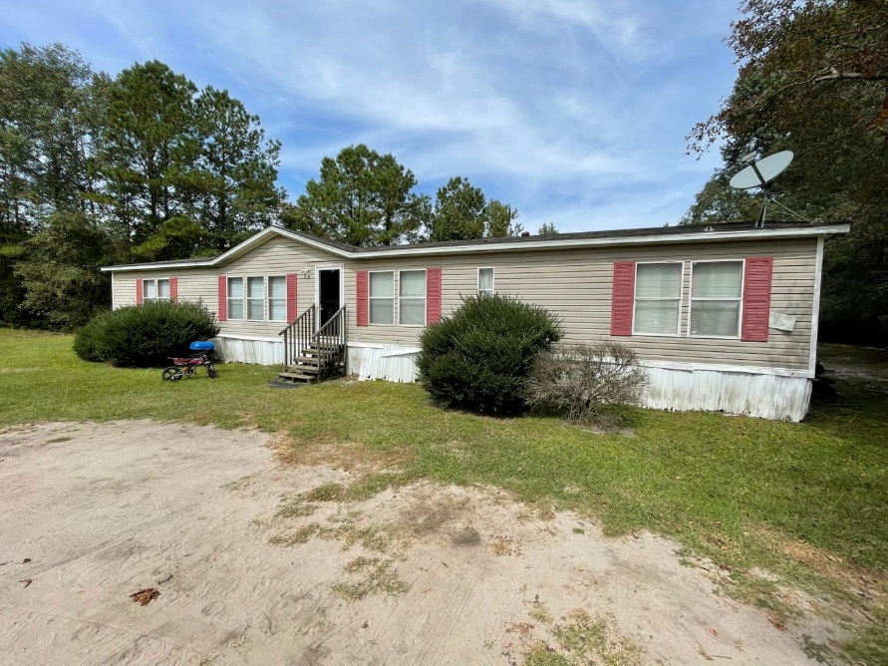
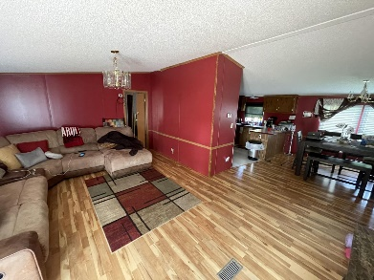
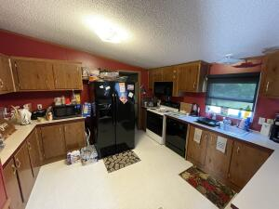
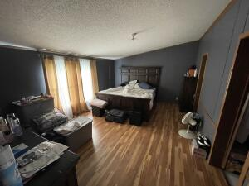
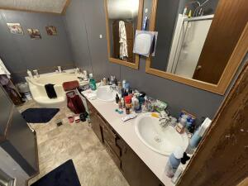
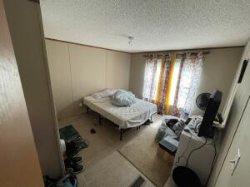
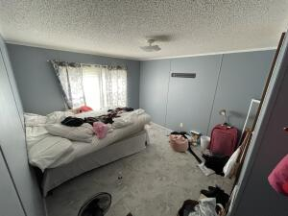
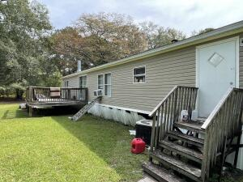
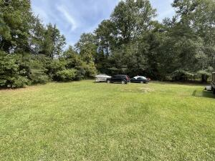



WALTERBORO DOUBLE WIDE READY FOR NEXT OWNER!
191 Deloach Avenue
Walterboro, SC 29488
MLS# 22025162
$119,900
4 Bed | 2 Bath | 1,904 sf
Looking for a big 4 bedroom and 2 full bathroom home in Walterboro? Here's your home! Located in a quiet neighborhood of Walterboro, this large 4 bedroom double wide offers PLENTY of living space and backyard. This home offers an open living room, dining room and kitchen combo creating a smooth flow to get to each room. The wood floors throughout the house are definitely hard to miss! High cathedral ceilings make the home feel even bigger. The kitchen offers tons of countertop and cabinet space, perfect for all of your cooking needs for daily use, entertaining, holidays, the list goes ON! Off the kitchen you have a separate laundry/mud room with a door for backyard access. The primary bedroom is enormous offering an en-suite with double vanities, a garden tub, and separate shower. Additionally you'll find a walk in closet in the master bedroom with PLENTY of room for all of your clothes. Can't forget about the huge backyard, with plenty of room to host outdoor events, for a pet, enjoying the weather, etc. Come take a look at this home today!
Nick Mazzilli (843) 640-5575
nick@nickmcharleston.com www.mavenrealtysc.com
Maven Realty
2180 McMillan Ave
#71672
Charleston, SC 29405

