Slide 1
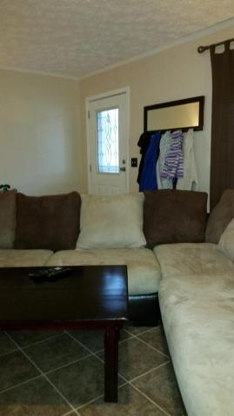
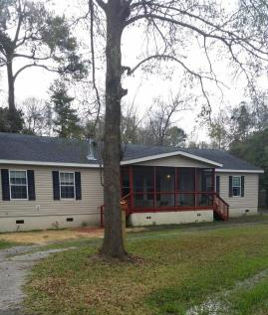
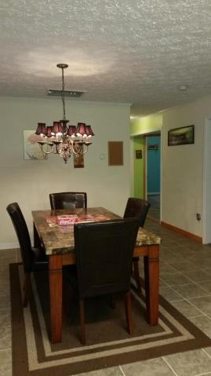
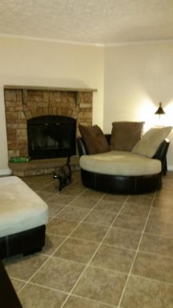
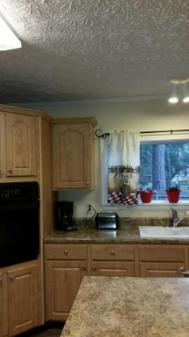
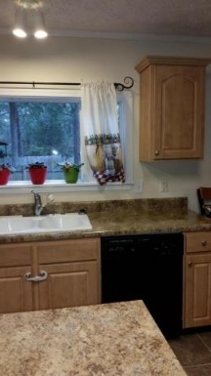
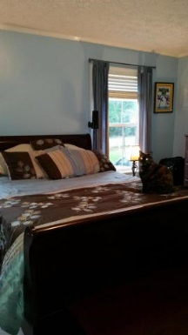

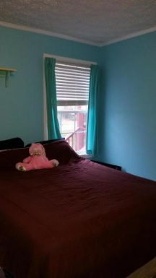
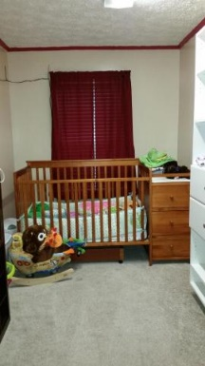


A Wonderful Place to Live
Brokers’ Open House Thursday, Jan 28th, 11-1
Gas Card Drawing
1925 Old Parsonage Road
West Ashley ~ Charleston, SC 29414 ~ MLS# 16000601 ~ $190,000
Beautiful, well-appointed home with screened front porch, a back porch and fenced back yard. Walk into a spacious, clean living with a fireplace. The large eat-in kitchen has all appliances, lots of cabinet space and an island. The master bedroom is separate from the secondary bedrooms with a closet large enough to use as a nursery. Bath has garden tub, separate shower and cabinets. On the other side of the living space are colorfully painted rooms that will allow you to express your creative side. Separate laundry room, lots of closet/storage space.
Susan Woodworth Kraber
Mobile - (843) 779-9655
susankraber1@gmail.com
ERA Wilder Realty, 125-F Wappoo Creek Dr, Charleston, SC 29412

