Slide 1
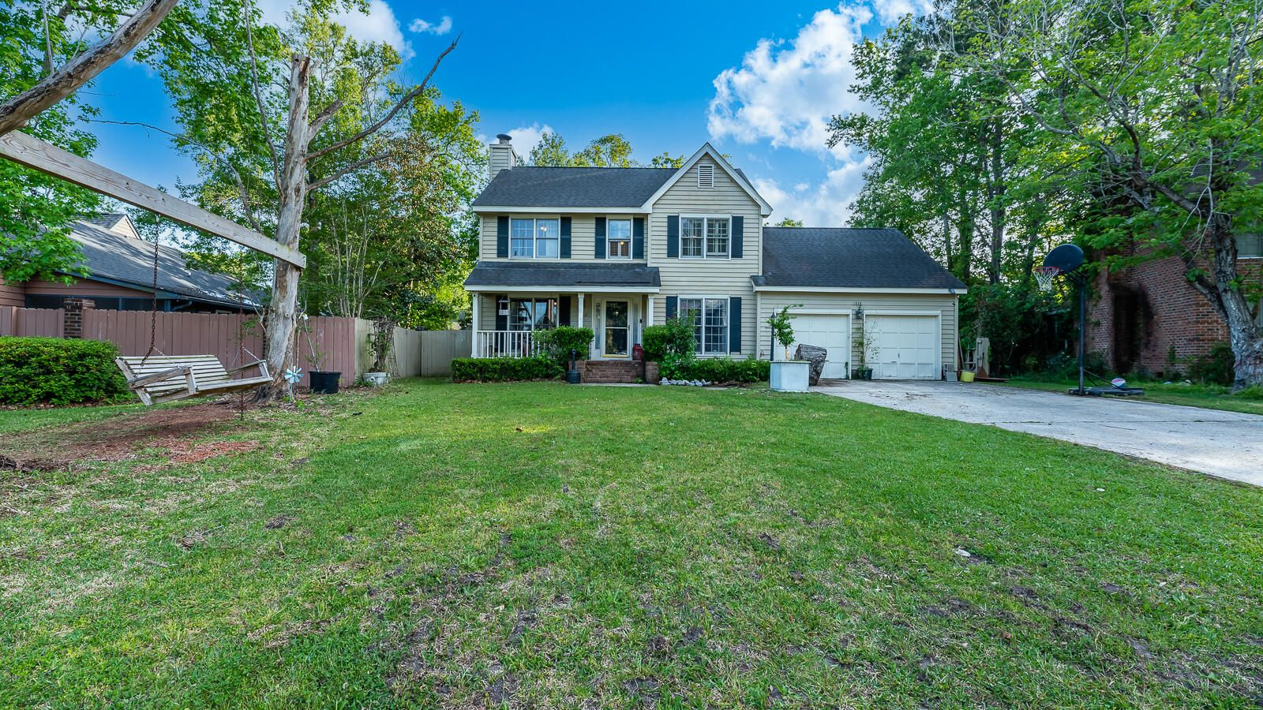
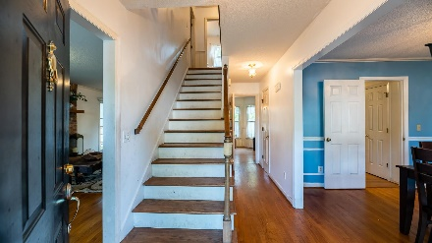
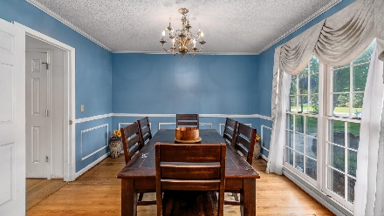
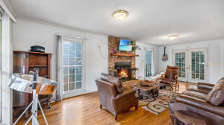
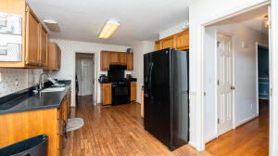
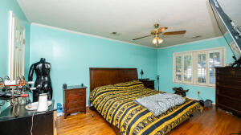
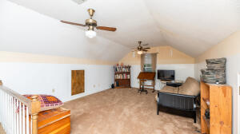
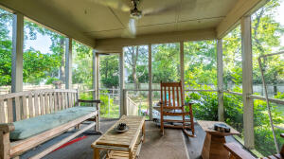
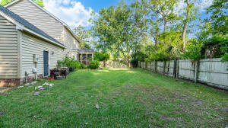



1926 Sandcroft Drive
Rice Hollow | Charleston, SC 29407 | MLS# 22010884 | $430,000
GREAT INVESTMENT OPPORTUNITY IN WEST ASHLEY
Welcome to 1926 Sandcroft Drive! This home located in the Rice Hollow subdivision in the heart of West Ashley. Conveniently located, close to shopping, hospitals, restaurants and parks. Downtown Charleston and beaches are only a short commute! This home has 3 bedrooms 2.5 baths plus a loft that can be used as a 4th bedroom, game room or office! On the first floor you will be greeted with a spacious living room, dining area, and kitchen. There is also a screened in porch. All bedrooms are located upstairs. This home has great potential and ready for a new buyer!
Ashley Wright
843-605-7205
ashleywrightrealestate@gmail.com
Excel Real Estate
4975 Lacross Rd. Ste 355
N Charleston, SC 29406
ashleywright.excelrealestatesc.com

