Slide 1
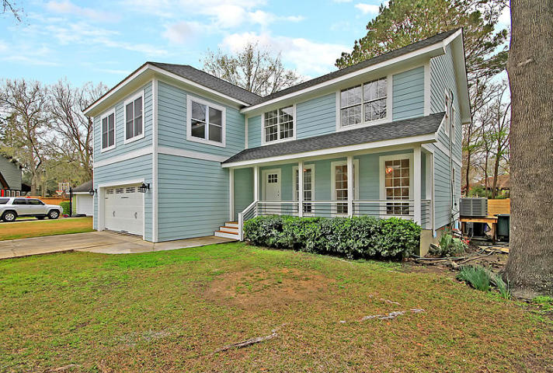
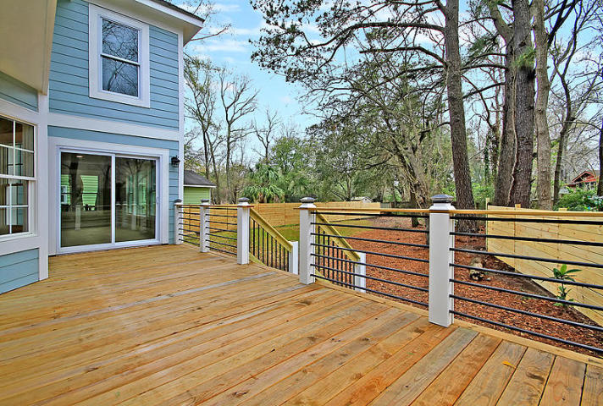
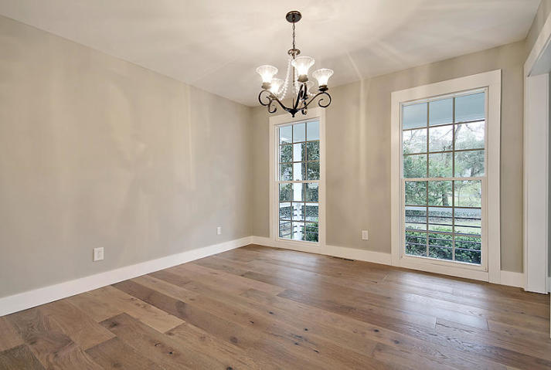
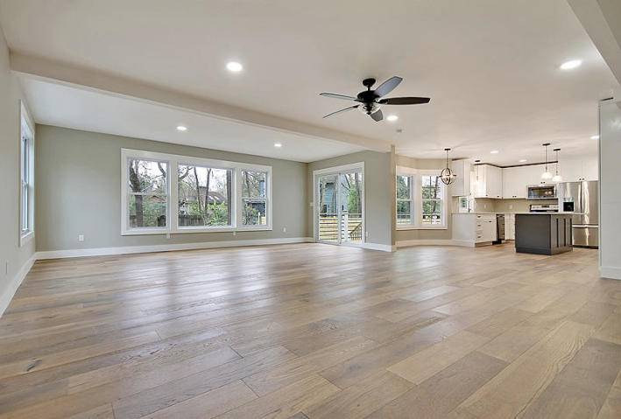
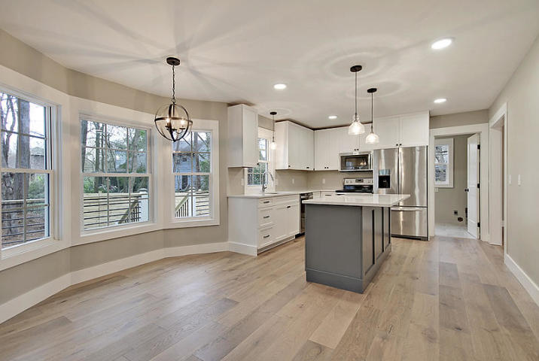
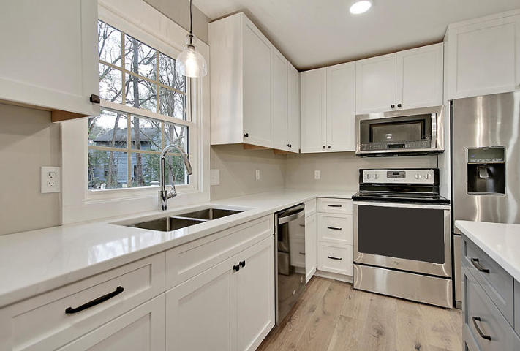
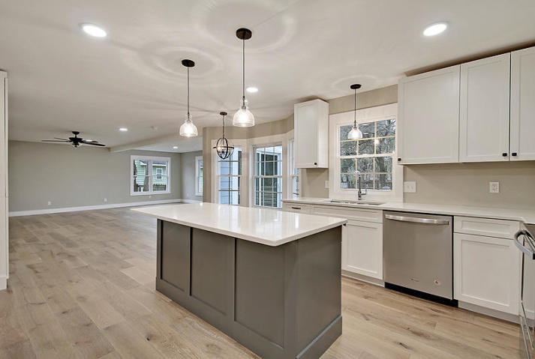
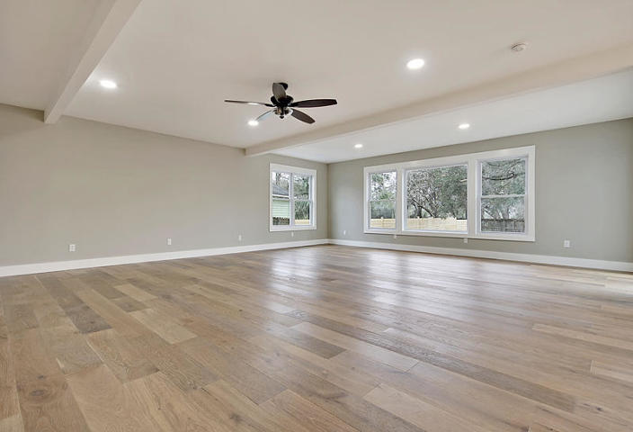
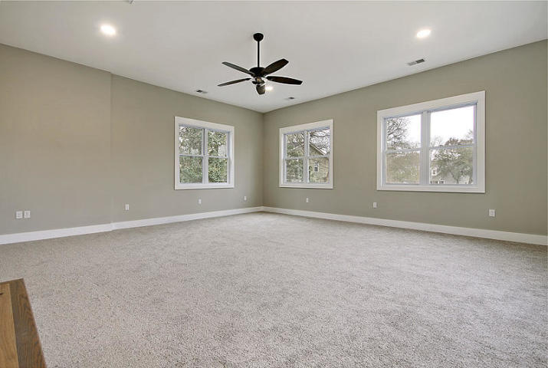
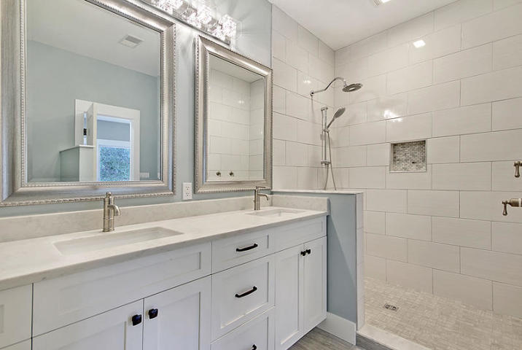
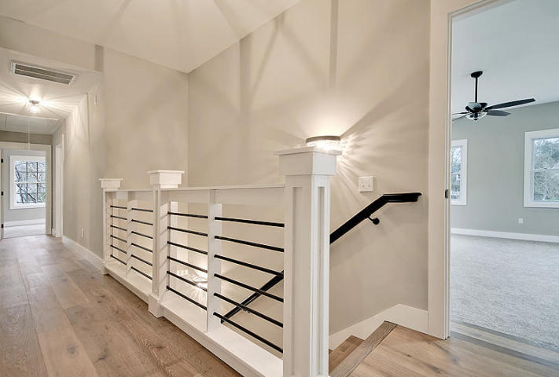
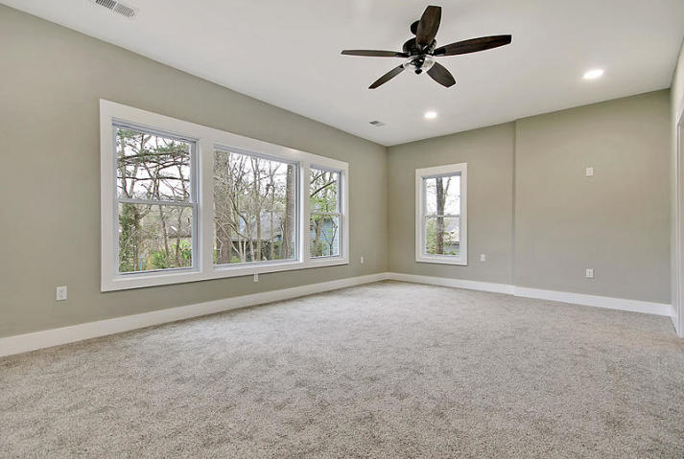
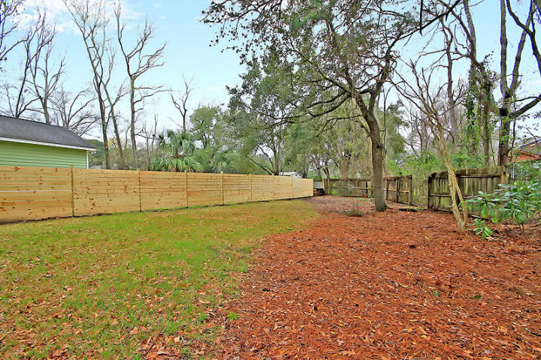
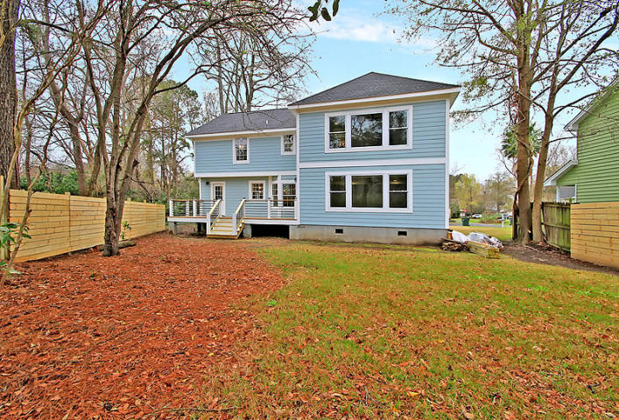


Open House ~ Saturday 6/8 from 1 to 4
Hosted by Terri Suiter | 843-343-3436 | terrisuiter@kw.com
Buy.......Build.....Begin
1928 Madagascar Court
Charleston, SC 29407 | MLS# 19007584 | $545,000
We are proud to present this wonderfully redesigned and renovated home containing 4 bedrooms, 3.5 bathrooms, an open floor plan all in 3085 Square Feet of fantastic space. The home at 1928 Madagascar Court was built in 1986 on a quiet cul-de-sac in Rice Hollow. The lot backs up to a marsh near Ashley Hall Plantation Road. The home had a small Finished Room Over the Garage (FROG), a step-down family room and vaulted ceiling leading to an outdoor screened porch. My clients brought the home out of the 1980's by rebuilding the downstairs structure and extending the conditioned space out and up. Approximately 900 square feet were added by enlarging the downstairs family room, a large second master suite upstairs with 9' ceiling, and dramatically increased the size of the FROG which now has a 10' ceiling.
If you are looking for very large rooms, open space, great natural lighting, a custom kitchen built for the best gourmet, large master suite, a second master upstairs, a large Room over the Garage that could easily turned into a Theater, a quiet cul du sac setting backing up to the marsh, a family of hawks nesting in the trees in the back yard, lots of song birds and nature all nestled in Rice Hollow Subdivision then this is your new home. Seeing is believing so take a moment and investigate your new home.
Bob Ramella, Broker
CRS, CDPE, RCC, e-Pro
(843) 330-8300
bob@bobramella.com | bobramella.kw.com
Keller Williams Realty Charleston | 496 Bramson Ct Ste 200 | Mt. Pleasant, SC 29464

