Slide 1
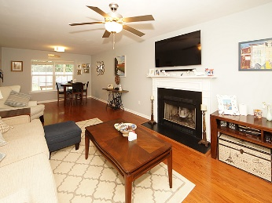
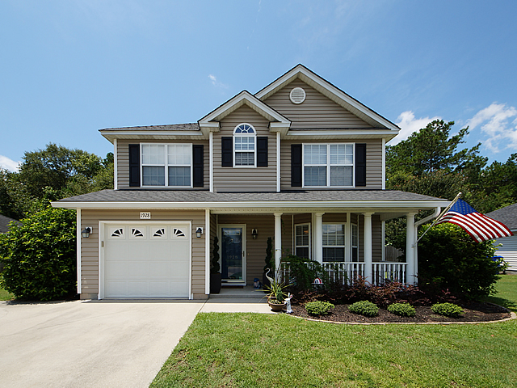
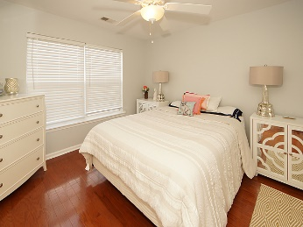
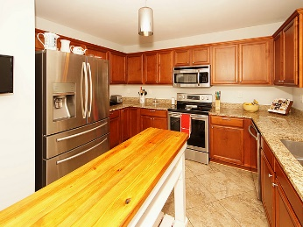
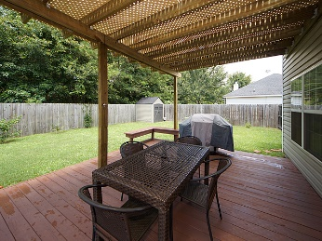
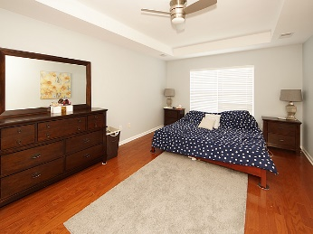
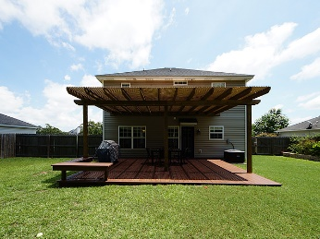
Lovely Johns Island Home Ideal For Entertaining
1928 Staffwood Road
Staffordshire ~ MLS# 17020504 ~ $275,000
Lovely 3 bedroom 2.5 bath in a convenient neighborhood on Johns Island. This home has many upgrades including wood floors throughout except in the bathrooms & kitchen, granite counter tops and stainless appliances. The kitchen is fabulous, a large eat in area and the island conveys as well as new high end refrigerator (with an acceptable offer). There is a separate dining area and the large family room downstairs. Upstairs you will find a large master with a tray ceiling & a large walk in closet. The master features a garden tub and separate shower. The two secondary bedrooms are good sized, one comes with a projector & big screen that will convey. The backyard has a large patio with a lattice roof to keep the sun off of you. It has a privacy fence and is great for BBQ's.
Mike Goldston, Realtor
mikesellscharleston@gmail.com | 843-343-7026 | www.cometocharlestonsc.com
Brand Name Real Estate | 4 Carriage Lane, Suite 106 | Charleston, SC 29407

