Slide 1
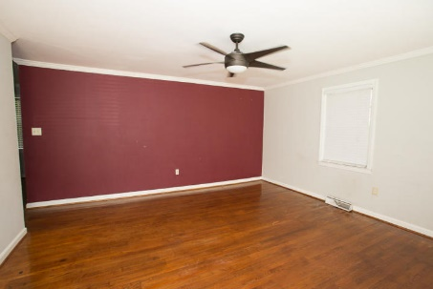
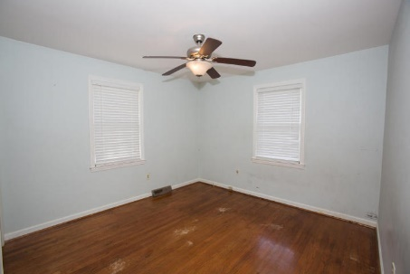
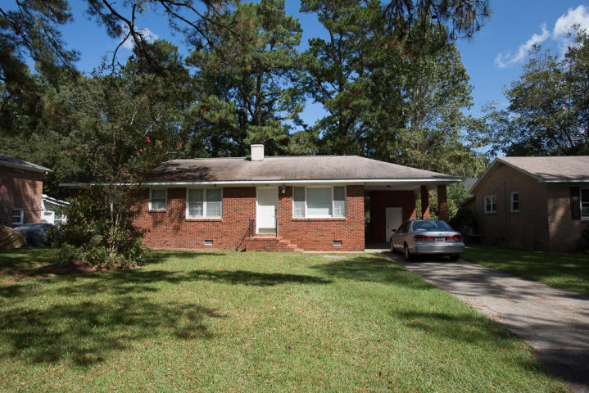
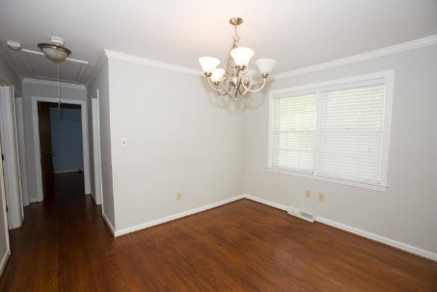
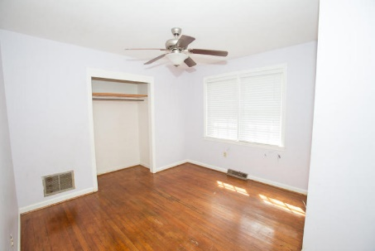
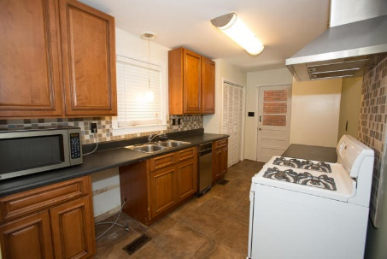
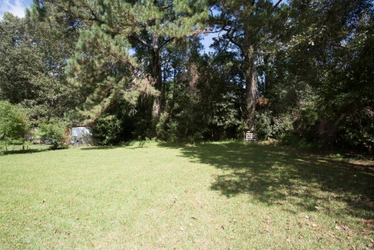


Must See! Great Location!
1928 Teakwood Road
Beechurst · Charleston
MLS# 17026955 · $189,000
Great location!!
3 bedroom, 1.5 bath brick home in West Ashley.
Hardwood floors throughout.
Updated kitchen with tile flooring.
Fenced in back yard.
Great starter home or investment property.
X flood zone.
Michael Dew
O (843) 870-7000
M (843) 870-7000
michaeledew@gmail.com
www.michaeldewrealestate.com
AgentOwned Charleston Group
902 Savannah Hwy
Charleston, SC 29407
Real Estate ● Mortgage
Insurance ● Business Brokerage

