Slide 1

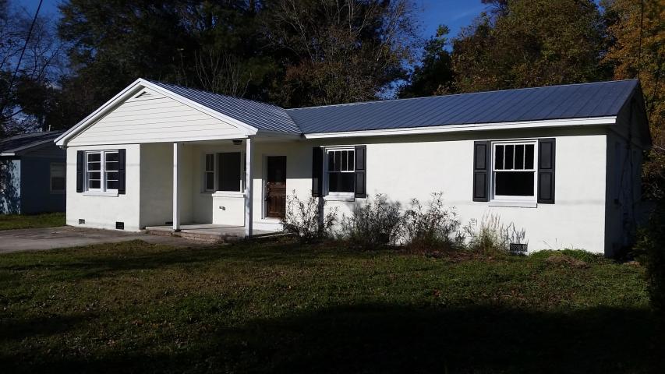
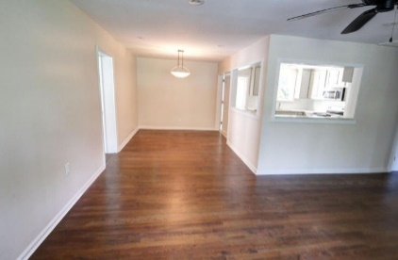
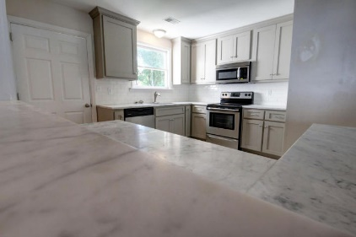
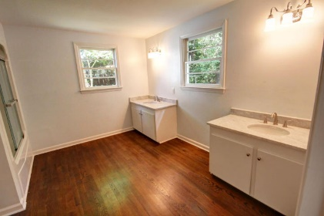
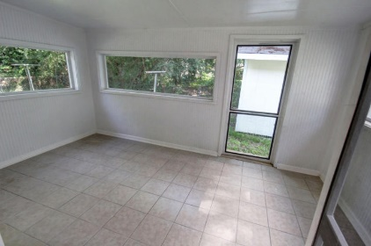

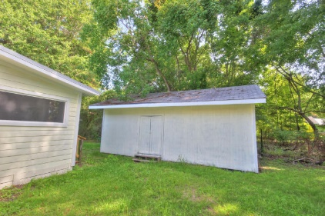
1928 2nd Drive
St. Andrews Heights
Charleston
MLS# 15016457
$253,900
4 Bedrooms
2 Bathrooms
1,991 Sq Ft
3% Commission + 1% Bonus
Only 4½ miles to
Downtown Charleston!
Just Reduced 10k!
Only 4½ miles to Downtown Charleston!
This professional renovation is NOW COMPLETE and provides for low maintenance living since it now has:
* NEW metal roof
* NEW stucco covered mason wall
* NEW 200 amp electrical service and new fixtures
* NEW HVAC and ductwork
* NEW plumbing
* NEW locally hand-crafted custom cabinets
* NEW Carrera marble counter tops and custom tile backsplash
* NEW stainless steel appliances
* NEW wood floors
* NEW interior and exterior paint and more!
It also has a rear screen porch that is 10' x 16' and a detached shed that is approximately 14' x 36' (buyer to confirm).
You can't beat the location, as it's moments to Downtown Charleston, major shopping and I-526.
Schedule your appointment today!
Meg Hopkins Kandik
Cell - 843-814-5137
meg@holycityre.com
*3% commission+1% bonus with BIC approval for ratified contract on or before 12/31/15

