Slide 1
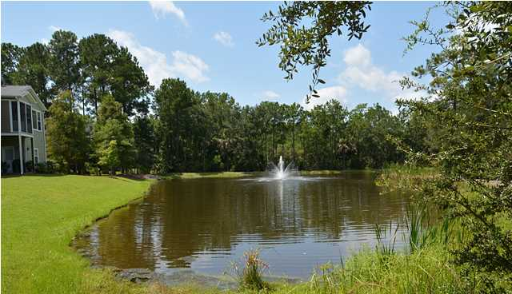
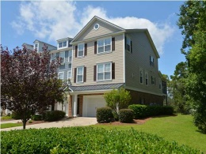
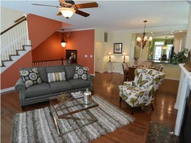
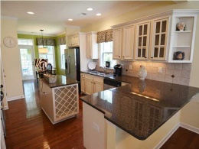
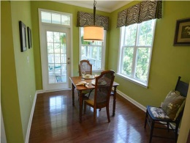
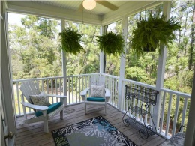
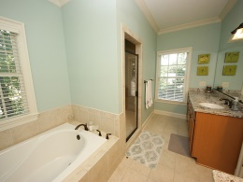
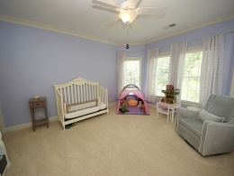
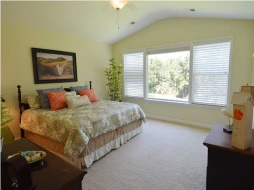
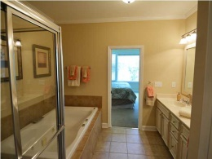
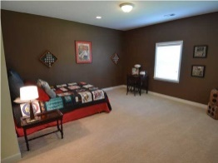
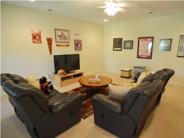
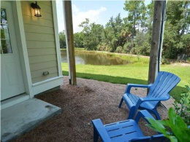


Just Reduced!
Now $370,000!
192 Fair Sailing Rd
Dunes West - Mt Pleasant
MLS# 1422485
3200 SF behind The Gates at Dunes West for $118/SF. This beautiful end unit town home lives like a home but require no exterior maintenance! Privacy of wetlands and lagoon view make it a picture perfect setting. The home was tastefully upgraded throughout including a security system, designer lighting, and custom paint colors. You can enjoy one floor living with the MBR, kitchen, DR, LR, laundry and screen porch- ALL on the main level. PLUS - Spacious MOTHER IN LAW suite or Bonus Room with private entrance on Ground Level. Upstairs two large bedrooms that share a bath, second laundry room and a 3rd living space. Comfortable elegance describes this home. Plus - enjoy the great amenities that Dunes West offers.
Geri Lipps
843-810-8398
glipps@carolinaone.com

