Slide 1
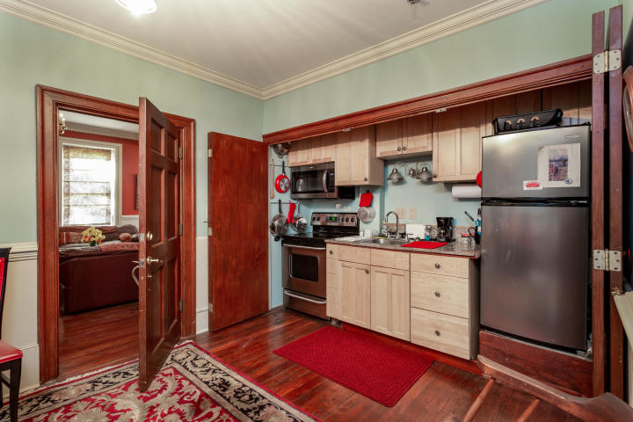
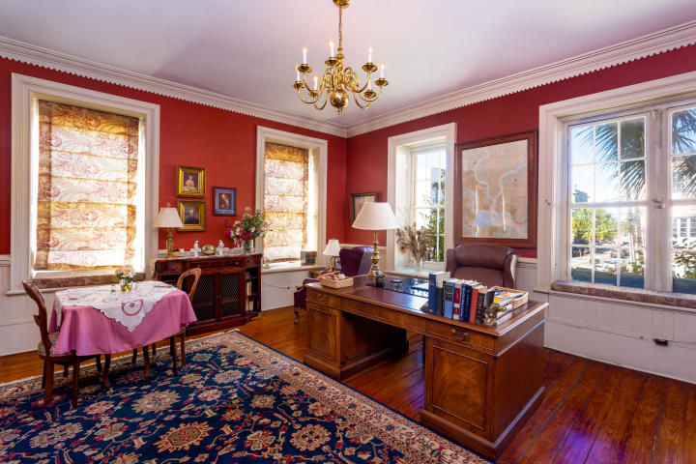
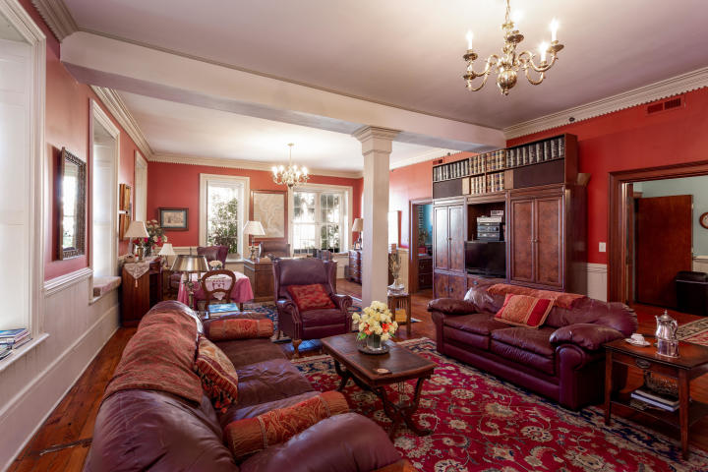
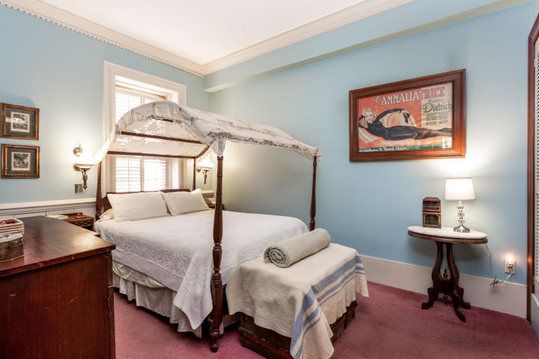
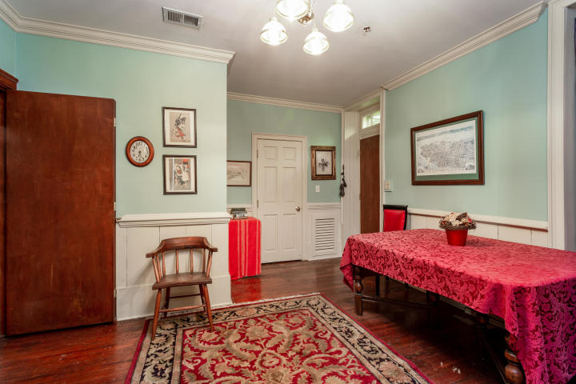
Furnished Downtown Rental
192 E Bay Street #201
French Quarter ~ Charleston, SC 29401 ~ MLS# 19019465 ~ $3,500
A perfect example of Southern Charm situated in the heart of Old Historic Charleston, this fully-furnished one bedroom, one bath condo is two blocks from the City Market, Waterfront Park, and some of Charleston's best dining and shopping. Recently renovated, this exquisite condo boasts 10 foot ceilings, heart pine floors, a large 35 foot living room bathed with light, leather couches, antiques, oriental rugs, fireplace, antique canopy bed, large shower, and separate office with Partners Desk. 192 East Bay has everything you'd expect from a historic Charleston address complimented by modern conveniences. Come see what it's like to reside in the heart of America's most historic city!
Christie Fowler 843-810-9263
christiemfowler@gmail.com
Old Dominion, REALTORS · 890 Johnnie Dodds Blvd · Mt Pleasant, SC 29464

