Slide 1
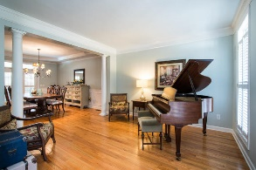
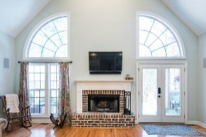
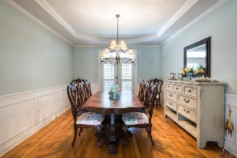
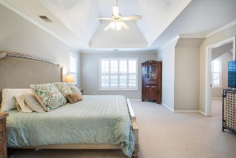
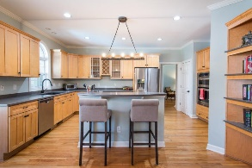
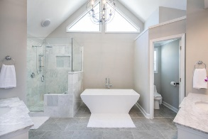
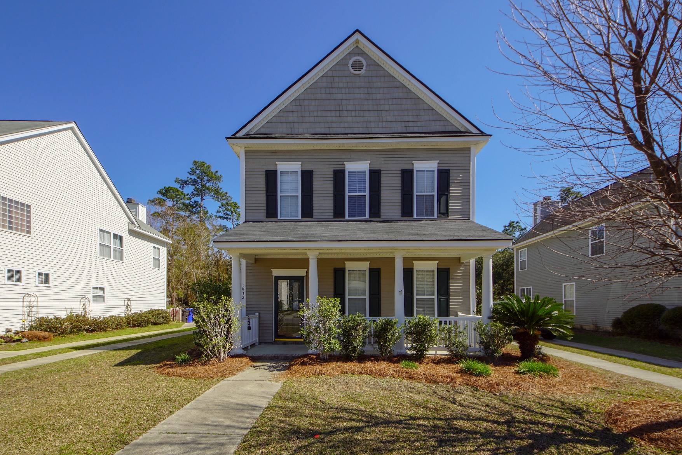
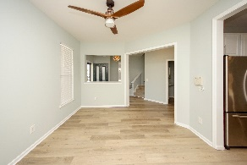
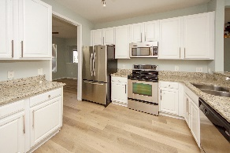
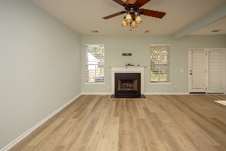
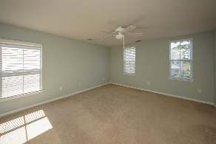
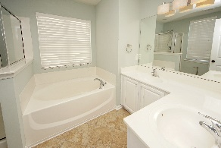
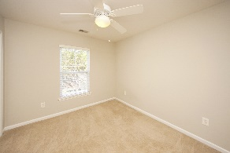
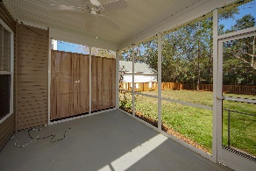
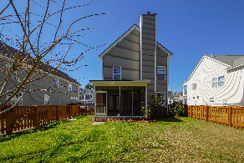
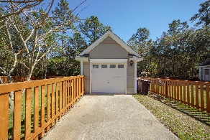


1932 Hubbell Drive Park West ~ Mount Pleasant ~ MLS# 19006818 ~ $340,000
JUST REDUCED!
Rent to Own!
Gorgeous home with upgrades galore! NEW roof, NEW fence, NEW laminate flooring throughout the 1st floor, and FRESH paint! Nice hallway entrance with the formal dining room to the right and built-in seated bench on the left. Eat-in kitchen includes granite countertop, stainless steel appliances, including refrigerator, and an area for barstool seating. Spacious living room has a wood burning fireplace and lots of natural light! Step outside onto your private screen porch overlooking the .28 acre yard. Nobody will build behind you, this home backs up to a peaceful and quiet wetland/wooded area. Fresh paint throughout the downstairs. All three bedrooms are located upstairs. Master bedroom is oversized. Master bathroom has a dual vanity with soaking tub and separate stand up shower. 1 car detached GARAGE included! You will be impressed! Move in today and start enjoying all that Park West has to offer including two community pools, tennis courts, play areas and endless walking trails. The Village subsection has its own play park and crabbing dock. Park West schools and shops are located inside the development, no need to leave!
Cathy Sembower 843-259-1350
csembower@carolinaone.com www.cathysembower.com
Carolina One Real Estate
195 W Coleman Blvd
Mt Pleasant, SC 29464-3495

