Slide 1
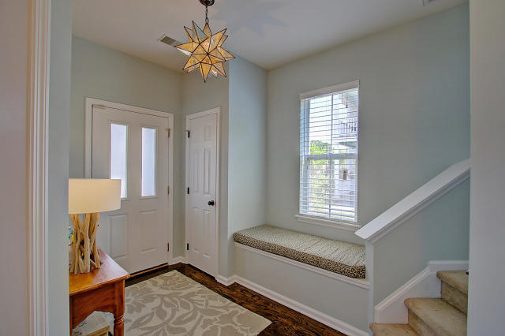
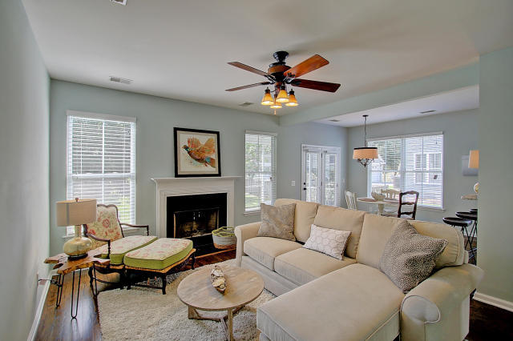
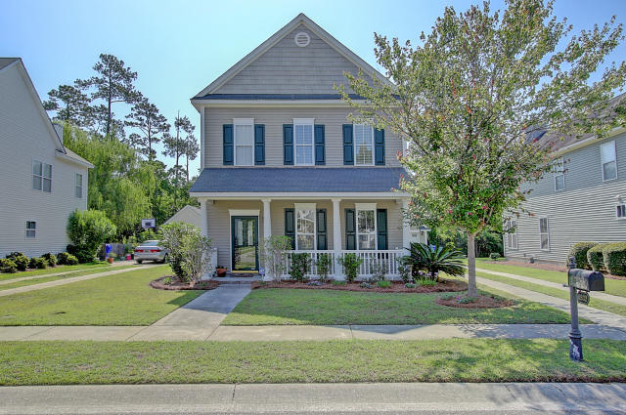
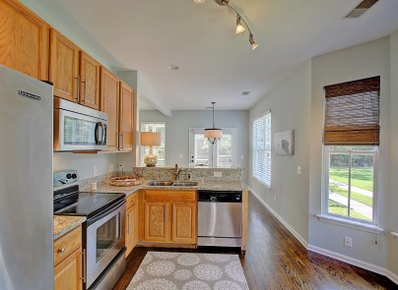
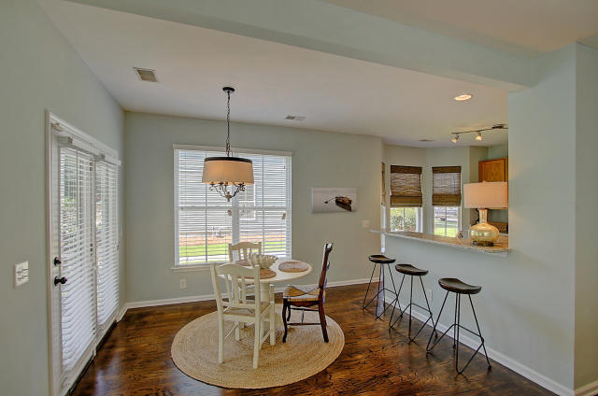
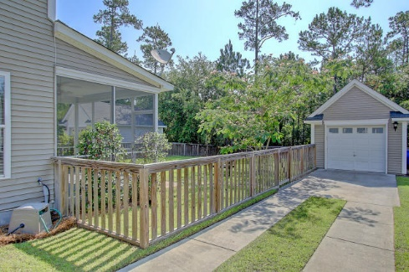


1932 Hubbell Drive Park West Mount Pleasant, SC 29466 MLS# 16014839 $339,000
JUST REDUCED! This won't last long!
Move-In Ready Village in Park West
Move-In Ready Village in Park West
Charming home on a great lot, fenced in with views of the wetlands. You will enjoy the front porch, screen porch, hardwood floors and detached garage.
This move-in ready home has recently seen new interior paint, stainless steel appliances, granite, hardware, and more.
Neighborhood offers a Play Park, Pool and Crab Dock. This well cared for home in The Village at Park West is ready to enjoy by the new owner.
Darlene Smith Office - (843) 886-8110
Mobile - (843) 696-7824
darlenesmith@carolinaone.com
DarleneSmithTeam.com
Carolina One Real Estate
1503 Palm Blvd Ste
Isle of Palms, SC 29451

