Slide 1
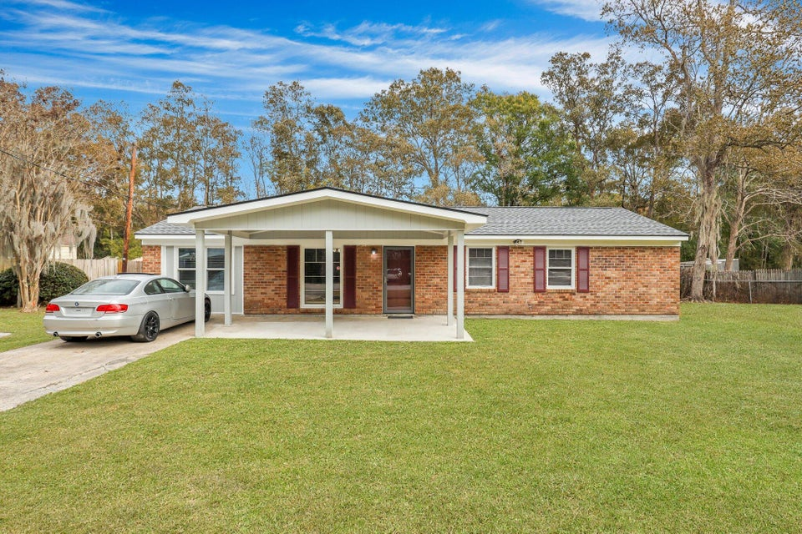
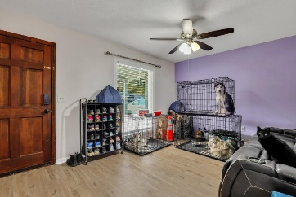
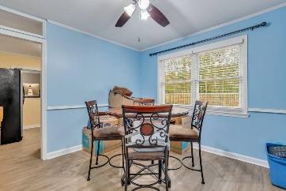
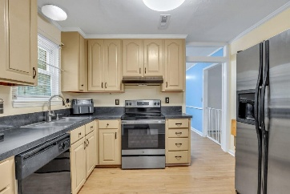
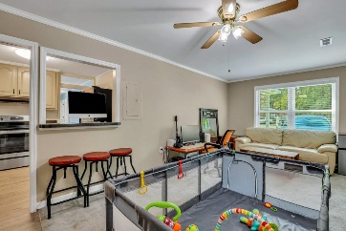
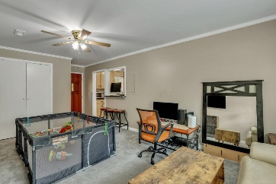
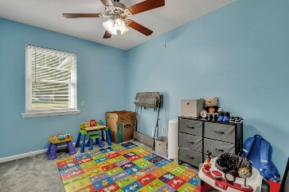
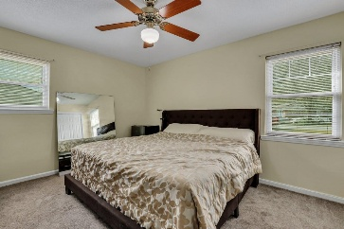
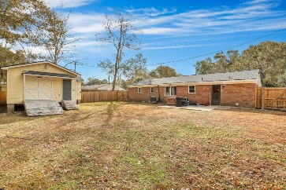
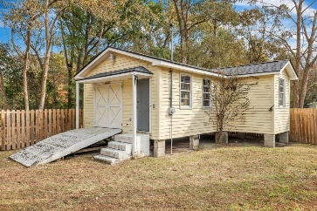
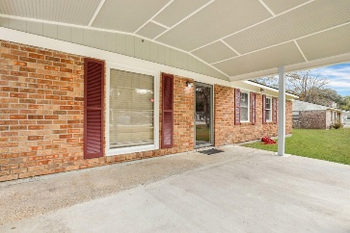



House Hack in West Ashley!
1932 Sunnyvale Avenue
Greenwood Park
Charleston, SC 29414
MLS# 24030442
$425,000
3 Bed | 1 Bath | 1,293 sf
NO HOA! Welcome to this beautifully renovated one-story brick home nestled in the sought-after Greenwood Park Subdivision of West Ashley. This charming three-bedroom residence boasts a host of updates, including brand-new kitchen cabinets, sleek countertops, and a modern kitchen floor. Additional enhancements include a freshly built front porch, cozy new carpet in the bedrooms, a stylish wood fence for added privacy, smooth ceilings, vinyl windows, and an enclosed garage. The property also features a carport and a separate Accessory Dwelling Unit (ADU)/Workshop with its own electrical meter, offering an incredible opportunity to transform it into a rental and generate additional income to help cover your mortgage. A perfect house-hacking opportunity in a prime location!
Nick Mazzilli 843-640-5575
nick@themazzilliteam.com
themazzilliteam.com
Maven Realty
2180 McMillan Ave
#71672
Charleston, SC 29405

