Slide 1
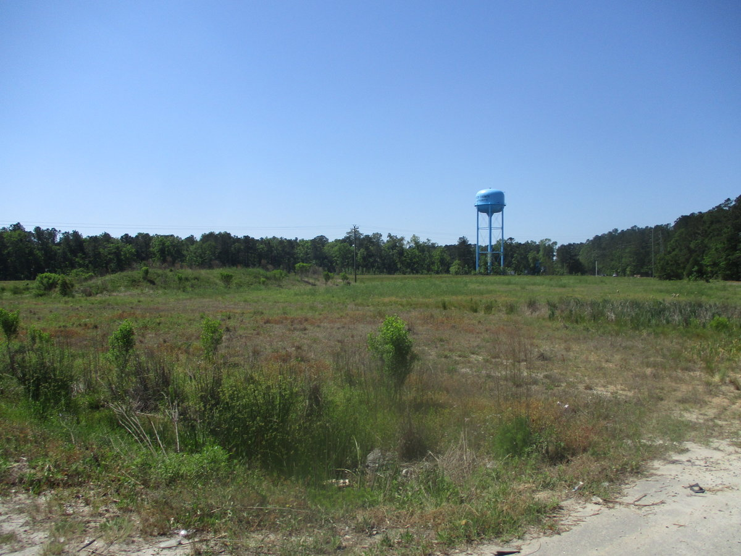
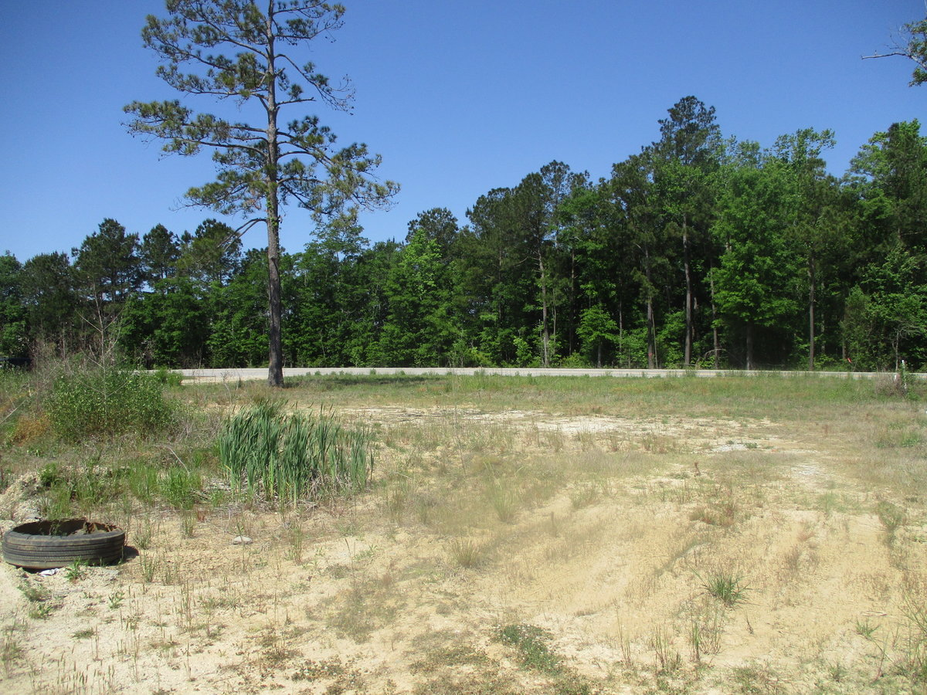
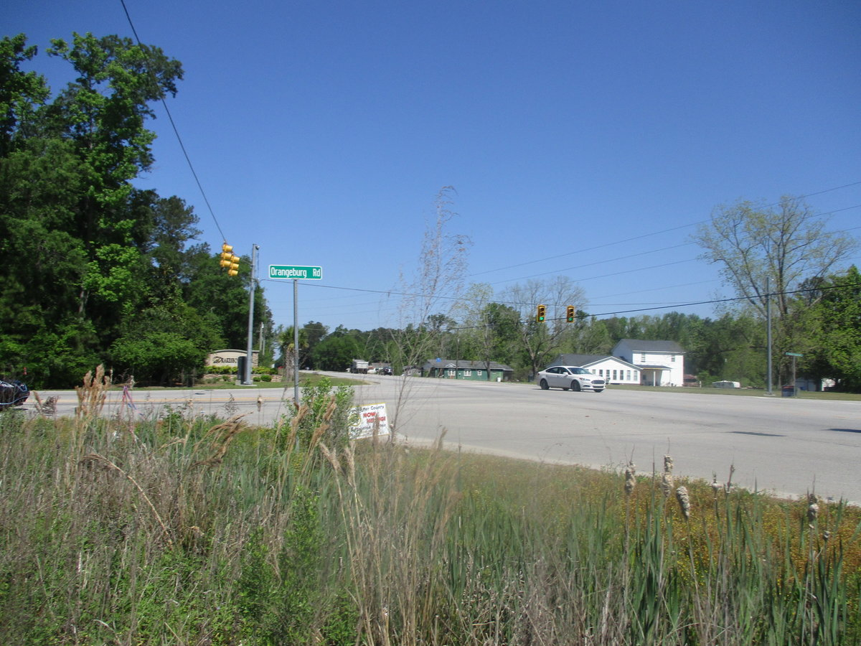
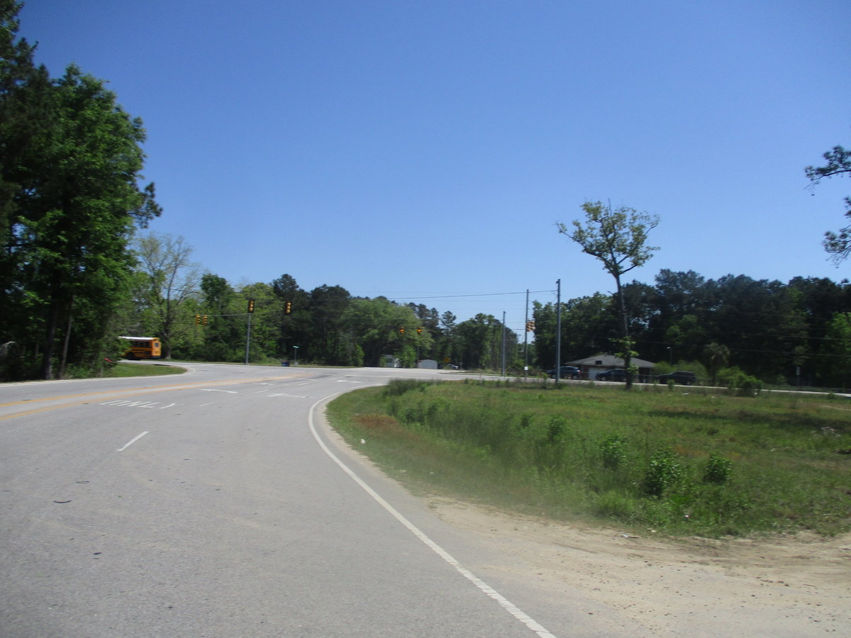
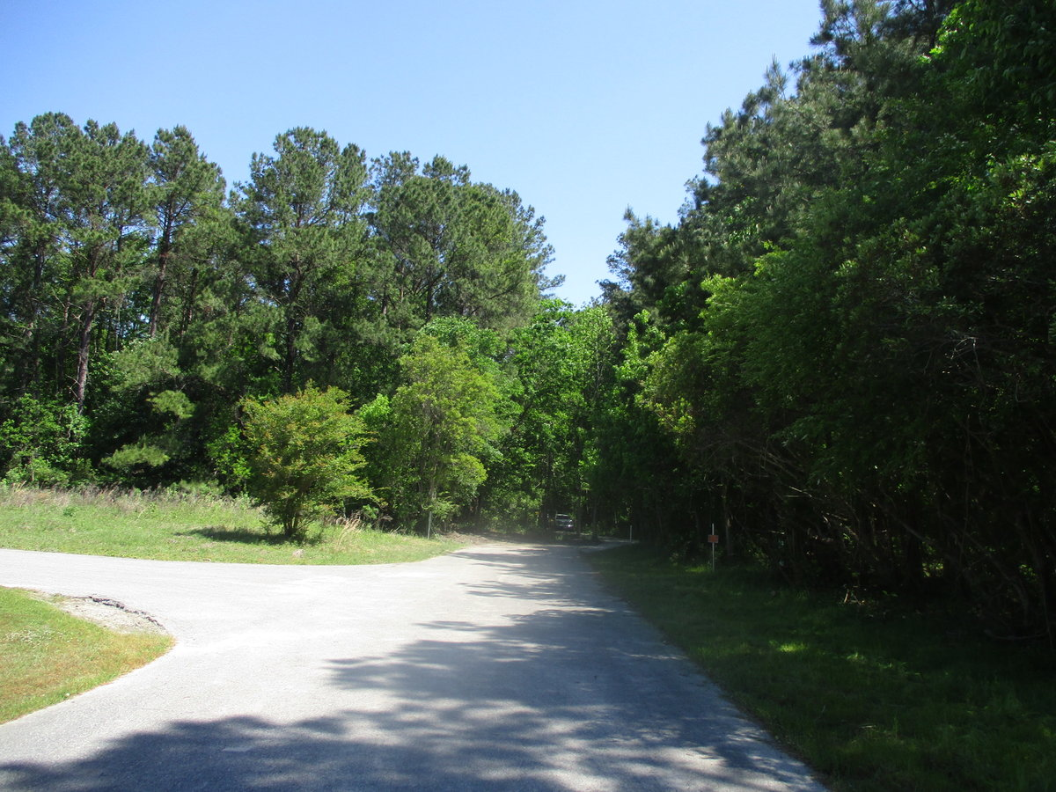
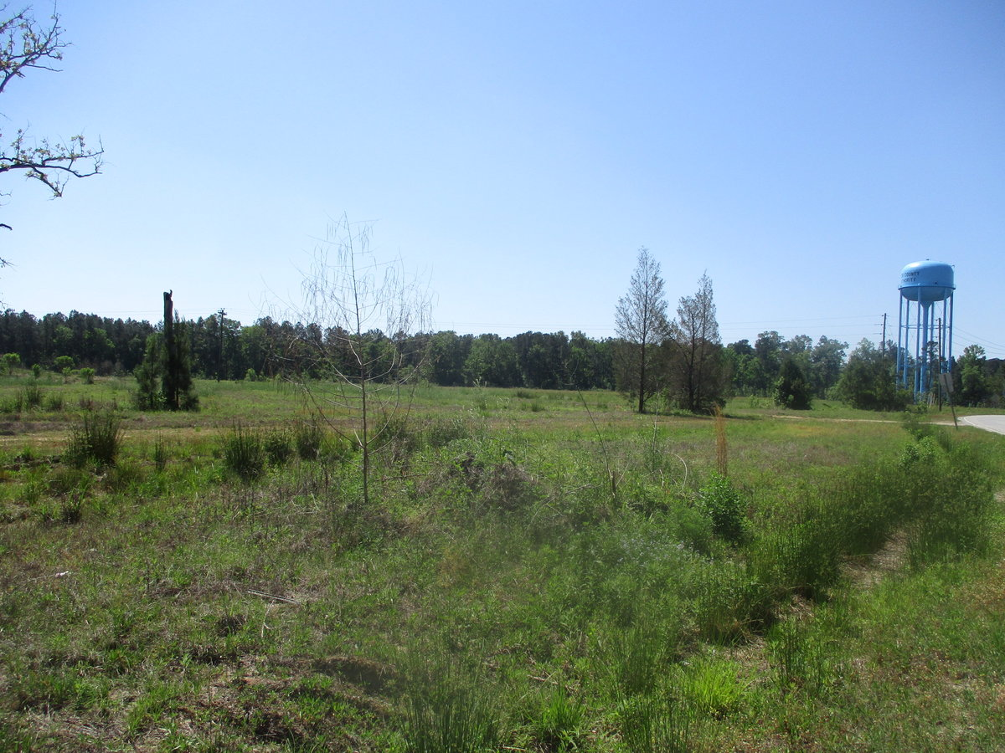
Commercial Land - Booming Area
1936 Orangeburg Rd / 3315 W 5th North St
Summerville SC
MLS# 30727859
$400,000
Located on the corner of Hwy 78 & Orangeburg Rd close to Drakesborough S/D, new Food Lion, Multi-Family is under contract behind this property, & is the main thoroughfare for anyone who works for Volvo & Walmart distribution center that takes this route everyday.
Charles Salmonsen
M (843) 224-0300 | O (843) 388-6613 | charles@salmonsen.com
Salmonsen Realty | 864 Lowcountry Blvd Ste B | Mt Pleasant, SC 29464

