Slide 1
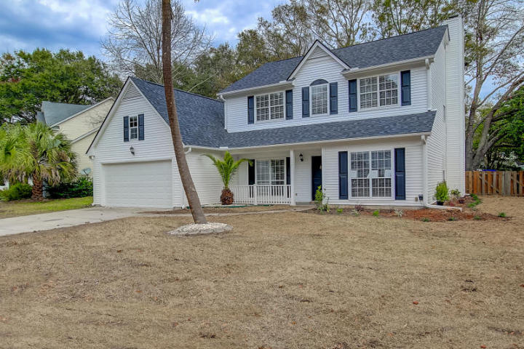
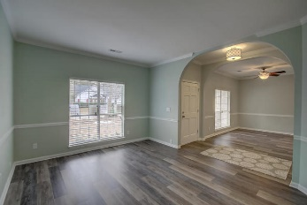
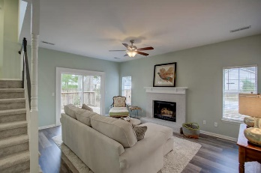
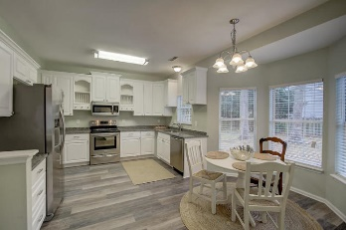
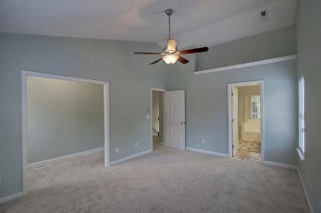
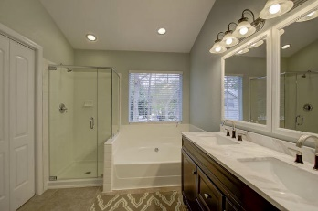
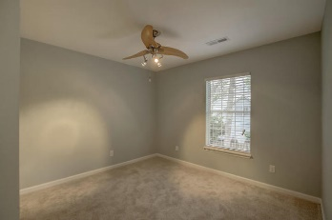
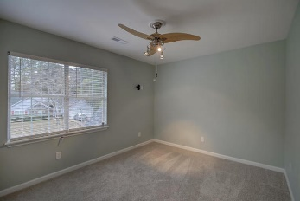
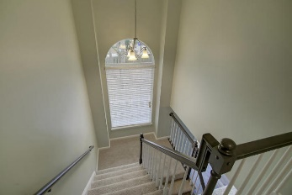
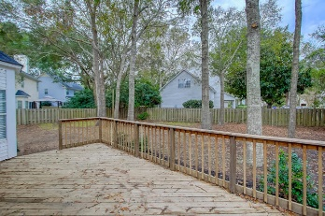
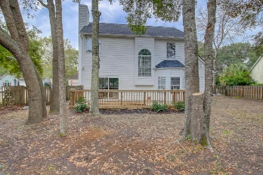

Why Buy New When You Get Move-In Ready
1937 Oak Tree Lane
Sweetgrass · Mt Pleasant, SC 29464 · MLS# 17000728 · $449,000
VERY DESIRABLE LOCATION!!
Why purchase new when you can get a move-in-ready home with a large corner lot, mature trees and a great location without waiting! This home has crown molding in the dining and living area. New LVT plank flooring. New stainless steel appliances. Granite counter tops. Smooth ceilings. New light fixtures. New carpeting upstairs. Renovated master bath with garden tub and separate shower. Huge master closet. Extra seating area or small office in the master suite. Renovated second bath with shower/tub. Large deck off the family room which has a wood burning fireplace. Large fenced in backyard. Nice garage with finished walls. New garage door and lift. New architectural shingles. This is a home you definitely need to put on your must see list.
RE/MAX Alliance
1200 Two Island Ct.
Ste. A
Mt. Pleasant, SC 29466
Ken Earnhardt
Office - (843) 352-7943
Mobile - (843) 343-3872
earnhardtken@gmail.com

