Slide 1
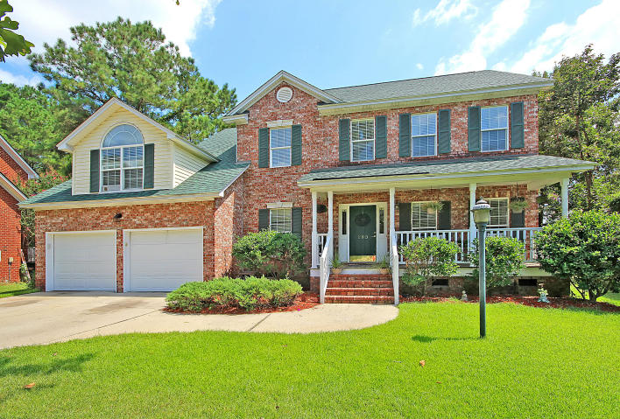
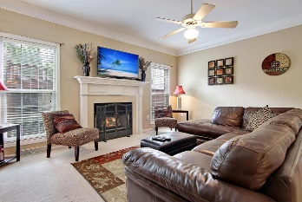
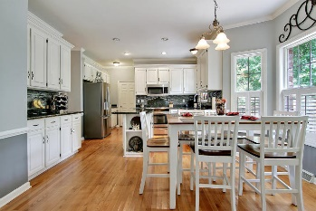
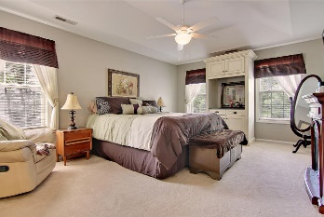
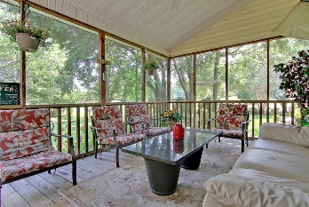
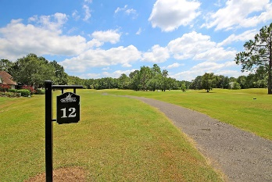


COME AND SEE THE SHOW!
193 Hamlet Circle
Crowfield Plantation
Goose Creek, SC 29445
MLS# 16023466
$321,900
A Stunning fully detached 2 story brick and vinyl home that is situated on a quiet tree-lined golf course lot and offers million dollar views of the golf course (11th Green and 12th Tee) and private pond. This Remarkable home offers 4 large bedrooms upstairs (FROG is considered the 4th bedroom) including the spacious master bedroom suite offering trey ceilings, a huge walk-in closet, master bathroom with double vanities, oversized separate shower and a large soaking tub. The main floor with a dramatic foyer (18Ft Ceiling) offers several large rooms with selected wood flooring and authentic crown molding, including the Charming Formal Dining Room with crafted wains coating, crown molding and valuable built-in cabinets, a private office with a Distinctive ceiling and crown molding, a large family room with a cozy fireplace, a modern family sized Eat-in Kitchen with quality granite counter tops and selected back splash, priceless kitchen cabinets, built-in stainless appliances and gorgeous wood floors. There is a private walkout to a popular screened porch and an awesome wood deck that is perfect for outside entertaining and cookouts. This Beautiful home is priced way below its true value. Bring your check book, the Line Forms Here! Age, sqft, taxes, acreage, schools are approximate buyer to verify any and all information deemed necessary.
Bill Everett, Jr
Broker
843-693-8539
Bill@TheEverettGroup.net
RE/MAX Pro Realty, 9209 University Blvd, Charleston, SC 29406

