Slide 1


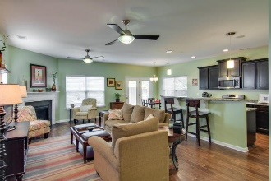
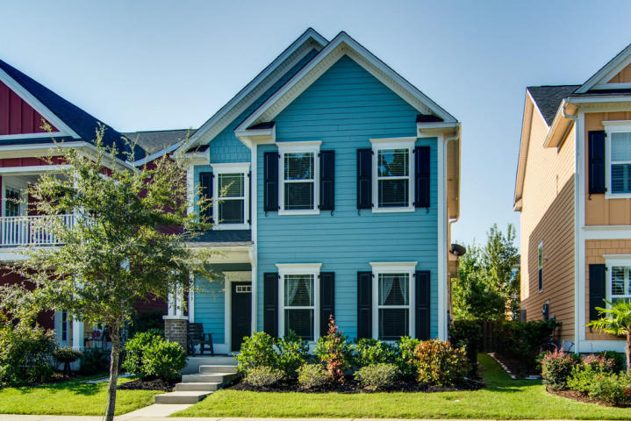
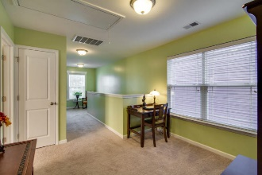
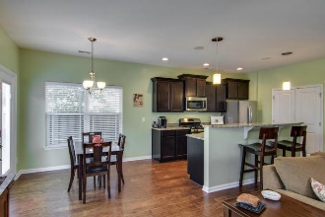
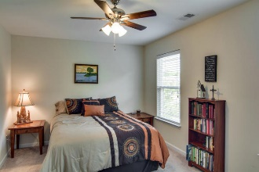
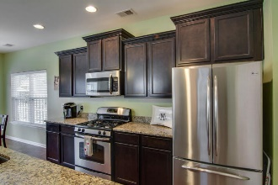
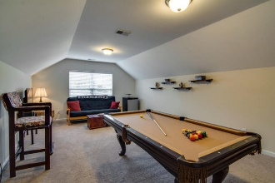
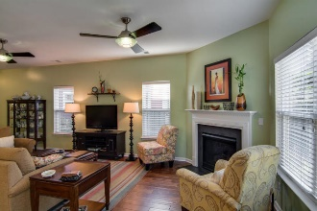
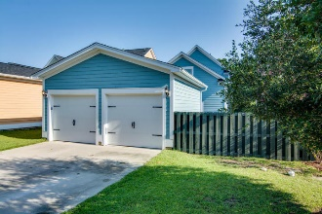
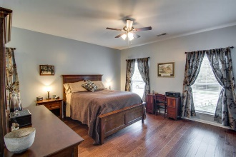
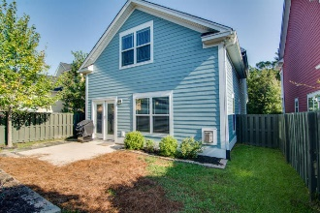
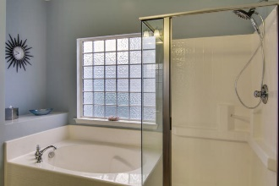
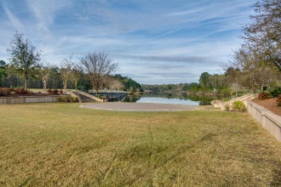

New listing in The Ponds! Better than a model!
193 Lotz Drive
The Ponds ~ Summerville
MLS# 16024324 ~ $289,900
Just Reduced!
Beautiful home in The Ponds!!! This home shows like a model! Master down, 2 bedrooms, a loft and a bonus room upstairs! From the moment you walk up to the porch, you will see the care that has been taken of this home. Enter the foyer to the gleaming hardwood floors which flow throughout the downstairs, including the large master bedroom. Half bath and laundry room are located off the hall. When you enter the living area to the spacious family room, which is open to the kitchen and eat-in area, you will feel right at home! Granite counters, stainless steel, staggered cabinets, pantry, a great kitchen for cooking with the family. Upstairs find 2 nice sized bedrooms a loft and a great bonus room for added living space. The yard is fenced. 2 car garage allows for parking your car, with plenty of room to park in the drive behind the garage. The Ponds is a desired neighborhood due to the walking trails, lake, clubhouse, pool, grand oak trees, a wonderful place to call home! Dorchester II schools. Younger kids will attend the new Sand Hill Elementary school. Call today to tour this beautiful home!
Laurie A Loparo, ABR
laurieloparo@gmail.com
lauriesellscharleston.com
Golden Bear Realty | 654 Coleman Blvd, Suite 100 | Mt Pleasant , SC 29464
Cell (843) 442-1290 | Office (855) 352-9088 | Fax (561) 721-3311

