Slide 1
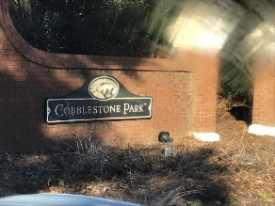
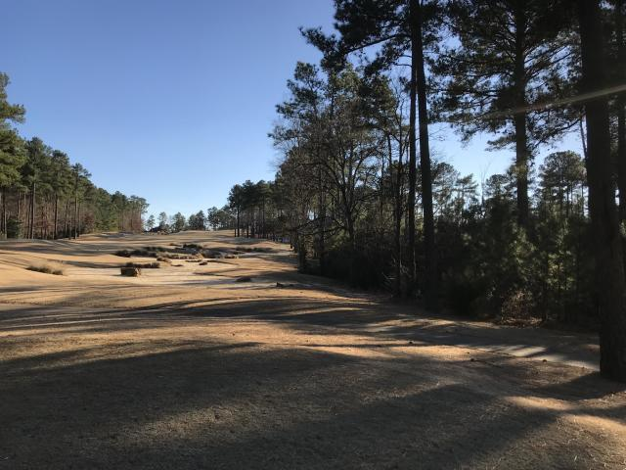
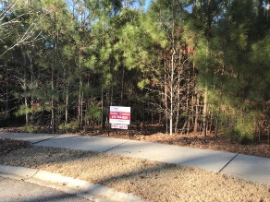
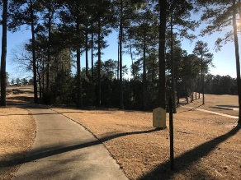
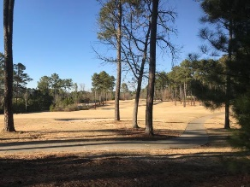
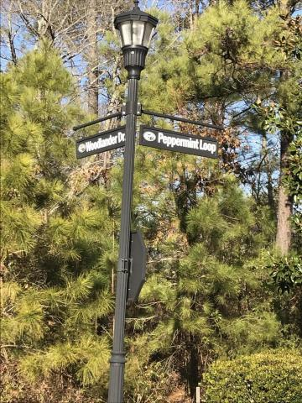
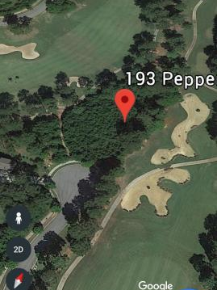
Terrific Golf Course Lot For Sale!
193 Peppermint Lane
Blythewood, SC 29016 | MLS# 18000800 | $32,000
One of the most desirable lots in Cobblestone Park!
Beautiful, private, large lot on cul-de-sac and on golf course near Hole #6 . Enjoy immense privacy since golf ranges prevent other homes from being built near this lot. Features long, unobstructed views of golf course. Great club amenities. Tax Map # 15204-03-17. Agent is owner.
Heather Coleman
heather@heathercolemansc.com | (843) 864-9054 | www.heathercolemansc.com
Brand Name Real Estate | 4 Carriage Lane, Suite 106 | Charleston, SC 29407

