Slide 1
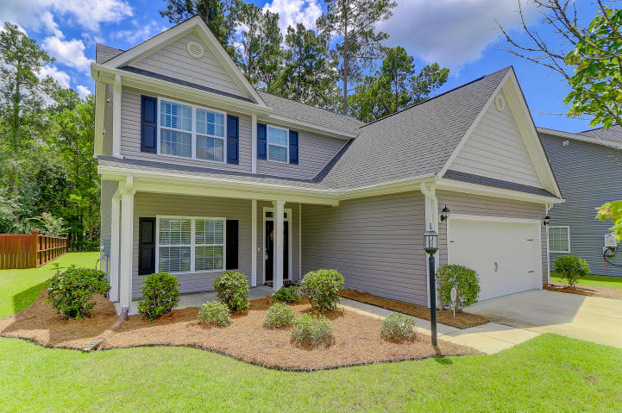
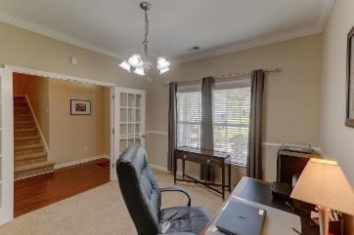
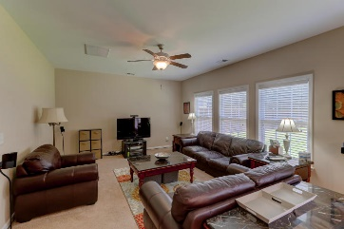
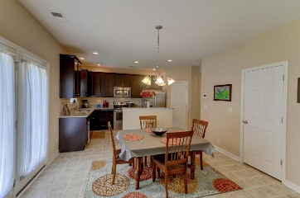
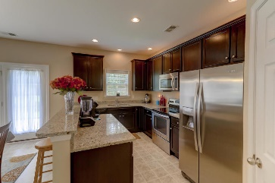
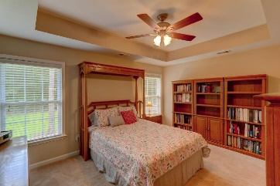
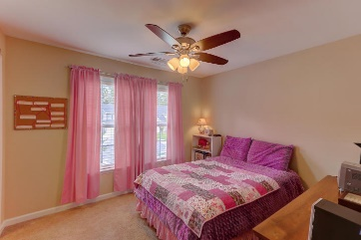
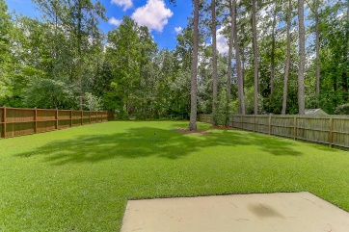
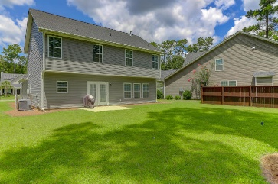


193 Withers Lane Bellwood ~ Ladson, SC 29456 MLS# 18022737 ~ $239,000
Perfect Condition
Huge Yard
Beautiful, like new Ashbury Plan located on a quiet cul-de-sac. This is a business 'Relocation' and the family will be sad to leave their lovely home. Enjoy the large, lush fenced back yard and manicured lawn. Enjoy the cool evenings on the front porch. This 2 story home features 4 nice sized bedrooms and 2.5 baths. Trey ceilings in the master with a large master bath. The spacious kitchen features stainless steel appliances, pantry and bar are opened to the family room. Tons of wonderful light stream through this home. You will feel right at home at 193 Withers Lane, Ladson, SC.
Darlene Smith Office - (843) 886-8110
Mobile - (843) 696-7824
darlenesmith@carolinaone.com
DarleneSmithRealEstate.com
Carolina One Real Estate
1503 Palm Blvd Ste
Isle of Palms, SC 29451

