Slide 1
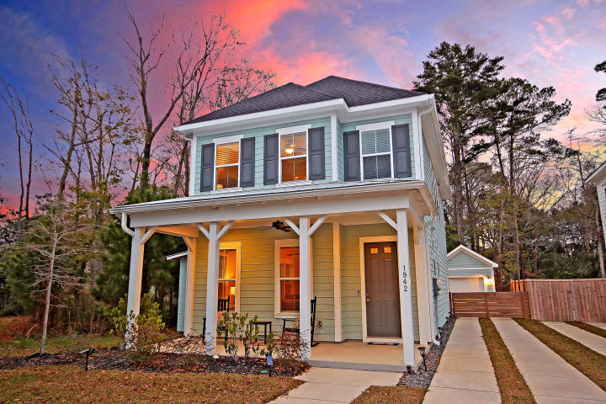
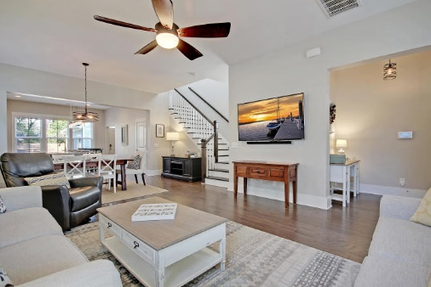
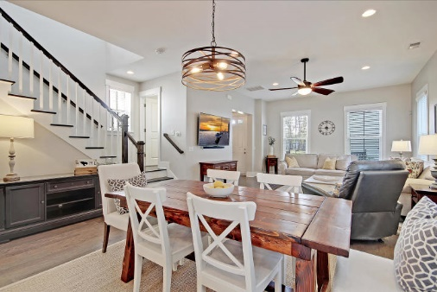


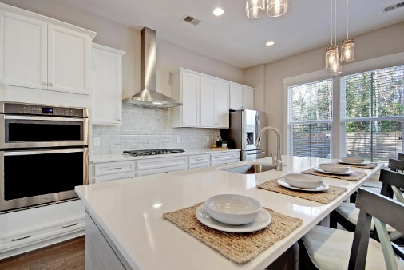

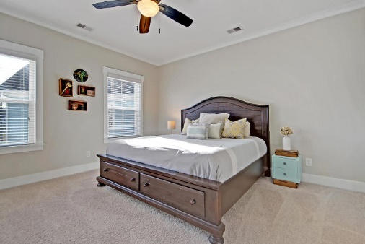
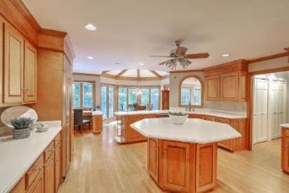

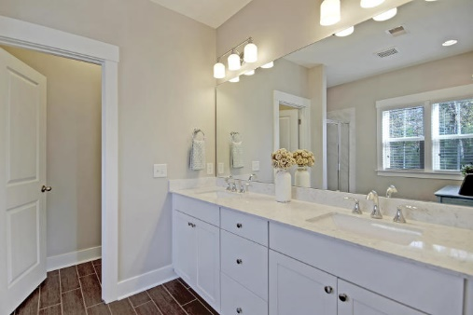


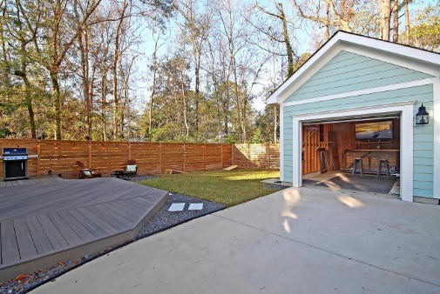

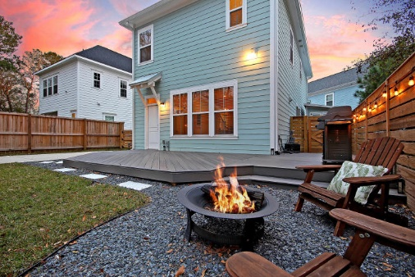
Parkshore Marshfront
Just Reduced!
Open House Saturday 1-4
1942 Fleming Woods Road
Fleming Park ~ Charleston, SC 29412 ~ MLS# 20002072 ~ $429,900
This gorgeous James Island home situated back on a peaceful wooded lot within the highly desirable Fleming Park Community looks like something straight out of a design magazine. No detail was spared when crafting this luxury home, built in 2017. Impeccably maintained, this home features beautiful upgrades such as quartz countertops, top of the line stainless steel appliances, and beautiful contemporary light fixtures. The open concept floor plan is perfect for entertaining. The first floor is light and airy with an open kitchen/living/dining floor plan and gorgeous hardwood floors. The gourmet kitchen is every chef's dream with built-in wall oven/microwave, gas cooktop, and a stunning custom tile backsplash. The large island with shiplap accents will be the hub of your gatherings!
Storage solutions come easy in this home! A large walk-in coat closet greets you at the back entrance. Off the kitchen, enjoy a spacious walk-in pantry with installed shelving, extended wrap-around space for larger items, and automatic lighting. All three spacious bedrooms are on the second floor. The master includes an oversized walk-in closet while the en suite features a double vanity with upgraded drawer storage. Each of the two guest rooms has considerable closet space and the guest bath has double wide cabinet storage below the vanity.
This home boasts a one of a kind outdoor space that sets it apart from nearby homes in the community. The backyard is a must see with a new custom wrap-around, low-maintenance composite deck, fire pit area, wooden privacy fence, and a detached garage - all surrounded by a lovely wooded view. A true private oasis that is perfect for entertaining your next get together or a quiet night in!
Some additional features of this home include: QEI security system with a smart programmable back door lock, interior lights, and doorbell (with video). Includes pre-installed motion sensor, front/back/garage door sensors, and window sensors on the first floor. The service can be transferred to the new owner for a minimal monthly fee. Keypad lock on the garage door. Full yard irrigation system. Full house gutters. Built-in pest control system, termite bait stations, and transferable termite bond.
The neighborhood has a massive green space with walking trails, playground, picnic space and dog park area with waste stations. Enjoy all the amenities of this community while still being only minutes to downtown! Less than 5 miles to the peninsula, approximately 2 miles to James Island County Park, and approximately 8 miles to Folly Beach. Approximately 16 miles to the airport and approximately 14 miles to Sullivans island.
Additional features include:
Move in ready!
Lovely, quiet neighborhood with walking trails, pergola, and playground.
Home has been meticulously maintained and features beautiful upgrades.
Tiled bathrooms and beautiful hardwood flooring throughout first floor.
Private backyard, surrounded by woods and enclosed with privacy fence, great for pets and children.
Detached garage that is perfect for extra storage, work out equipment, or use as a fantastic entertainment space!
Spacious open floor plan with amazing flow.
10 ft ceilings on the first floor and 9 ft ceilings on the second floor
Hurricane boards pre-drilled with all hardware and instructions included
In addition to the garage, there is also a custom built shed providing even more storage!
Great location close to beaches and downtown Charleston. Easy daily commute to MUSC.
Low-stress, move-in-ready living at its finest. Book your showing today!
David Clausen | 843-619-0405 | dclausen@mattoneillteam.com
Katie Wishneff | 843-870-8784 | kwishneff@mattoneillteam.com

