Slide 1
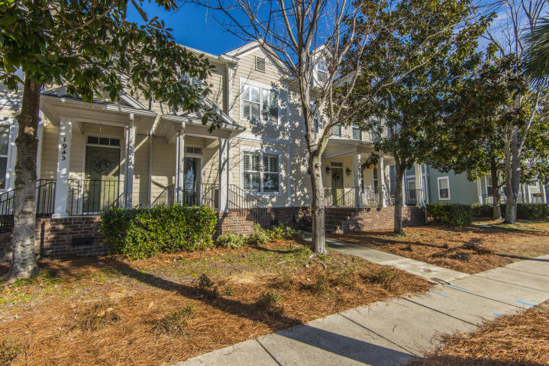
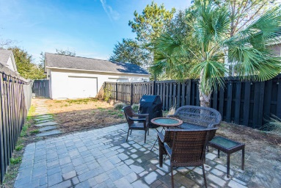
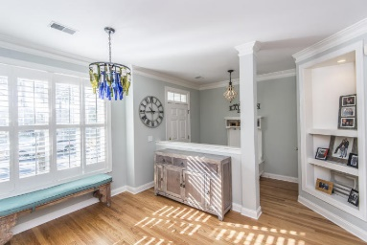
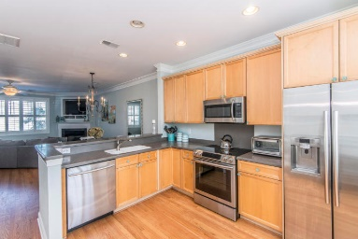
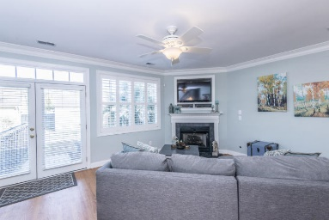
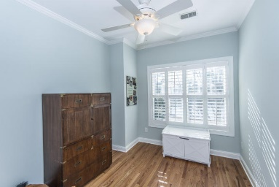
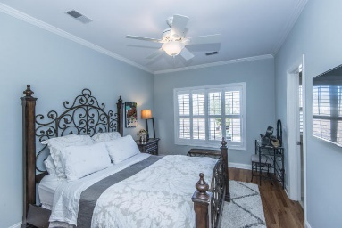
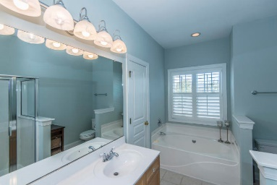
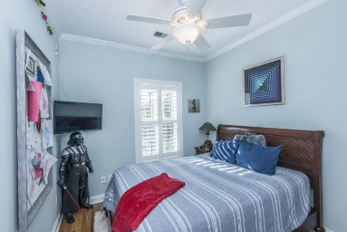
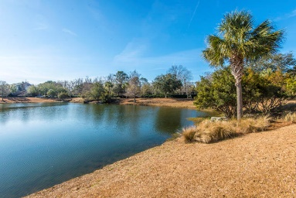


Agent Bonus & 6 Months Regime Paid
1943 Pierce Street
Daniel Island ~ Charleston
MLS# 18002197 ~ $399,900
Move in ready 2 story townhouse on Daniel Island ideally located across from pond and within walking distance to Pierce Park pool & pavilion. Home is recently painted with hardwood floors, built ins, upgraded lighting and plantation shutters throughout. Fully appointed eat in kitchen with raised breakfast bar, corian countertops and 2014 stainless steel appliances. Open floor plan offers separate dining area, and fireplace in family room. Master suite is upstairs with walk in closet and private bath featuring garden tub and walk in glass shower. 2 additional bedrooms upstairs share full bath. Courtyard out back with patio and surrounded by privacy fence. One car garage can be accessed from rear alley. Buyer will pay 6 months regime fee with acceptable offer!
Jennifer Frampton Pait
843-568-9509
jenniferfp@carolinaone.com

