Slide 1
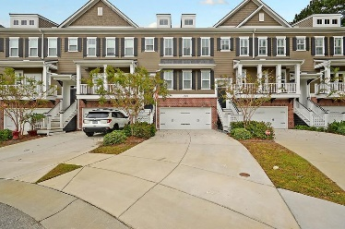
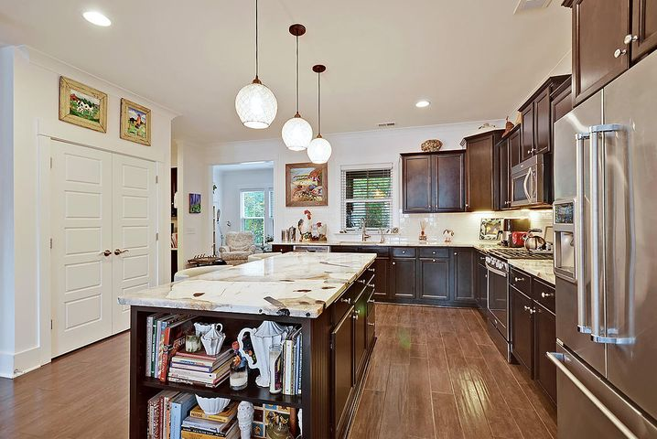
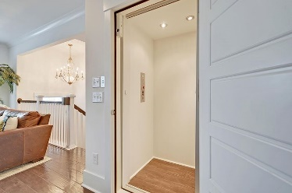
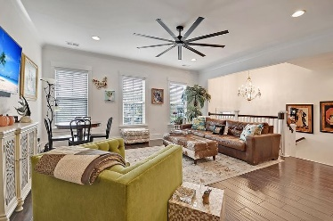
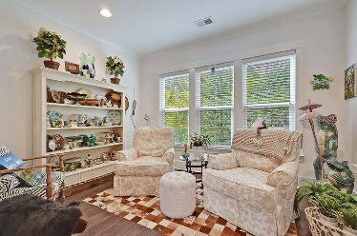
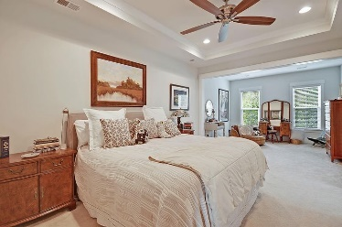
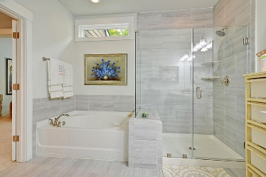
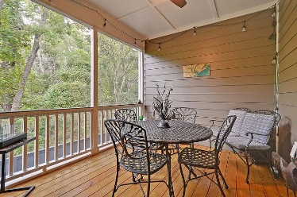
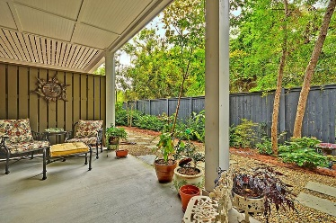

1943 Carolina Towne Court Carolina Walk · Mount Pleasant, SC 29464 MLS# 20028968 · $639,800
Elevator In Place
STUNNING 3 bedroom 3.5 bath townhouse centrally located by Towne Center Mall. This home has wonderful curb appeal and is exquisite inside and out. Upon entering the home you are greeted with handsome hardwood floors, heavy crown molding, open floor plan, 3 stop elevator, and an abundance of natural light. The CHEF INSPIRED KITCHEN is gorgeous, beautiful one of a kind granite, stainless steel appliances, HUGE island, gas stove cooktop, subway tile backsplash, custom 42" cabinets, and tons of counter space-the kitchen is spectacular and a must see! The great room is open to the kitchen and is spacious. Off the kitchen is also an office area, powder room, light and bright sun room and screen porch! The stately master bedroom suite is on the third level and has a sitting room and a luxurious spa-like bath with relaxing soaking tub, separate seamless glassed door tiled shower, dual sink vanity, and oversized walk-in closet with custom built in closet system. On this floor there is an additional nicely sized bedroom with ensuite full bath and big walk-in closet. Finishing off the top floor is a large laundry room with plenty of space to move around. The first floor has a full bath and bedroom with outdoor access. This is a perfect room for guests, older children, or to make an office as it is extremely private. The backyard is quiet and has a wonderful covered patio that is ideal for grilling and entertaining family and friends. LOCATION, LOCATION, LOCATION Carolina Walk in Mount Pleasant is a wonderfully landscaped community with walking trails and is centrally located, close to 526, schools, restaurants, stores, beaches, airport and downtown Charleston with 5 star restaurants, shops, history, tours...This home has it all-call today for a showing.
Take a video tour: https://vimeo.com/470845203
Stan Huff
843-670-2835 stan.huff@agentowned.com
Jill Marcacci
843-297-5590 jill@agentowned.com
www.agentownedrealty.com
AgentOwned Realty Co. Preferred Group, Inc. | 824 Johnnie Dodds Blvd | Mt Pleasant, SC 29464

