Slide 1
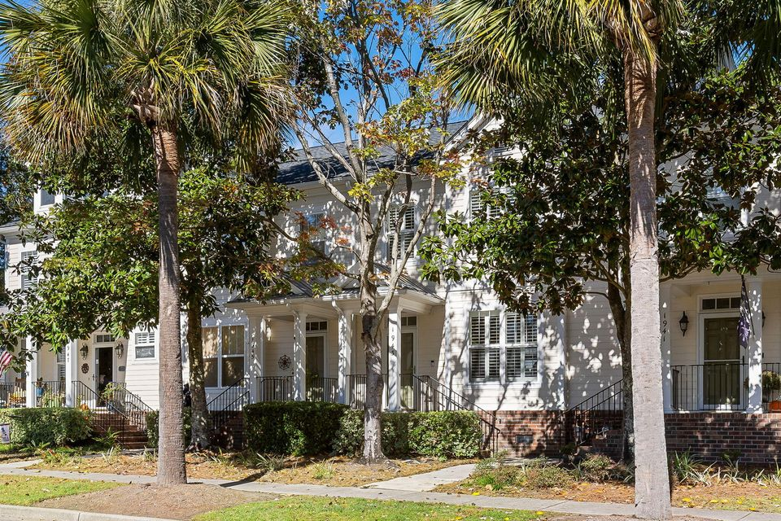
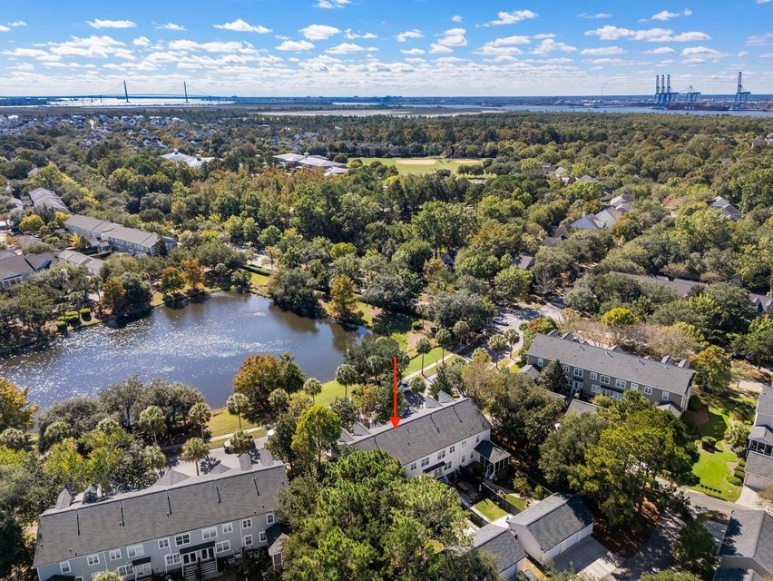
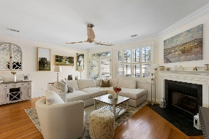

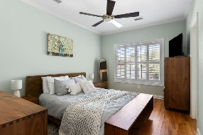
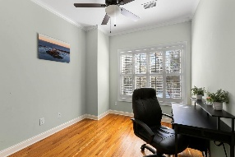
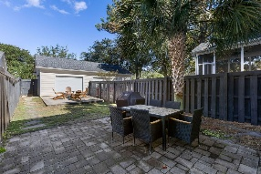
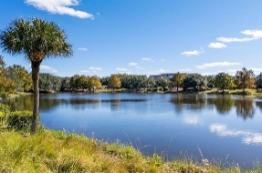
1943 Pierce Street
Daniel Island | Charleston, SC 29492 | MLS# 25029435 | Now $760,000
Daniel Island Townhome With Pond Views ~ Price Reduced!
Great 3 bedroom, 2.5 bath townhome in Daniel Island. Prime location just around the corner from the Daniel Island Trail and an easy walk to Pierce Park Pool and Pavilion. Take the DI Trail over the marsh and grab dinner, browse shops, or stroll along the beautiful waterfront park! Enter the front of the home through the foyer. Note the hardwood floors, crown molding, and plantation shutters that continue throughout the home. To the right is the kitchen featuring stainless steel appliances, Corian countertops, white Shaker-style cabinetry, and a breakfast bar that separates the kitchen from the dining area and family room. The family room features a gas fireplace, plantation shutters, and glass French doors leading to a private courtyard.
At the back of the courtyard is a detached 1-car garage. The primary suite as well as two additional bedrooms and another full bath are on the second level of the home. Enjoy the best of what Daniel Island offers from this great Pierce St location! (Note that a few furniture items could convey at an additional cost.)
VIEW LISTING
Andrea Rogers
843-532-3010 | andrearogers1@gmail.com | www.andrearogersrealtor.com
AgentOwned Preferred Group | 1400-G Palm Blvd | Isle Of Palms, SC 29451

