Slide 1
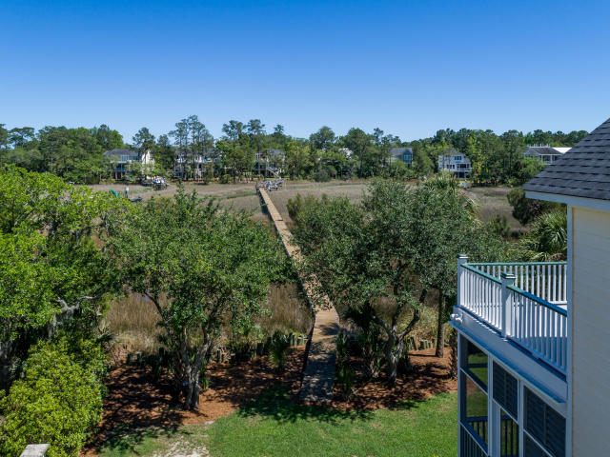
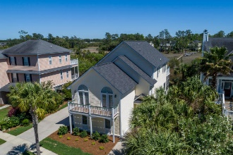
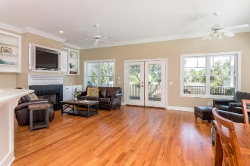

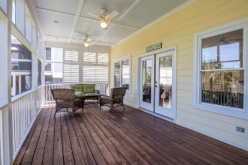
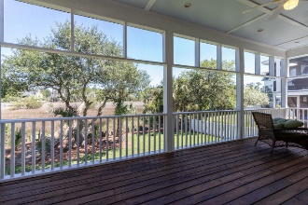
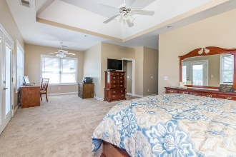

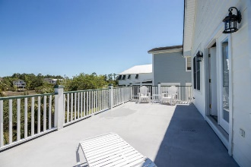
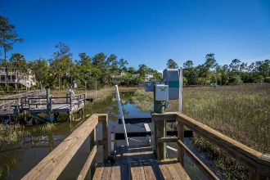
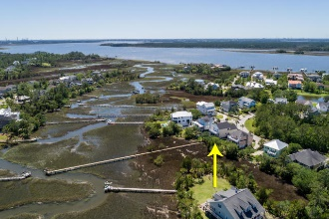


1944 Shields Lane
Mount Pleasant :: MLS# 17011930 :: $634,500
Rivertowne On The Wando
$15,000+ Below Recent Appraisal
Just Reduced
$789,000!
Priced BELOW APPRAISED VALUE of $650,000 - Appraisal DATED MARCH 2017 - Instant Equity !!!
Wow, what a price for this Waterfront Home ON A TIDAL CREEK - One foot of water at low tide and over 6 feet of water at high tide. Very close to the Wando River. You will have your own Private Dock and Boatlift. This listing has recently been reduced to sell. Please don't wait. Open floor plan with refinished hardwoods throughout the bottom floor and stairs. Wonderful full length back porch provides for a relaxing time away from it all. Enjoy the healthy salt air and water. Swim, fish, kayak and boat in you back yard. Well maintained home with new roof- 2017 and HVAC System - 2016. Move-in ready. Freshly painted walls and trim. You will be glad you toured this home.
Norman Cooper
REALTOR, ABR, GRI
(843) 460-0319 | norm@bhhssun.com
www.norm.myhomecharleston.com
BHHS Carolina Sun Real Estate
1440 Ben Sawyer Blvd ste 1503
Mt Pleasant, SC 29464

