Slide 1
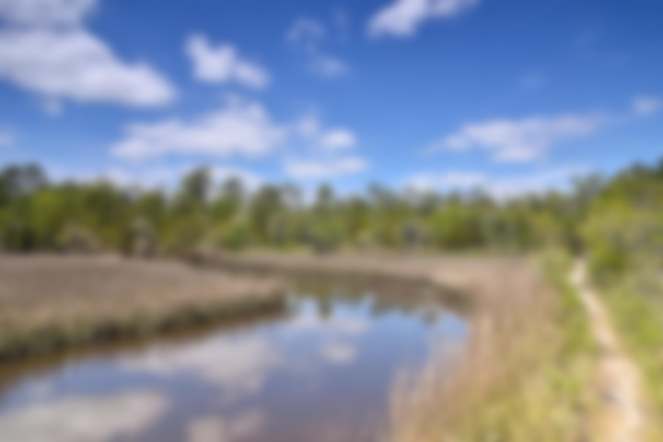
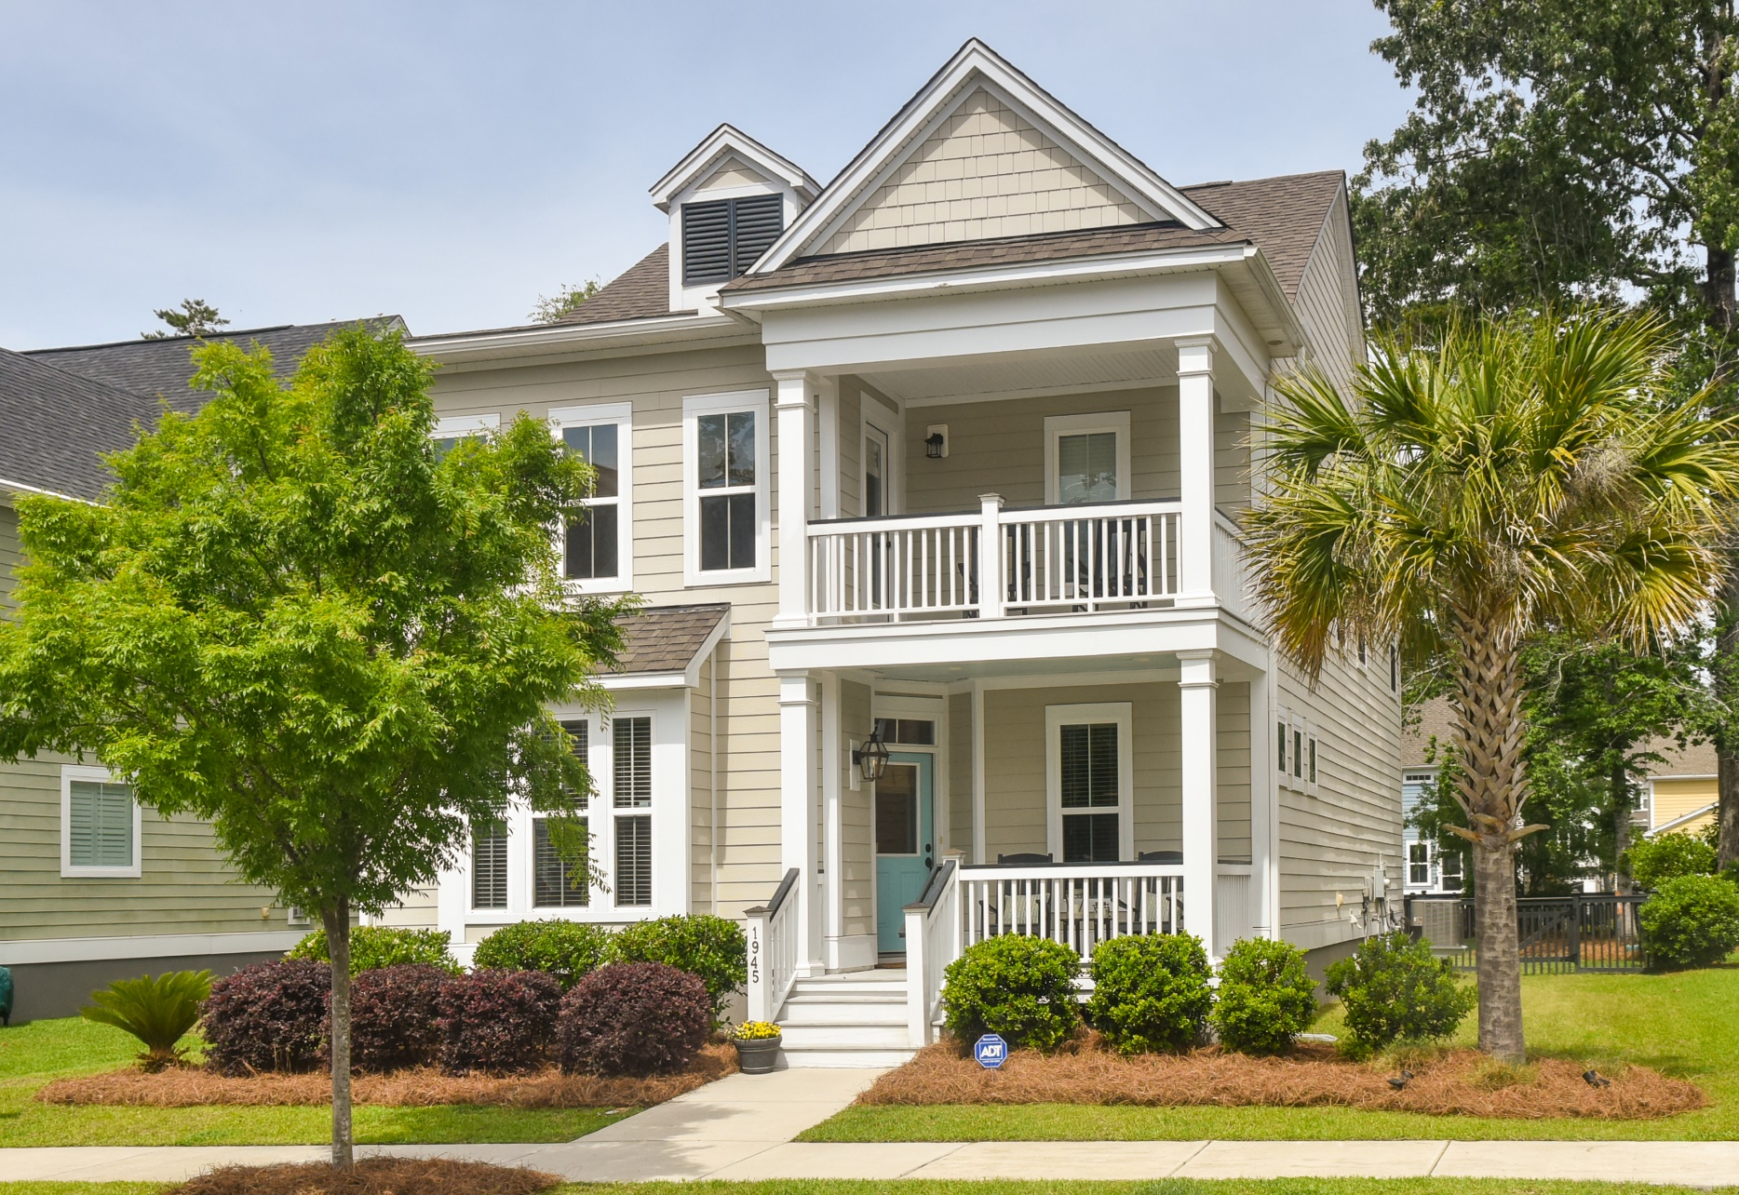
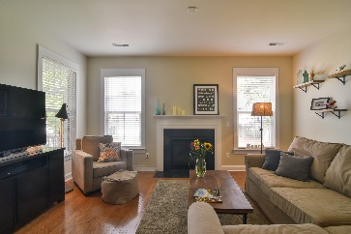
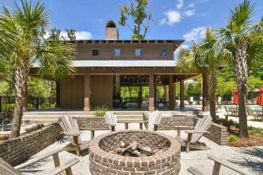
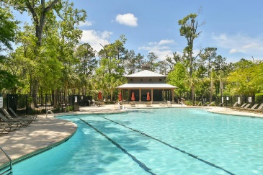
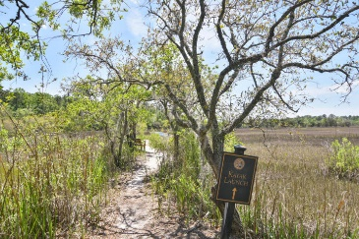
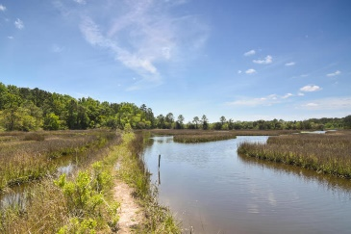
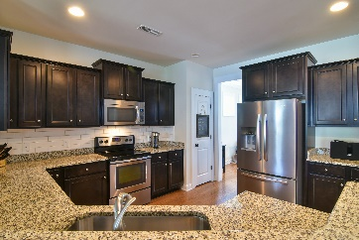
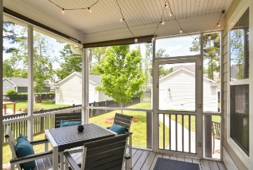
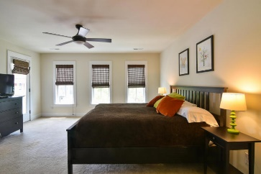
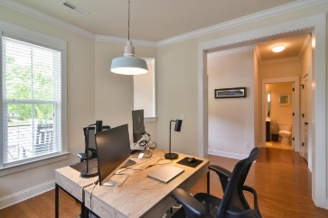
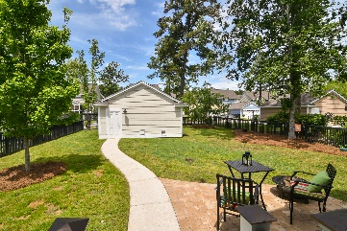
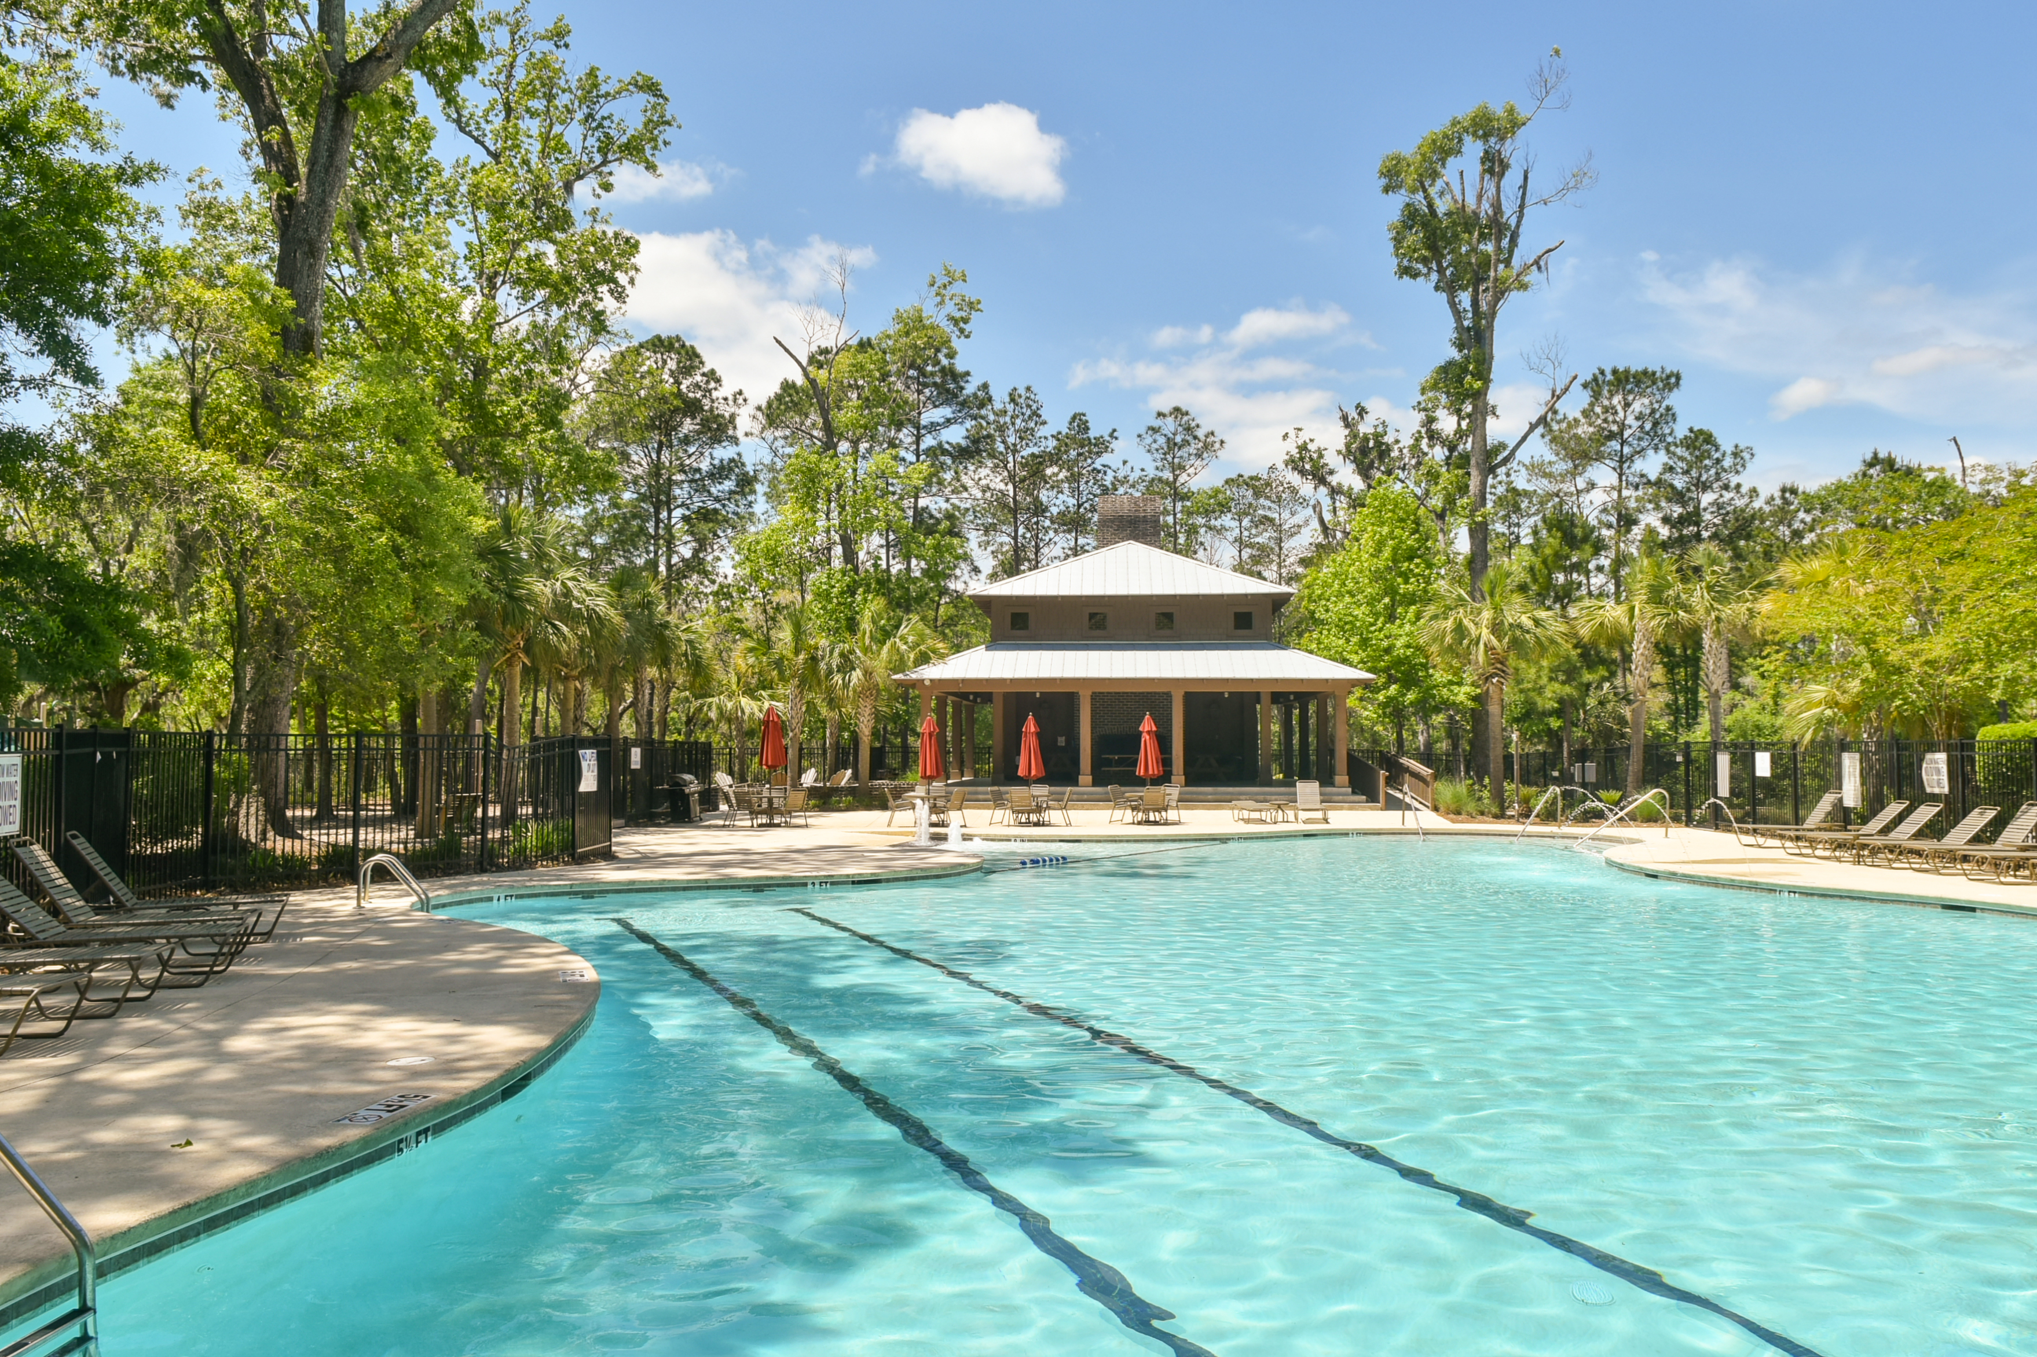



1945 Gracewood Drive Charleston | MLS# 18012065 | $370,000
Essex in Carolina Bay
1945 Gracewood Drive
MLS# 18012065
$370,000
Coveted location in Essex on a very quiet street
Charleston Single Magnolia Model plan
4 bedrooms, 3 full Baths
Open Floor Plan of 2338 Square Feet
Gorgeous hardwoods on the 1st floor
Granite counter tops and Stainless Steel Appliances
Outdoor living with 3 porches and a patio
Fire pit in the large fenced back yard
Neighborhood pools, playground, 3 acre park, fenced dog park, kayak launch
Greenway Trail is right outside your door
Darlene Tanenbaum (843) 817-9700
darlene.tanenbaum@carolinaoneplus.com
www.darlenetanenbaum.com
Carolina One Real Estate | 2713 Highway 17 North | Mt. Pleasant, SC 29466

