Slide 1
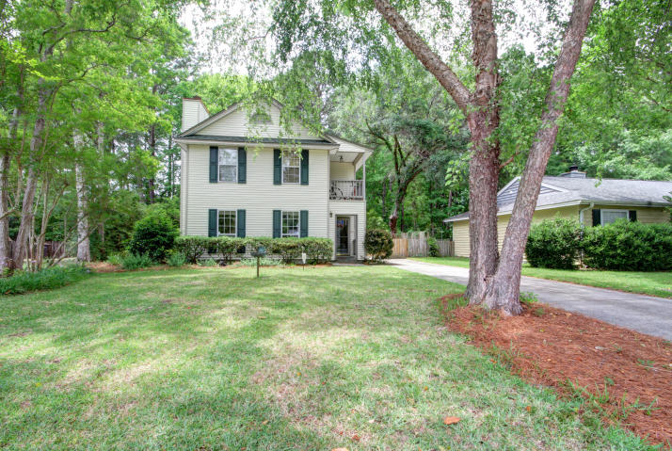
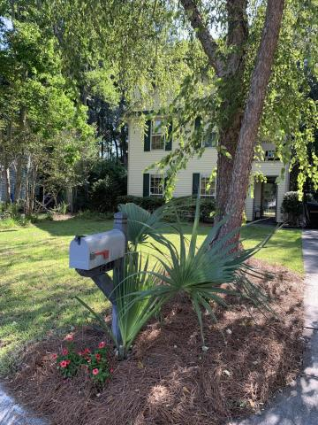
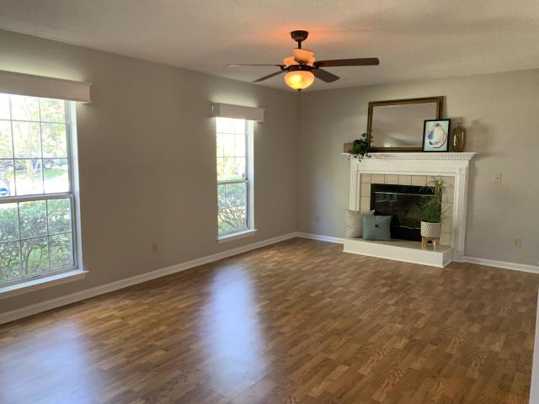
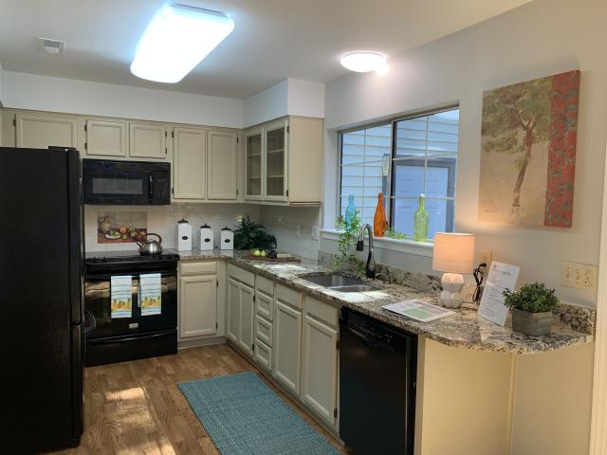
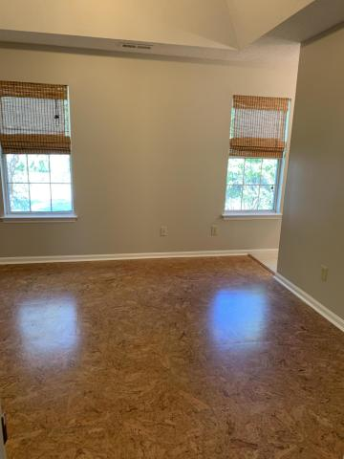
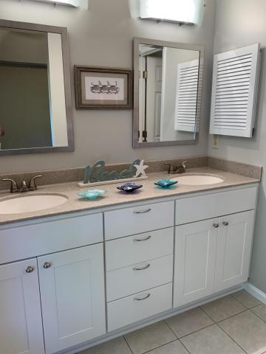
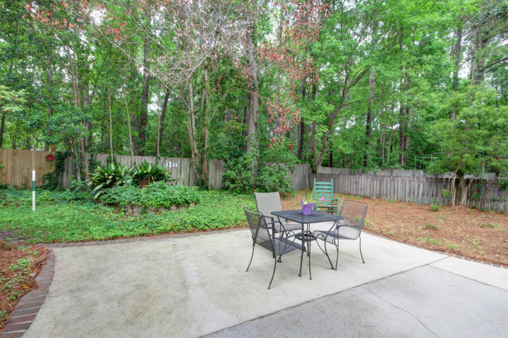

WOW! Shows Like New…
Ready Today in Longpoint
NO CARPET. Stunning laminate floors on main level with tile in baths. Upstairs beautiful CORK FLOORS in bedrooms. If you haven't seen CORK - its quiet, good insulation and BEAUTIFUL! Longpoint-home to Palmetto Islands County Park. Kayak, paddle board or walk the marsh trails all minutes from your front door. This home is surrounded by mature landscaping and beautiful low maintenance perennials. True hardwood treads on the stairs!
$1800 Lender Credit is available and will be applied towards the buyer's closing costs and pre-paids if the buyer chooses to use the seller's preferred lender. This credit is in addition to any negotiated seller concessions.
1946 Twickenham Place
Mount Pleasant, SC 29464
MLS# 19013458 | $339,500
Geri Lipps Carolina One Real Estate
843.810.8398 glipps@carolinaone.com

